Slide 1
Drought Monitoring
and Planning
Mark Shafer
Director, Southern Climate Impacts Planning Program
Professor, OU Department of Geography & Environmental Sustainability

Slide 2
Identifying Drought
Define a tornado
Define a severe thunderstorm
Define a hurricane
What do these have in common?
When it began, ended
Where it occurred
When it occurred
How bad it was
Ok, now do the same for drought

Slide 3
Impacts (Perceptions) Vary
Insufficient Water to meet needs
- Does water come out of my faucet?
- How is my garden doing
- Are the crops growing?
- Is stuff burning?
We focus on human aspects but the natural environment suffers too
- Wildlife impact
- Stream flows / temperatures
- Tree mortality / vulnerability to disease

Slide 4
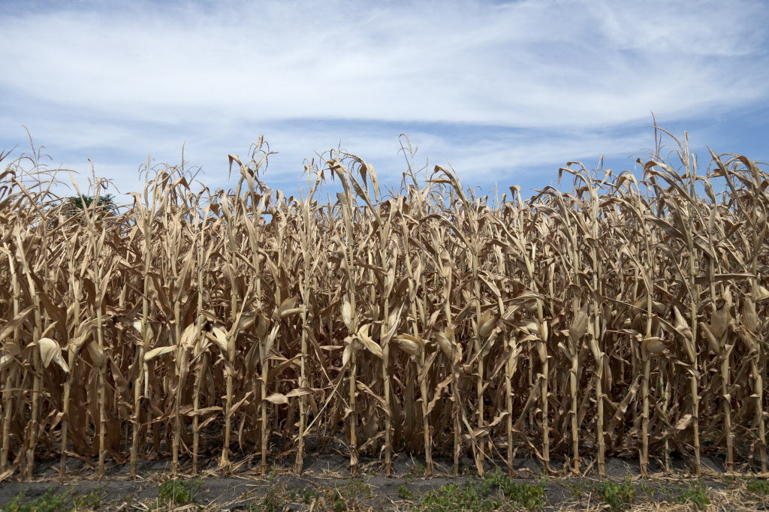
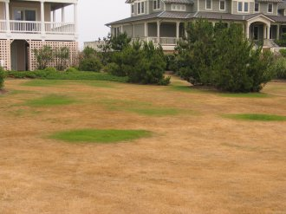
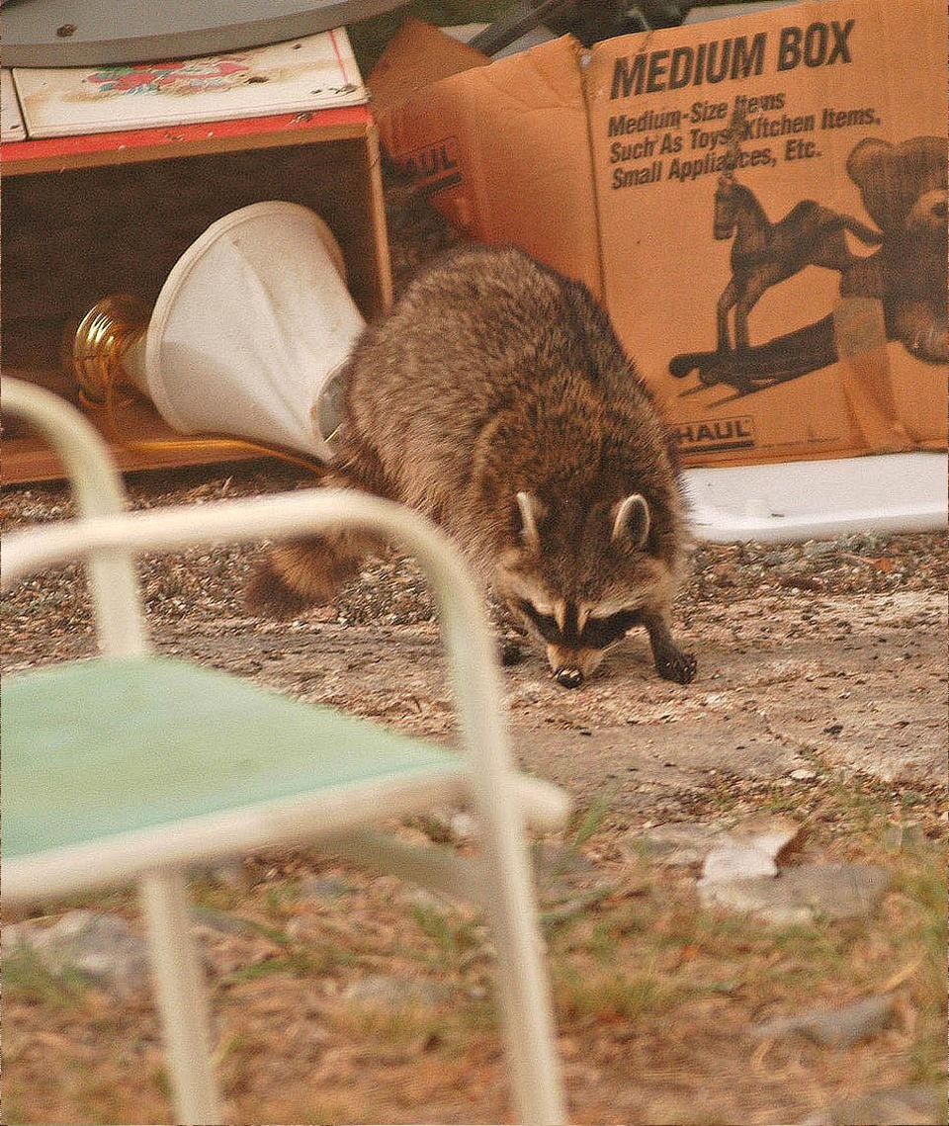
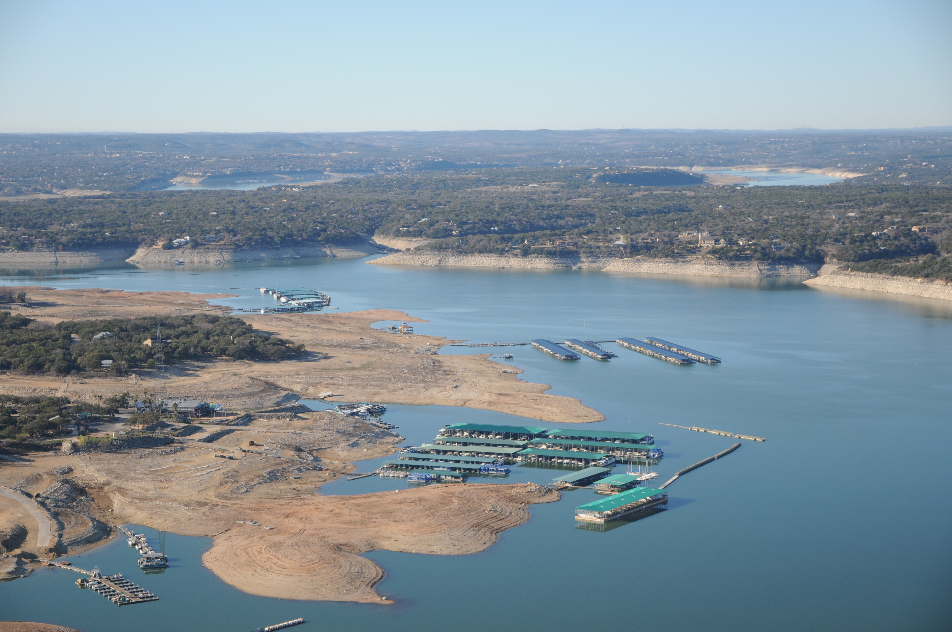
Drought Impacts Vary
Few dry weeks – lawns start turning brown, crops show some stress
- Agriculture, lawns affected
Few dry months – crops begin to fail, pastures go dormant, trees drop leaves
- Water restrictions, animal behavior
Dry years – water supplies diminish, springs stop flowing
- Water systems, erosion, economic systems
Dry decade – land abandonment, social and economic failure

Slide 5
Assessing Drought
Drought is a multi-faceted issue and requires a multi-faceted response
- Does a doctor take your temperature, check a chart, and say “based on your temperature, you are moderately-to- severely sick”?
- Instead, she uses the results of several patient-appropriate and symptom-appropriate tests, i.e., well-chosen indicators in concert with each other
- A responsible drought decision-maker (and those who supply data) should take the same approach
Time of year matters
- Dry summer: may develop rapidly (especially with high temperatures)
- Dry winter: nobody may notice

Slide 6
What is Drought?
Meteorological drought – departures from “normal” precipitation
Agricultural drought – soil/groundwater deficits that affect vegetation
Hydrologic drought – deficiency of water in watersheds, rivers; often lags agriculture impacts
Socio-economic drought – shortage of some item (water, food, fish, natural values) that affects the balance of supply and demand

Slide 7
The Rodney Dangerfield of Hazards
DROUGHT
WILDFIRES
Notes:
The SCIPP region deals with a lot of climate hazards.

Slide 8
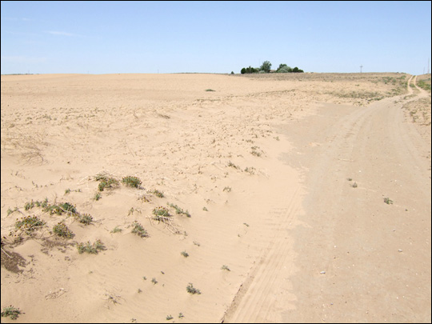
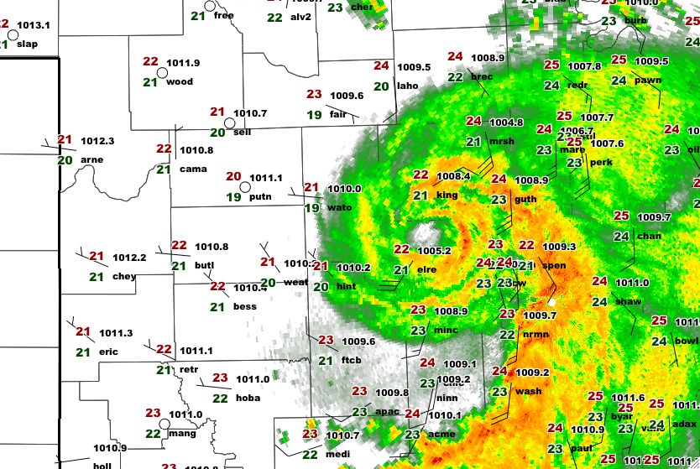
Events Change Quickly
2006: Billion-Dollar Drought
2007: Record Floods

Slide 9
Causes of Drought

Slide 10
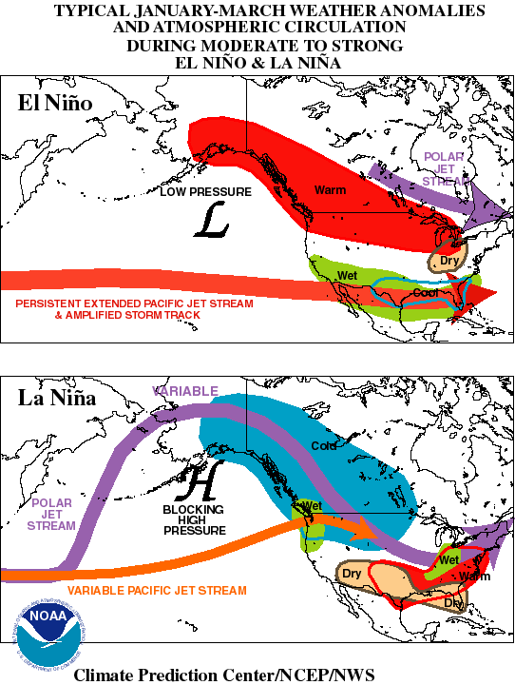
Typical ENSO Winter Effects
El Niño:
Lots of [non-Arctic] storms tracking rapidly from west-to-east across southern half of U.S.
Very wet across Southern states; very warm across Northern states
La Niña:
Storm track often stays north of us
OK warm & dry for extended periods.
When it jumps south (quickly) we get weather systems, but they often lack sufficient moisture
We go from warm, dry and windy to cold, dry and windy
The storm system finally explodes with precipitation somewhere around Memphis

Slide 11
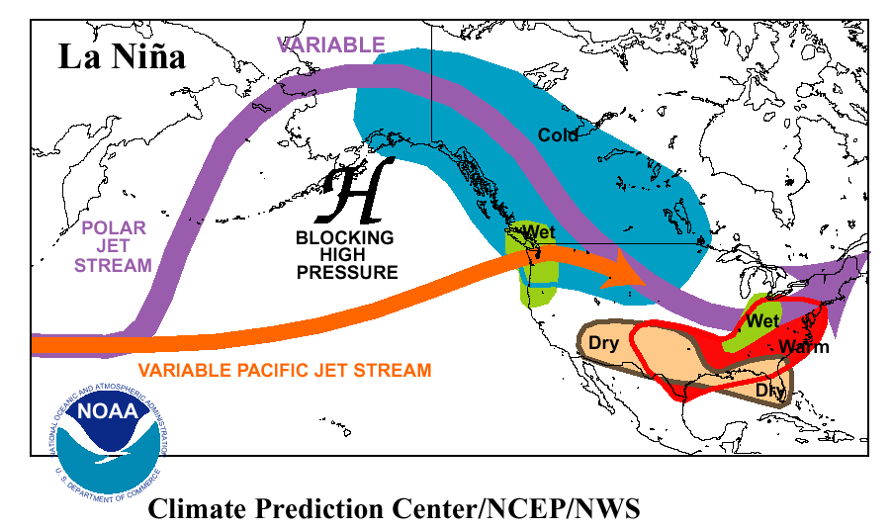
Present Day Glacial and Ice Cap Extent
Blocking ridge pushes jet stream northward
Our region tends toward northwesterly flow
Difficult to pull moisture up from Gulf = dry
Dry winter can lead to land-atmosphere feedback as the land warms in Spring
Dry land warms more quickly
Warmer temperatures increases evaporation

Slide 12
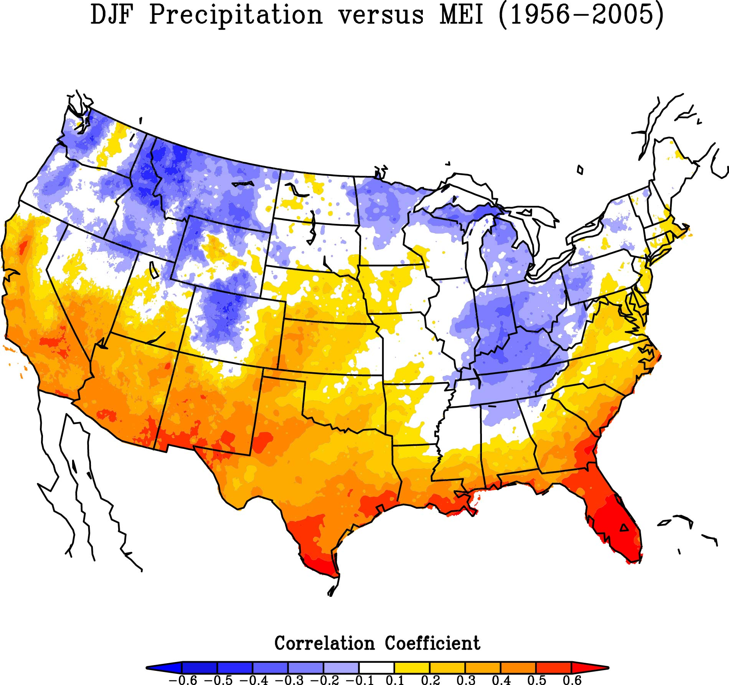
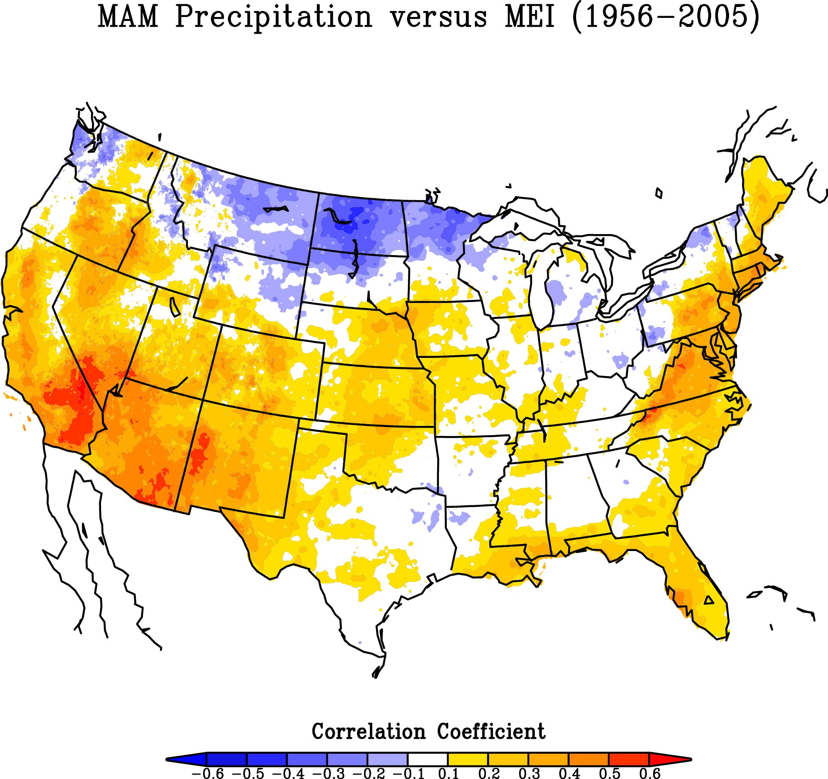
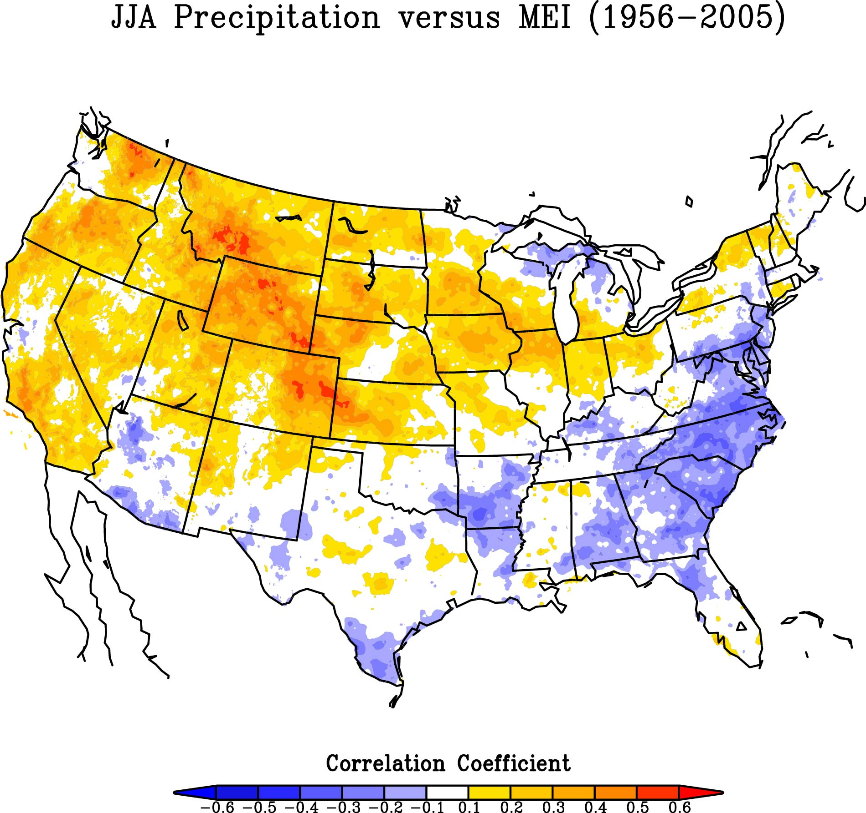
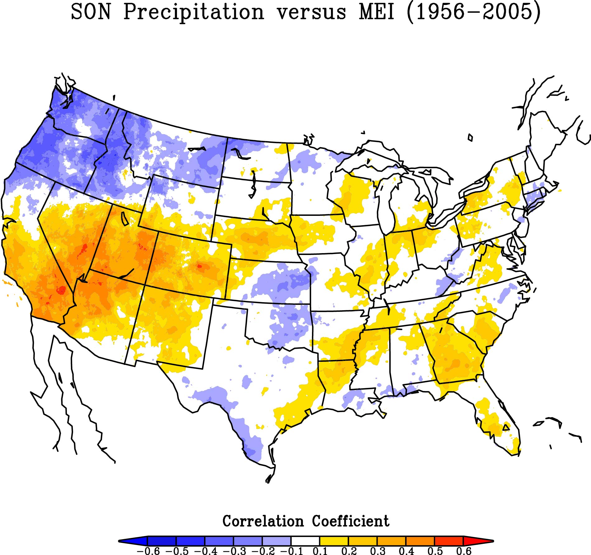
Seasonal cycle of ENSO impacts
New Mexico has positive correlations year-round, especially in winter and spring (top panels).
Texas correlates highest in winter. Summer and fall are barely constrained by phase of ENSO.
Oklahoma shows negative correlations in fall (lower right), while the other three seasons favor positive correlations, especially in winter.
La Niña favors
drought!

Slide 13
“Phases” of ENSO
Preference for El Niños
Preference for La Niñas
Unsettled,
but often weak
Source: NCA

Slide 14
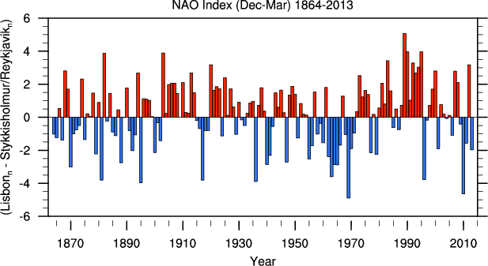
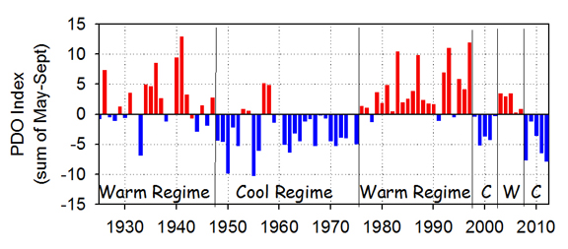
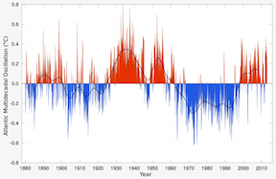
But Wait, There’s More…
North Atlantic Oscillation (NAO)
High-frequency oscillation
From Iceland to Azores: more pressure oscillations
Stronger impact on N. American east coast & Europe
Negative tends toward dry southern plains
Pacific Decadal Oscillation (PDO)
“Sloshing” between northern and central Pacific, typically 20-30 year period.
Effects similar to El Nino
May be a major contributor to extended drought patterns (negative phase)
Favors development of La Ninas
Atlantic Multidecadal Oscillation (MAO)
Also long pattern (20-30 years)
Positive phase usually dry southern plains
More active hurricane seasons as convection shifts eastward

Slide 15
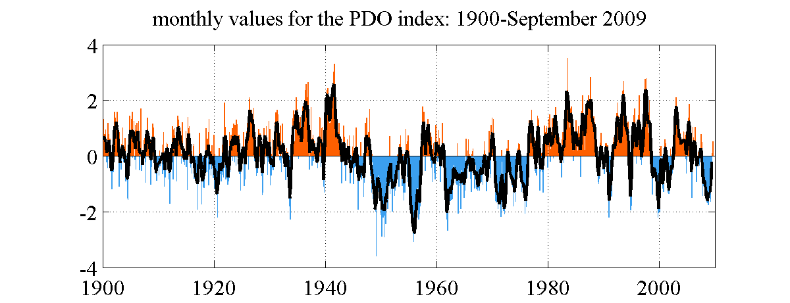
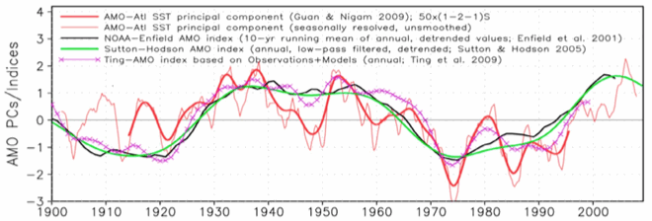
When These Align, It Can Be Bad News
PDO
AMO

Slide 16
2011 And Beyond

Slide 17
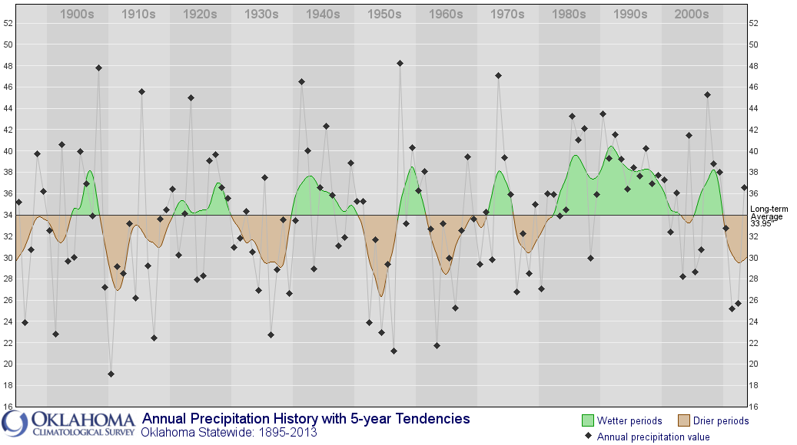
Historical Droughts in Oklahoma
Why not these?

Slide 18
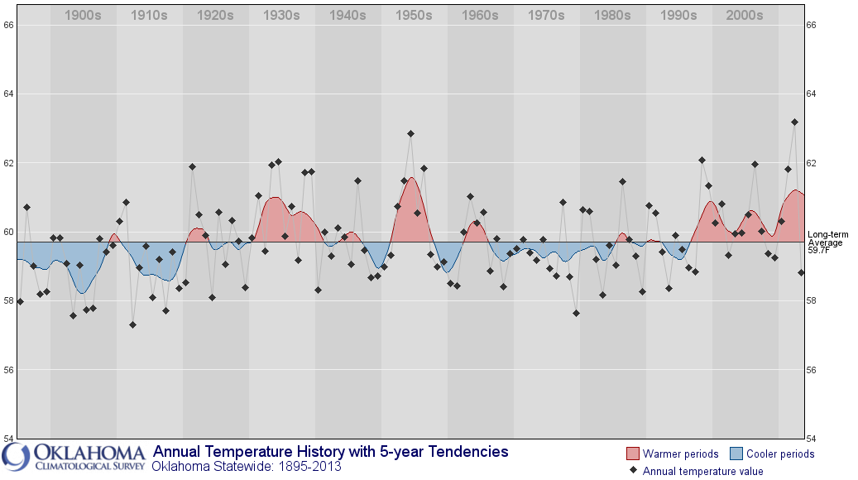
Not Just Rainfall…

Slide 19
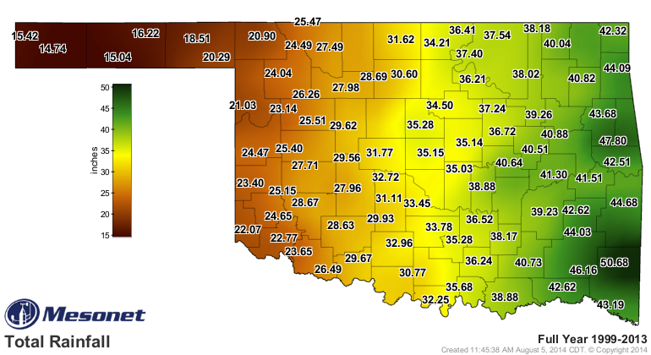
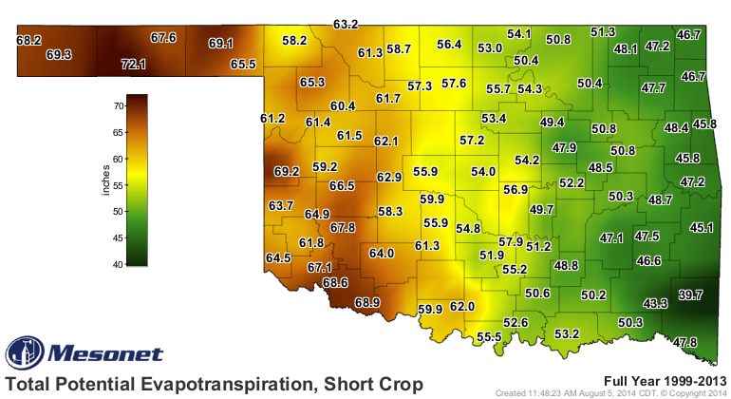
Most Rainfall in Western Oklahoma is Evaporated
Average Annual Precipitation,
1999-2013
Average Annual Evaporation
1999-2013 (short crop)

Slide 20
2011 Southern Plains Drought
At least $12B in crop and livestock losses
Lowest cattle inventory in decades
Record low water supply
Most severe wildfires in Texas, New Mexico History
Infrastructure: cracked pavement, foundations, water main breaks – 700 a day in Houston at peak
100-500 million trees killed (Texas Forest Service estimate)
In Mexico, 2.5M people in 1,500 communities lacked drinking water

Slide 21
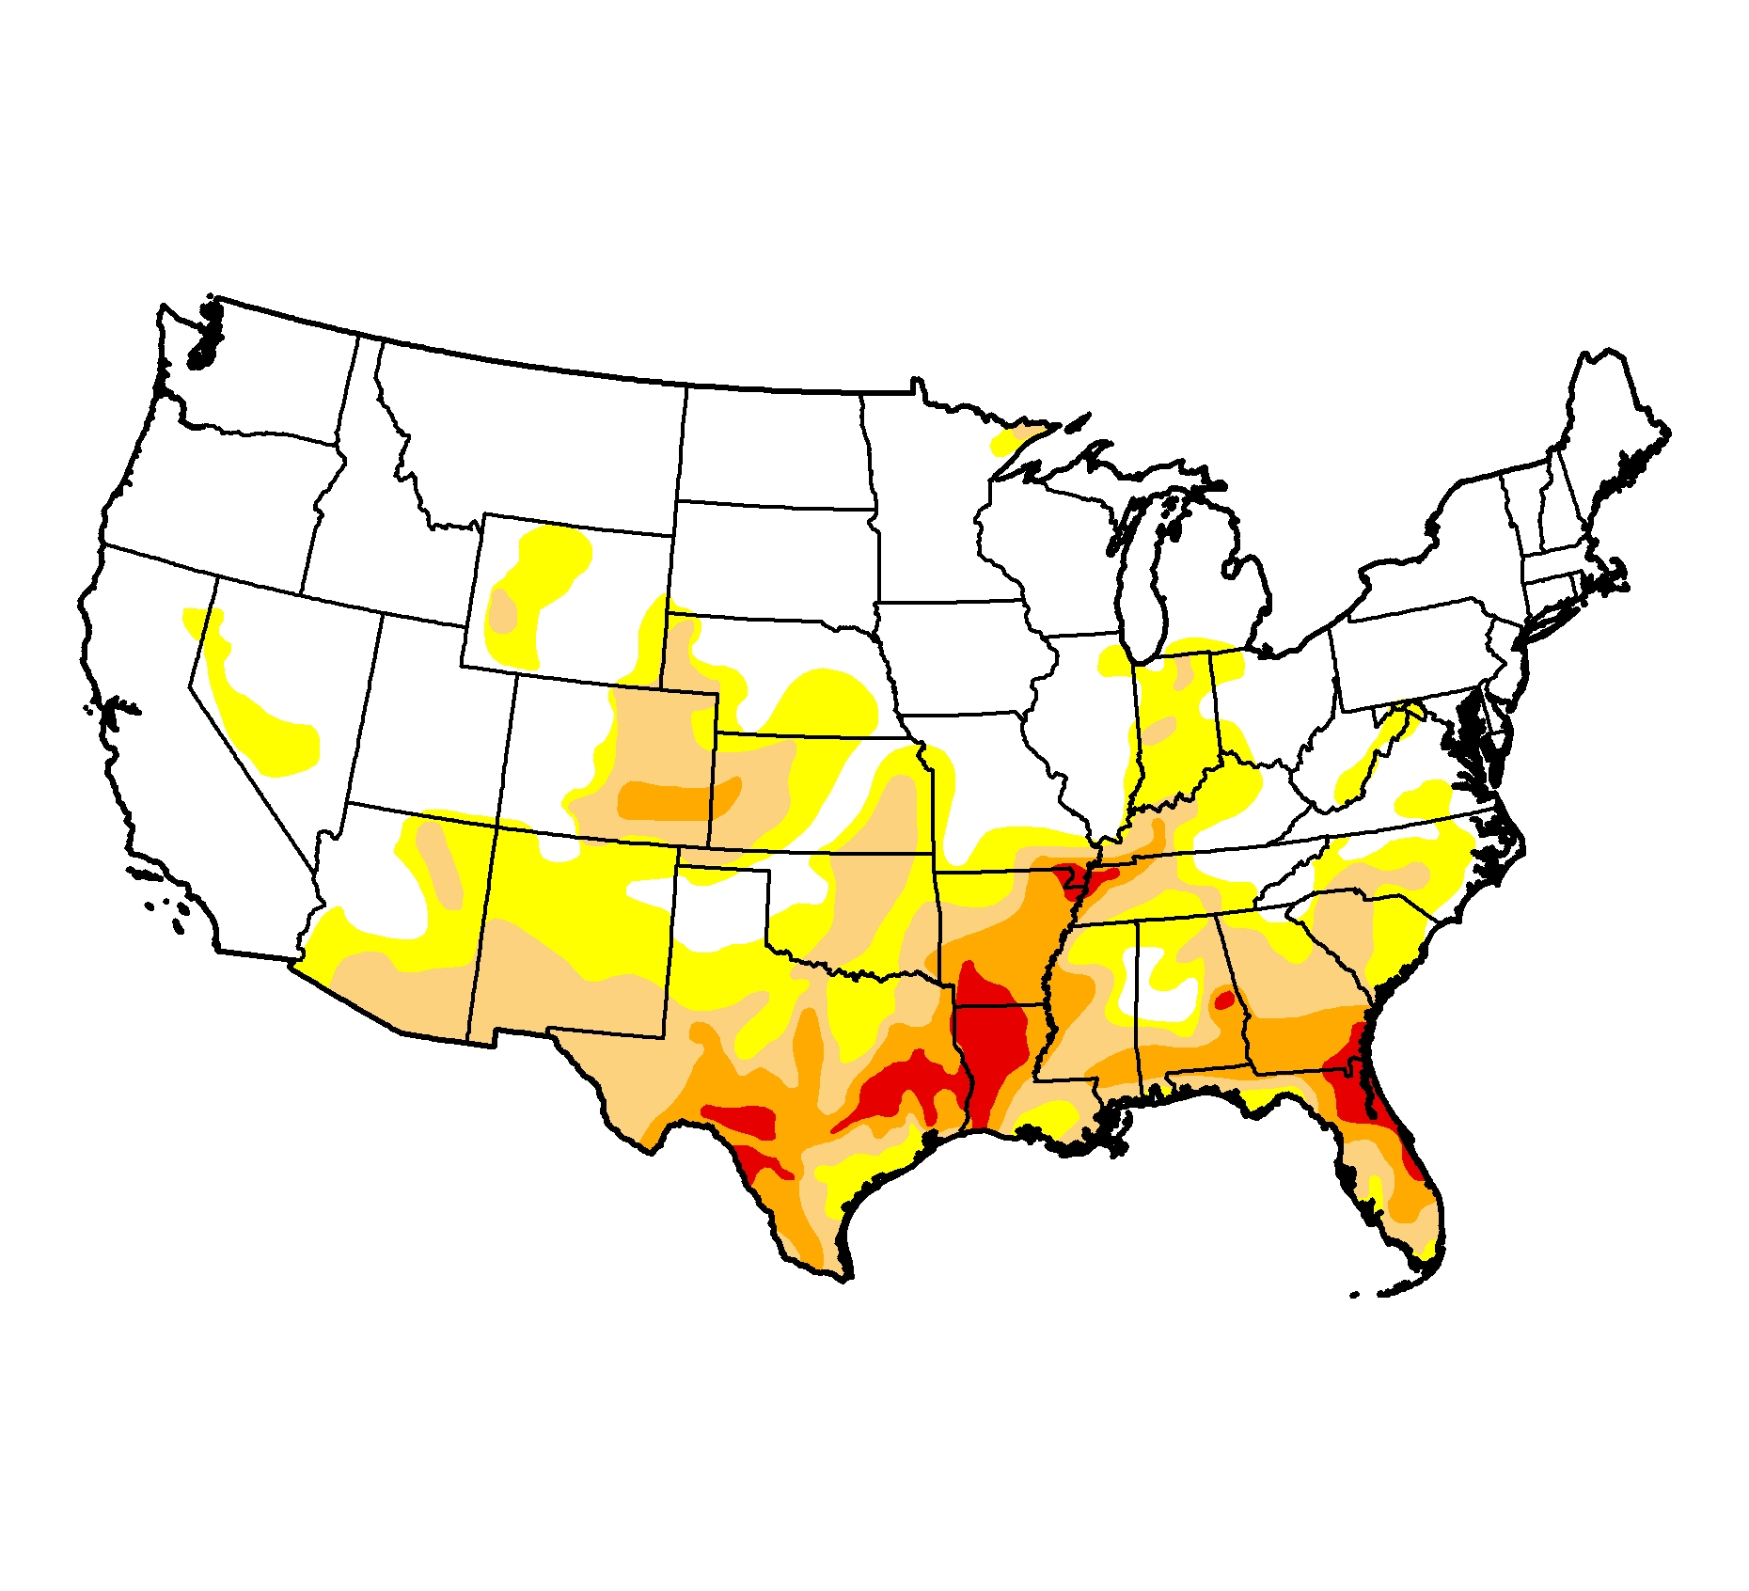
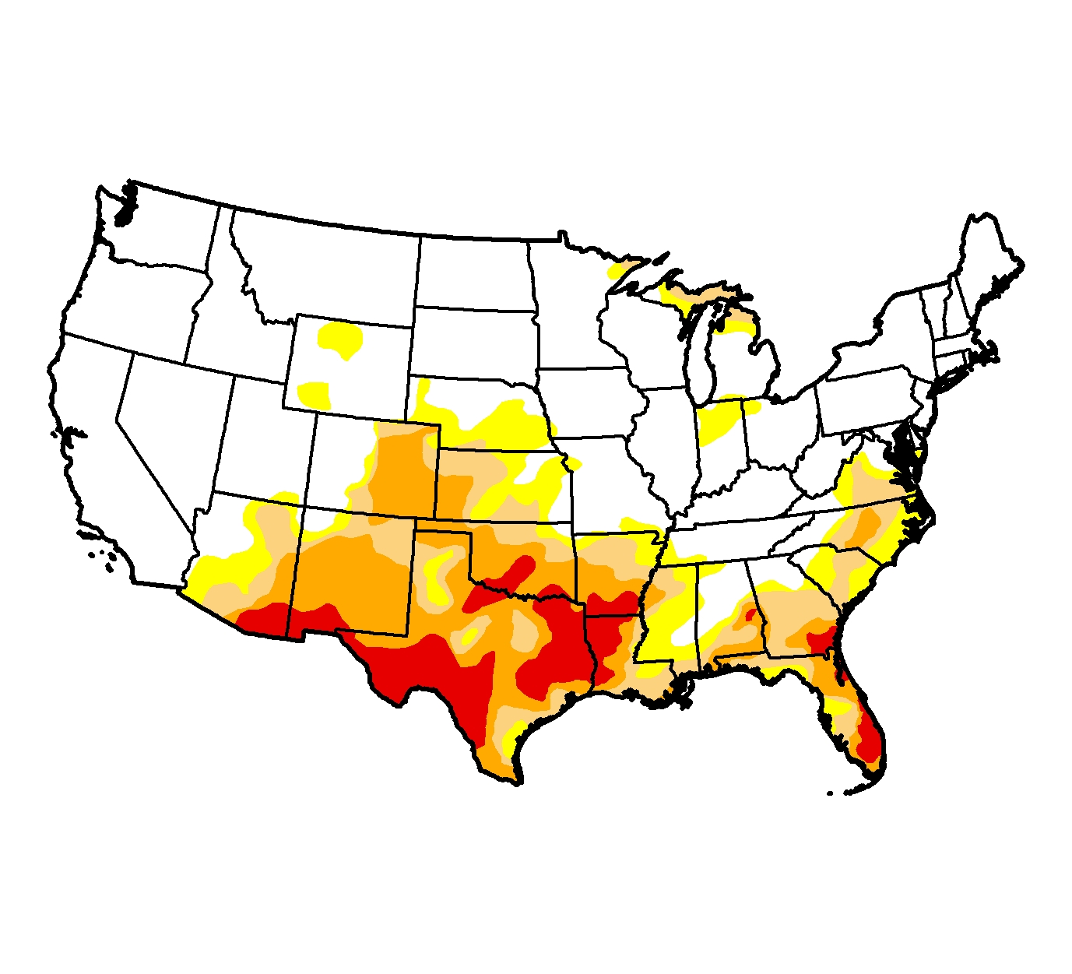
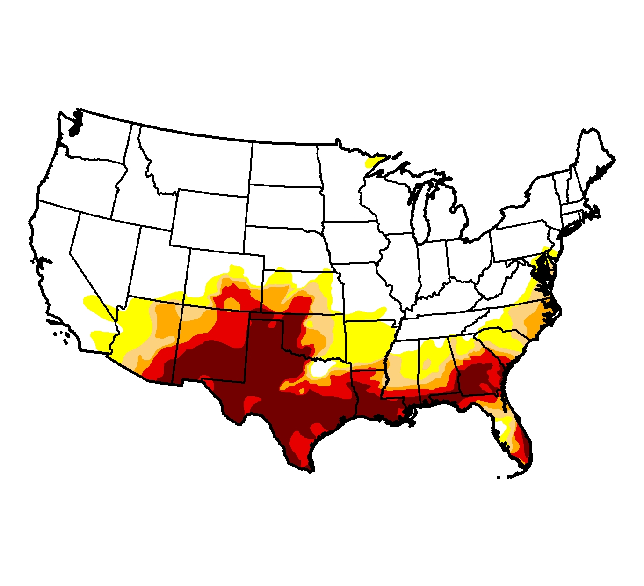
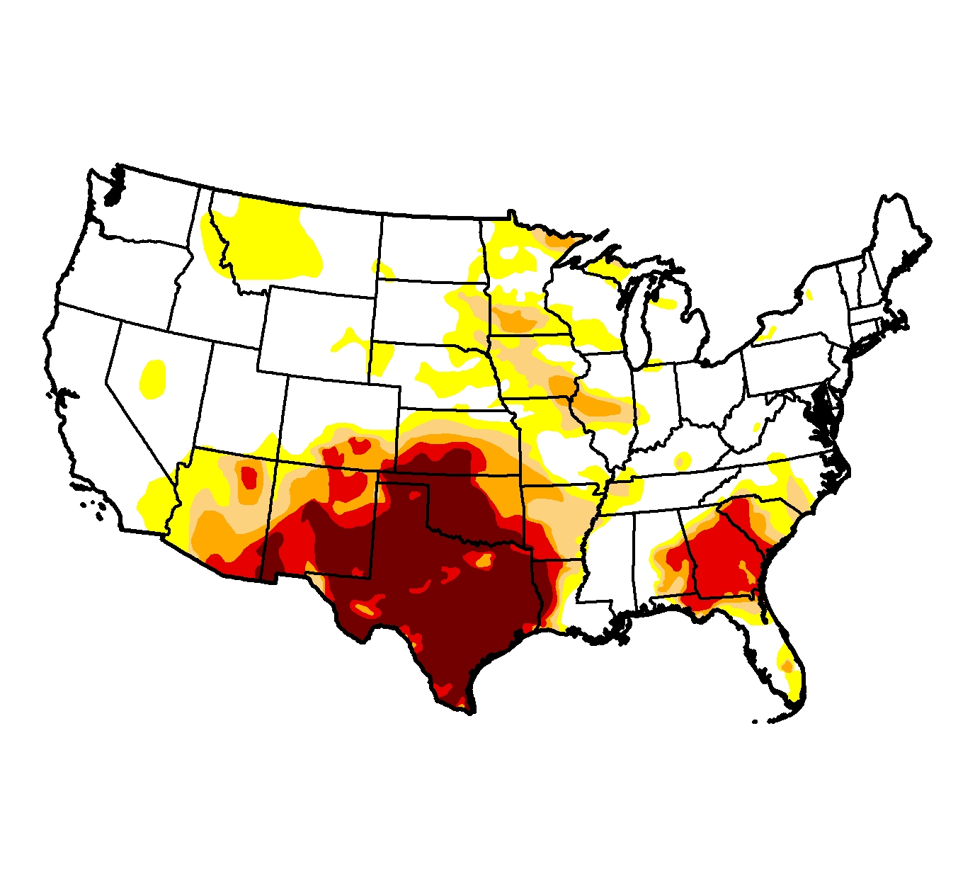
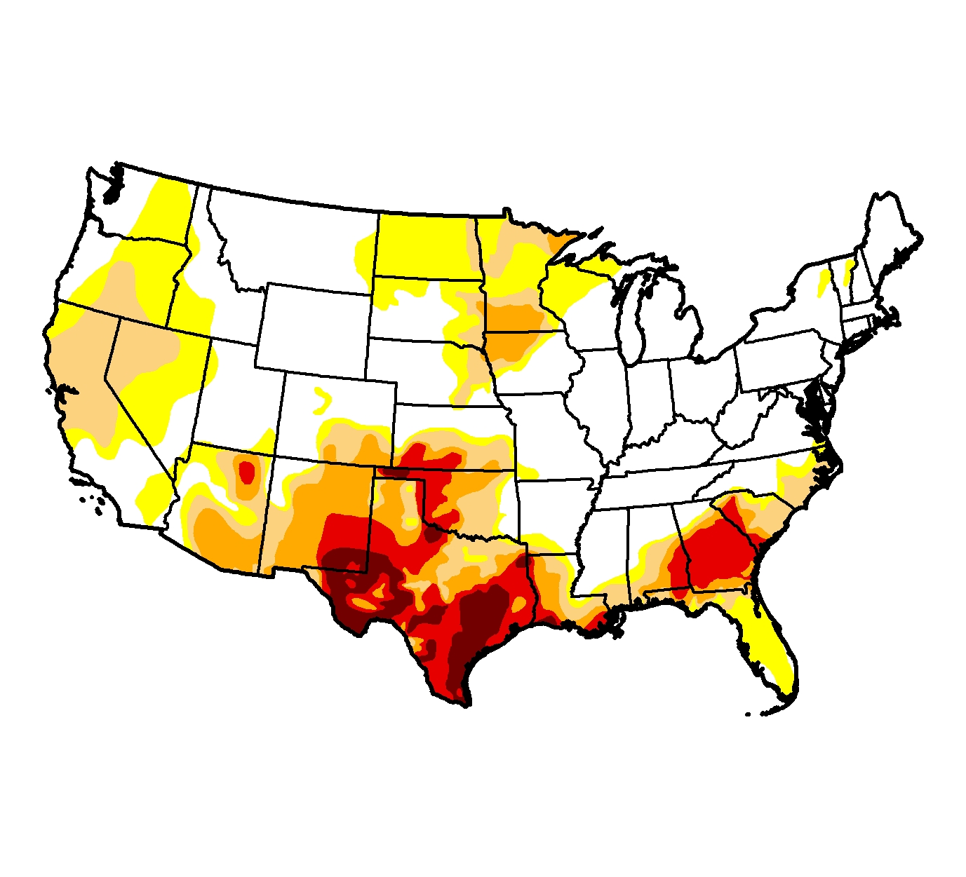
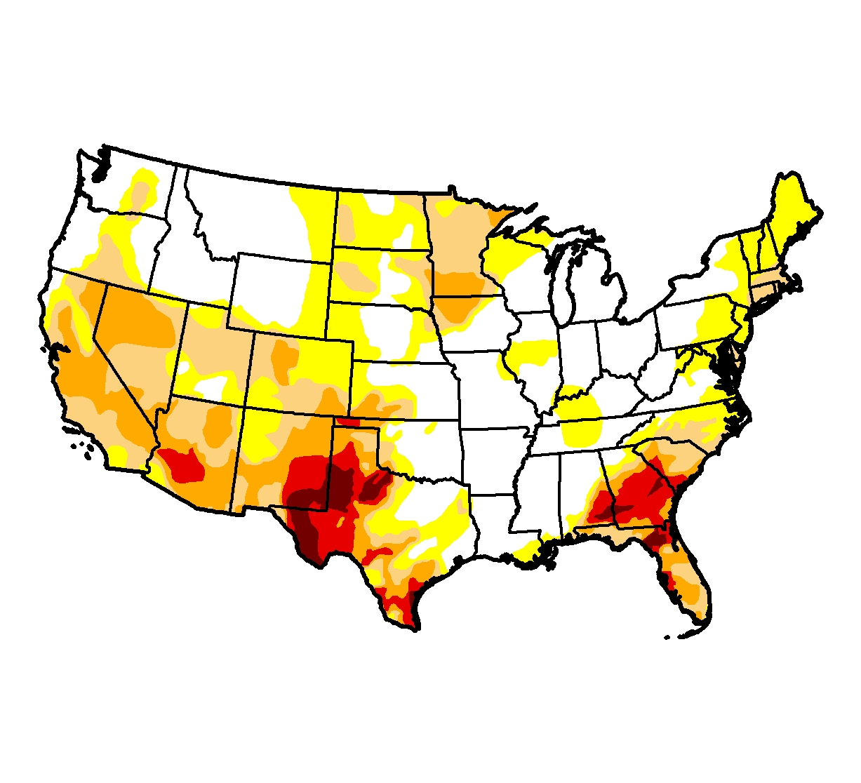
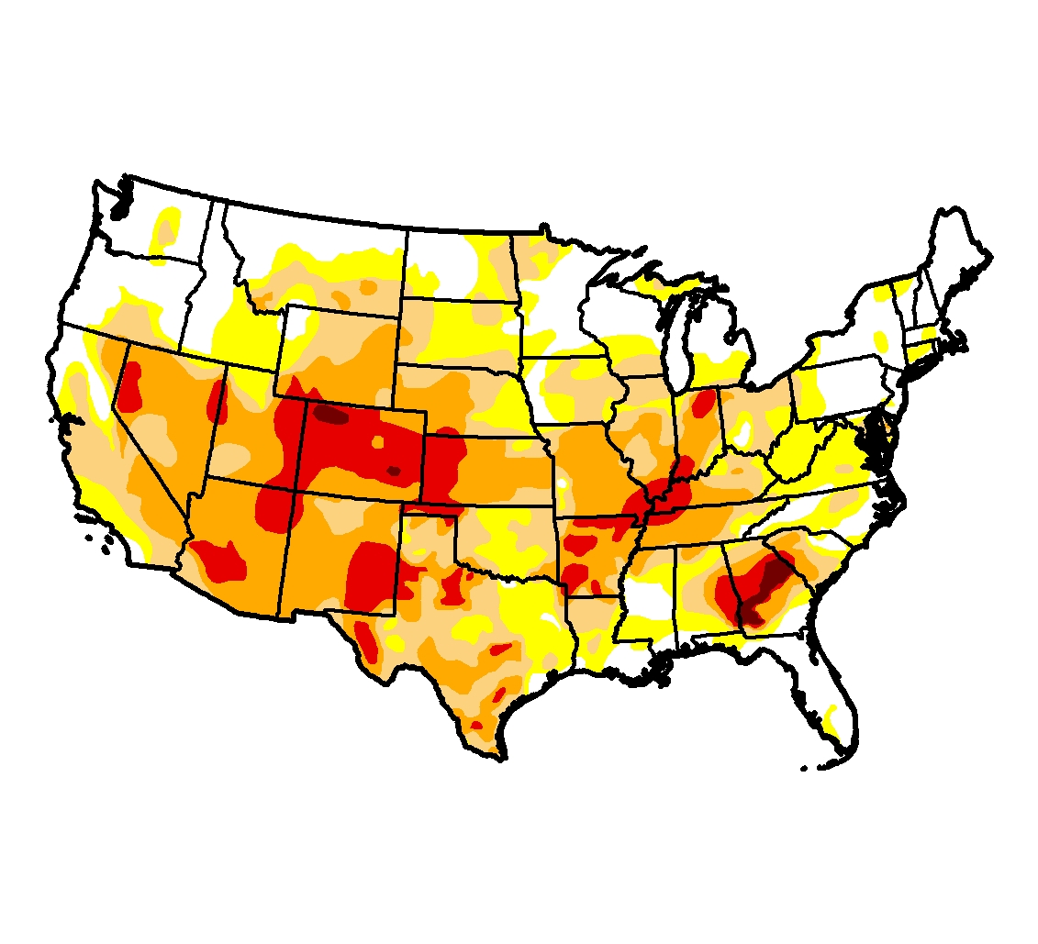
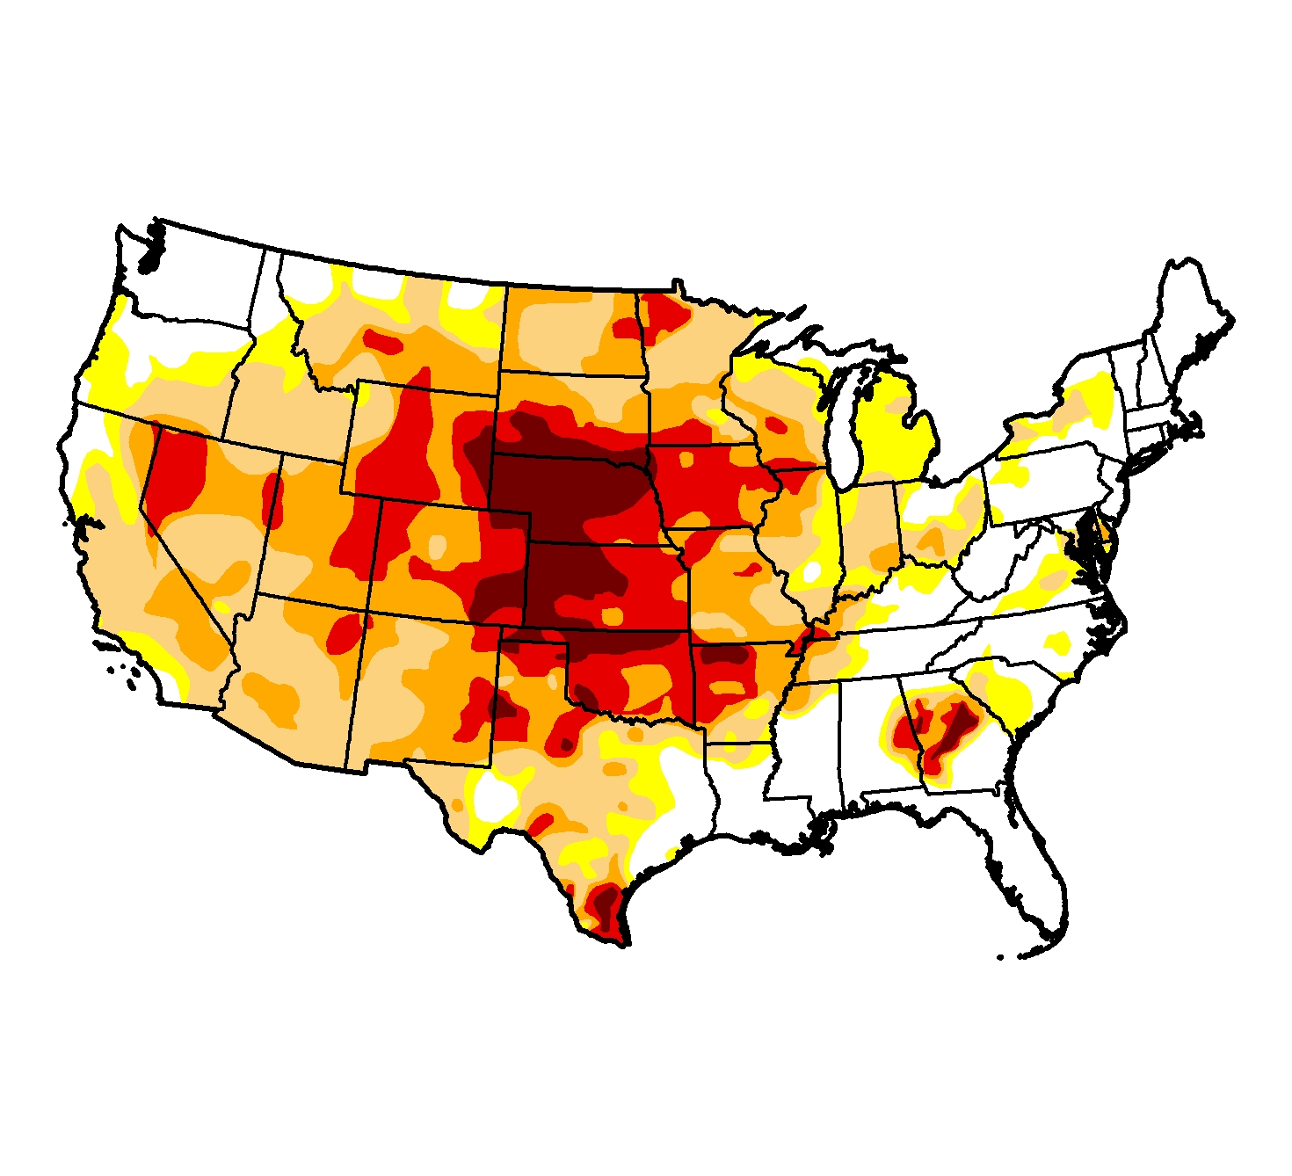
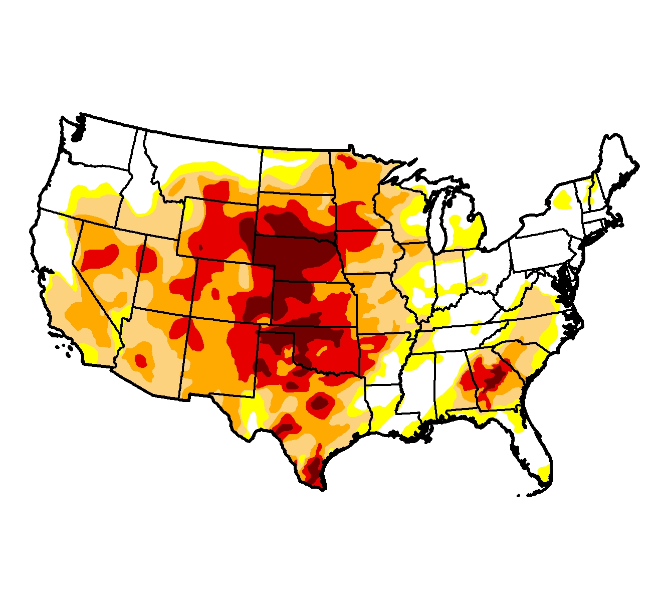
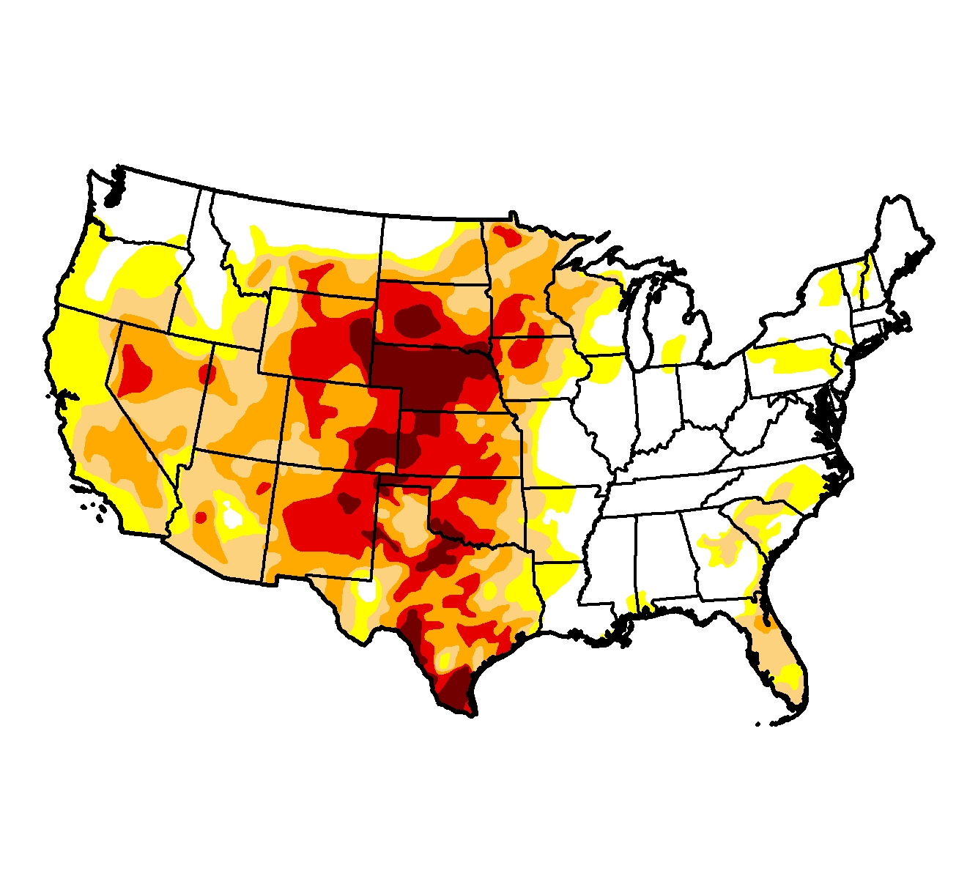
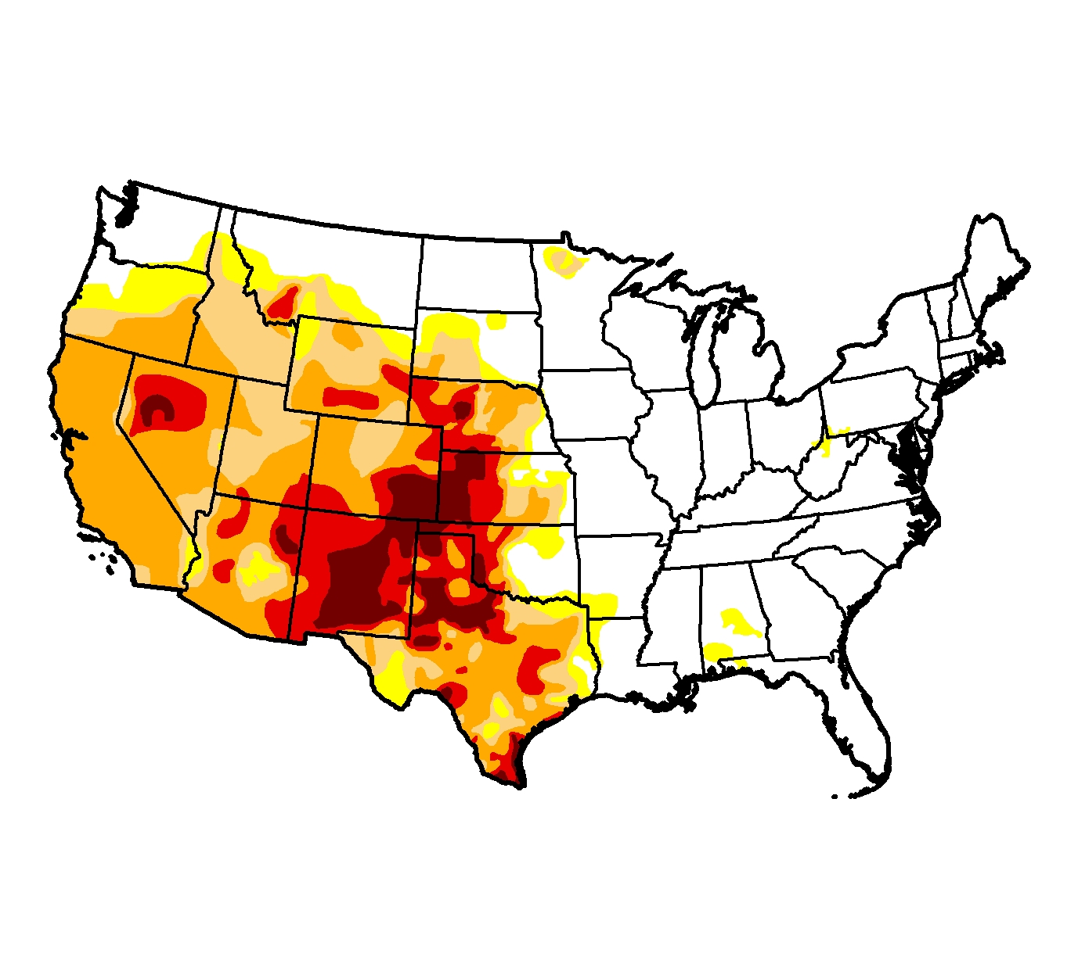
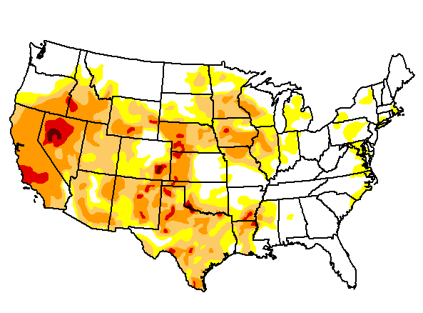
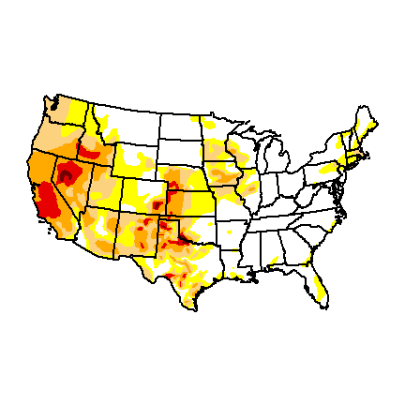
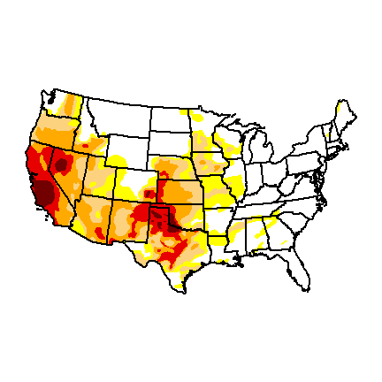
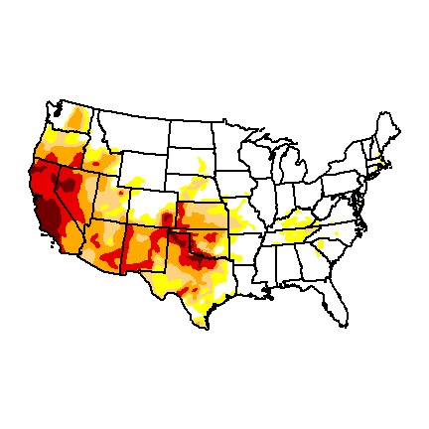
January 2011
April 2011
July 2011
October 2011
January 2012
April 2012
July 2012
October 2012
January 2013
April 2013
July 2013
October 2013
January 2014
April 2014
July 2014
October 2014
Notes:
How did we get here?

Slide 22
The Summer of 2011
Stationary meteorological conditions over a wide regional area
Ridge set up over the region and sat all summer
Extremes in temperature and precipitation
Enlargement of drought area and intensity
Feedback from dry soils
Widespread drought impacts observed in numerous ecological and economic sectors

Slide 23
More of this in the Future?
Higher air temperatures will cause increases in surface evaporation
Drier soils will absorb a larger proportion of the incoming heat from the sun
Hotter soils and adjacent air results in hotter summers
Even areas where precipitation does not decrease will be susceptible to drought from higher temperatures
Under higher emissions scenarios, widespread drought is projected to become more common over most of the central and southern U.S.

Slide 24
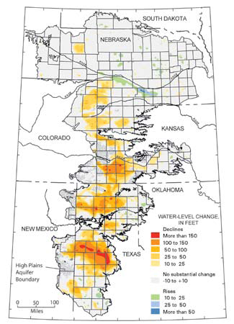
Looming Social Changes in West Texas?
Little recharge in southern part of High Plains Aquifer
Irrigation becoming more costly
Higher evaporation rates deplete surface water supplies
More competition for water

Slide 25
Monitoring Drought
Notes:
So, we’ve now seen that Earth is overall warming and human activities are the cause. What are the impacts?

Slide 26
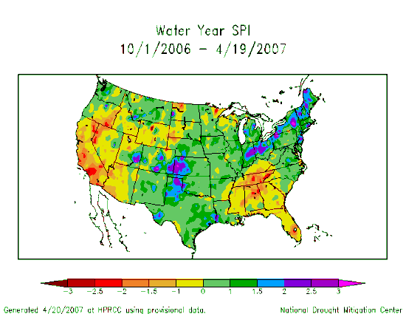
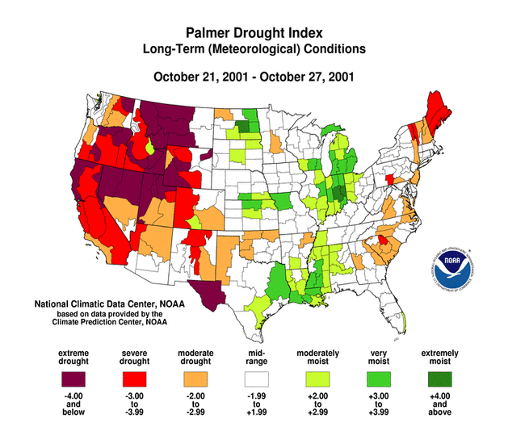
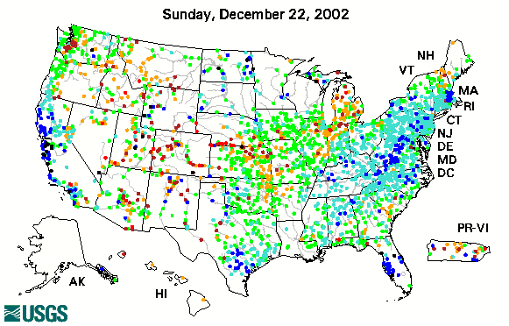
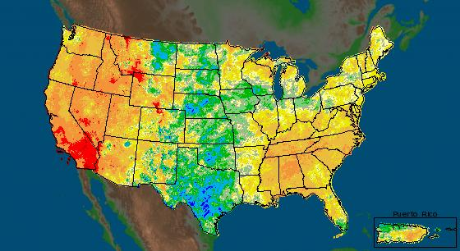
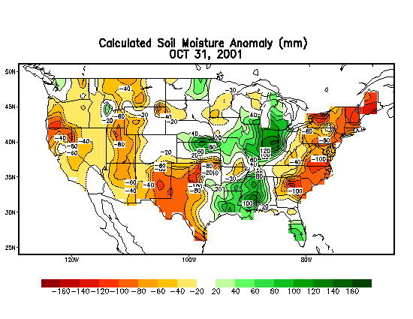
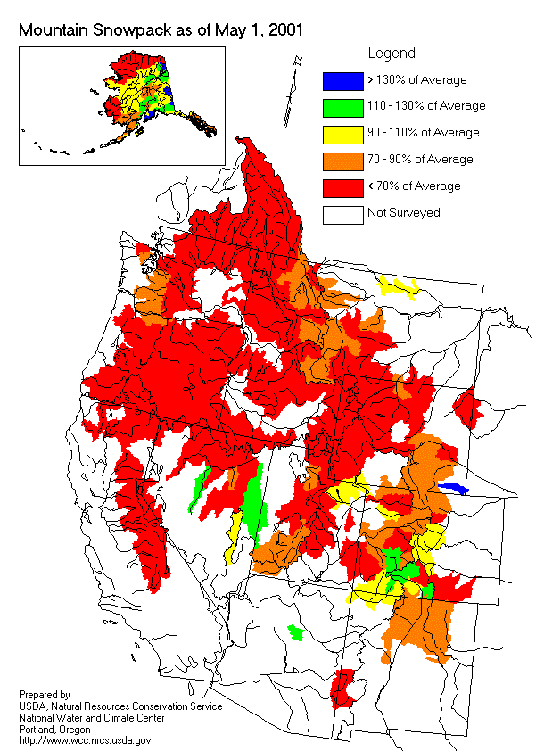
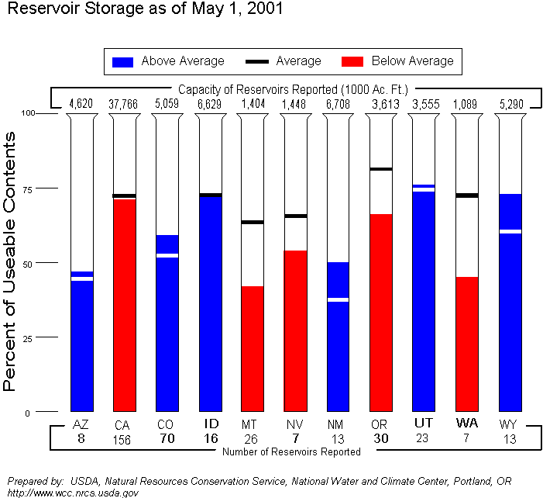
Different Uses Need Different Indicators
Precipitation Anomalies
Palmer Drought Index
Standardized Precipitation Index
Keetch-Byrum Drought Index
7-Day Avg. Streamflow
Mesonet data
Growing Season:
Crop Moisture Index
Satellite Veg. Health Index
Soil Moisture (Modeled)
In The West:
Surface Water Supply Index
Reservoir levels
Snowpack
Streamflow
Source: National Drought Mitigation Center

Slide 27
Key Variables in Drought Monitoring
climate data (temperature and precipitation)
soil moisture
stream flow
ground water
reservoir and lake levels
snow pack
short, medium, and long range forecasts
vegetation health/stress and fire danger
drought impacts
others?

Slide 28
Drought Monitoring
Rainfall Departures | Measured virtually everywhere Easy to calculate
Palmer Drought Severity Index | Good for long-term drought in relatively uniform regions Does not respond very rapidly
Standardized Precipitation Index | Measures how “unusual” precipitation departures are Calculated for different time scales
Keetch-Byrum Drought Index | Used for fire potential Responds quickly to weather conditions
Soil Moisture | Water-balance approach Tied closely to impacts
Evaporation | Includes temperature, wind, humidity Can be an early indicator
Reservoirs / Stream Flow | Monitoring water supplies Highly managed systems

Slide 29
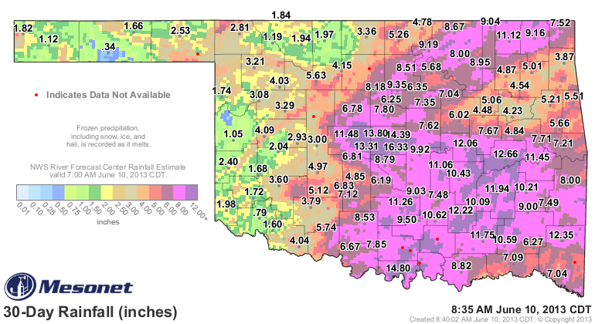
Rainfall Patterns
Notes:
Precipitation is the key indicator for vegetation growth & water resources
Temperature effects also important, but precipitation dominates
Measured virtually everywhere
Easy to calculate
Can be done for points over areas (such as a state or climate division)
Supplement with other networks like CoCoRaHS

Slide 30
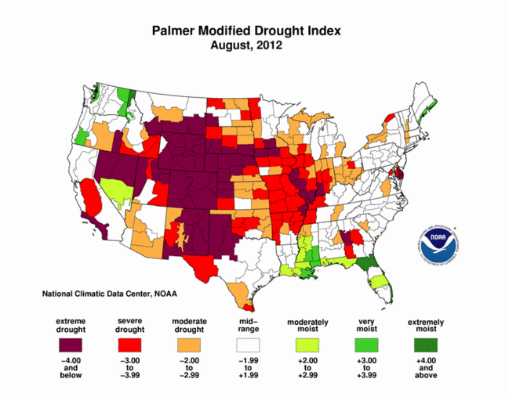
Palmer Drought Severity Index (PDSI)
Notes:
Developed in 1965 (first widely used soil moisture model)
Uses temperature and precipitation departures to determine dryness
Ranges from -4 (extreme drought) to +4 (extreme wet)
Standardized to local climate
Based on departures from local climate normals
Good for measuring long-term drought in relatively uniform regions
Not good for short-term drought / rapid changes
Not good for variable terrain (i.e., mountains)
May lag emerging drought conditions by several months

Slide 31
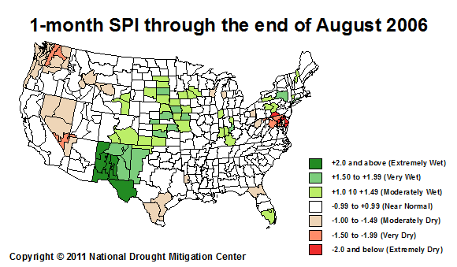
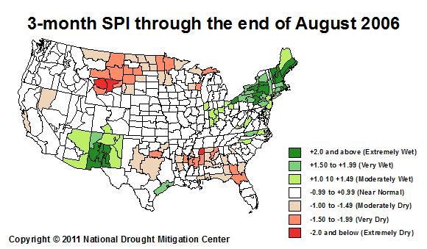
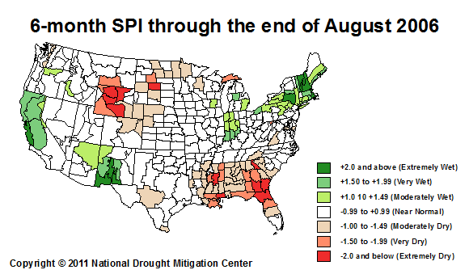
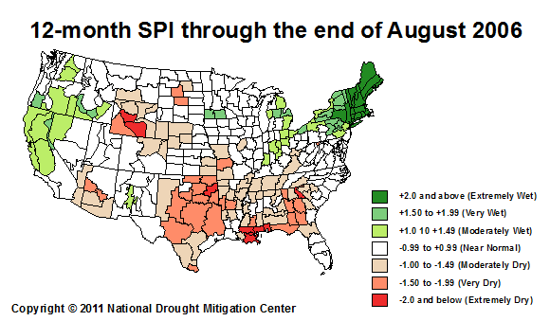
Standardized Precipitation Index (SPI)
Notes:
Developed in 1990s
Can be produced for a variety of time periods, depicting both short-term and long-term conditions
Based on precipitation over an accumulation period compared to the station’s historical distribution
Statistical “unusualness” of a period
PDSI uses a water-balance model to estimate evaporation based on temperature
Values of -2 or less are extremely dry; +2 and greater are extremely wet

Slide 32
Keetch-Byram Drought Index (KBDI)
KBDI Value | Interpretation
0-200 | No Drought-Slight Drought. Fuels and ground are quite moist.
200-400 | Moderate Drought. Dry vegetation begins to contribute to fire.
400-600 | Severe Drought. Escaped fire is difficult to control.
600-800 | Extreme Drought. Fire suppression is a major problem.
Notes:
Estimates dryness of soil and dead vegetation
Ranges from 0 (saturated soil) to 800 (dry soil)
Based on combination of recent precipitation and estimated evaporation
Soil may dry because of extended periods without precipitation or by high temperatures / strong winds
Developed for fire management purposes, but also a good short-term drought indicator

Slide 33
Soil Moisture
Notes:
Essential component of hydrologic modeling
Integrates precipitation deficits over time
Lagging indicator but strongly related to impacts
Valuable for assessing recovery
Few observations nationally, except for some state-run networks (like Oklahoma Mesonet)
Critical for ground-truthing satellite & model estimates

Slide 34
Evaporative Stress Index
Source: National Academy of Sciences
Notes:
Often the missing link in drought understanding
Direct measurement difficult and disappearing (pan evap)
ET models are getting more sophisticated
In 2011-2012, evaporation rates ran 30-40% higher than average
A lake that loses 60” on average, would lose an additional 2 feet!
New diagnostic tools like the Evaporative Stress Index can show areas at-risk

Slide 35
Reservoirs & Stream Flow
Source: National Academy of Sciences
Notes:
Also historically well-monitored but networks are degrading
Fewer stream gauges available
Reservoir data is fragmented across agencies
Small reservoirs that may be critical water sources may not be well-monitored
Need historical information on how quickly reservoirs decline to know if conditions are abnormally dry & how long supplies will last

Slide 36
Impacts
Actual effects of drought may not be properly aligned with indicators (lag effects)
Need to know if rain event produces expected responses
Federal assistance is tied to the Drought Monitor, so indicators need to match impacts
Some areas have limited data collection and rely upon estimation from satellite
Source: National Academy of Sciences

Slide 37
The Impact of Impacts
March 15, 2011

Slide 38
The Impact of Impacts
Ponds are drying up
Wheat will more than likely be gone by next week without a rain
Producers that intended to graze small grain pastures out are having to sell livestock
Planting of row crops will not happen until it rains; seedbeds are powder dry
The snow was not very beneficial to the wheat crop due to blowing and a very dry light snow
Several fires have started due to mechanical sparking
Blowing dust across the roads so bad from tilled cotton fields it is extremely dangerous to drive some roads
March 15, 2011
Source: National Academy of Sciences

Slide 39
The Impact of Impacts
March 15, 2011
April 19, 2011

Slide 40
All of this is combined into a single weekly product

Slide 41
Drought Intensity Categories
D0 Abnormally Dry (30% – 1 in 3 years)
D1 Drought Moderate (20% – 1 in 5 years)
D2 Drought Severe (10% – 1 in 10 years)
D3 Drought Extreme (5% – 1 in 20 years)
D4 Drought Exceptional (2% – 1 in 50 years)

Slide 42
Can zoom into regional and state

Slide 43
The Drought Monitor Objectives
“Fujita-like” scale
NOT a forecast!
NOT a drought declaration!
Identify duration (L, S)
Assessment of current conditions
Incorporate local expert input
Be as objective as possible

Slide 44
Drought Monitor Process
Monday (5 Days available)
Draft map sent to local experts
Tuesday (6 Days available)
Local expert feedback
Draft map sent to local experts
Draft text sent to local experts
Wednesday (7 Days available; ending 12Z yesterday)
Local expert feedback
Draft map(s) sent to local experts
Draft text(s) sent to local experts (Outlook)
Final map and text sent to secured ftp server
Thursday
Final map & text released on NDMC Website

Slide 45
Spatial Extent of Drought
August 2011: 67% of Southern U.S. in Extreme-Exceptional Drought
(18% of whole U.S.)
August 2012: 23% of Entire U.S. in
Extreme-Exceptional Drought
(28% of Southern U.S.)

Slide 46
Temporal Extent of Drought

Slide 47
Lies, Damn Lies, and Statistics
Often, the raw statistics do not reveal the complete picture!
55% vs. 57% vs. 57% doesn’t necessarily mean they’re all in the same situation!

Slide 48
Planning for Drought

Slide 49
Drought Planning has been Reactive
National Drought Mitigation Center

Slide 50
Why Plan for Drought
Drought is inevitable
Droughts lasting 3-5 years are not that uncommon
Pre-drought action shapes choices
Increased flexibility and healthy resources minimizes loss
Early responses are effective responses
The longer you wait, the fewer choices you have
Drought creeps up on you
Decision points helps limit surprise

Slide 51
The ABCs of Drought Planning
Assess Conditions
Rainfall patterns and departures from normal
Drought Indicators
Water Resources
Impacts
Be Prepared
Develop a good drought plan
Identify at-risk businesses and users
Make sure they have enough lead time
Communicate!
Who needs to know?
When do they need to know it?
How do you tell them?

Slide 52
What is in a Drought Plan?
Vulnerability Analysis
Response capacities – local, state, federal, tribal
Roles and responsibilities
Monitoring indices
Communication
Who makes the call…
Triggers
…and when

Slide 53
Mitigation & Response Programs
Drought planning
Improved monitoring / early warning
Water supply augmentation
Demand reduction/water conservation
Public awareness/education programs
Water use conflict resolution
Legislation/policy changes
Technical assistance on water management

Slide 54
National Integrated Drought
Information System (NIDIS)
Integrate observations and data systems
Credible and readily accessible information to inform decisions
Fill information gaps
Develop new tools
Drought scenarios
Coordinate research and science
Intergovernmental and private sector
Information dissemination and feedback

Slide 55
Drought-Ready Communities
Resource materials assembled into a “Drought Ready Communities Kit” to help guide communities in their assessment of drought risk and mitigation actions.
Elements include:
Developing a leadership team – who should be invited?
Data sources and how they may be used in assessing drought risk
Drought indicators and how they may be used
Sample documents for communicating drought status and educating the public
Example plans from other communities

Slide 56
Drought Ready Checklist
Getting Started
Identifying resources and forming leadership team
Information Gathering
water sources, climate, past droughts, and impacts
Monitoring
Determine indicators and appoint an authority
Communication
Develop materials and methods to inform community
Community Education & Outreach
Increase general awareness before a drought
Planning
Identify vulnerabilities and determine triggers and actions

Slide 57
Managing Drought Risk on the Ranch
Prepare for drought by increasing the health of the overall operation and maximizing flexibility
Write a Drought Plan that includes WHAT to do during drought and WHEN
When conditions require it, implement the plan and don’t second-guess it
After drought, have a plan for restoring the health of all parts of the ranch operation
Monitor how the drought plan works, and improve it as you learn

Slide 58
Plant Response to Rainfall
Precipitation in the cool season determines forage more than warm season
Months leading up to peak growing conditions are most critical (late spring – early summer)
Delayed plant response when very dry soils (typically when less than 75% of normal over growing season)
Excessive grazing during drought will further reduce yield, even if precipitation returns to normal
Impacts are cumulative and increase rapidly

Slide 59
Planning Resources
Drought-Ready Communities
http://drought.unl.edu/Planning/PlanningProcesses/DroughtReadyCommunities.aspx
Managing Drought Risk on the Ranch
http://drought.unl.edu/ranchplan/Overview.aspx
NIDIS
http://www.drought.gov
National Drought Mitigation Center
http://drought.unl.edu/

Slide 60
Thank You!
Mark Shafer
Southern Climate Impacts
Planning Program
Norman, Oklahoma
mshafer@ou.edu
(405) 325-3044
In Partnership With:
NOAA Regional Integrated and Assessments (RISA)
National Integrated Drought Information System (NIDIS)
NOAA National Climatic Data Center (NCDC)
National Drought Mitigation Center (NDMC)

