Slide 1


The Basics of Climate

Slide 2

Note: This slide set is one of several that were presented at climate training workshops in 2014. Please visit the SCIPP Documents page in the Resources tab on the SCIPP’s website, www.southernclimate.org, for slide sets on additional topics.
Workshop funding was provided by the NOAA Regional Integrated Sciences and Assessments program.

Slide 3
What determines climate?
Notes:
There are several factors that determine the types of climate we have on Earth.

Slide 4

Factor 1: The Sun and Uneven Heating of Earth
Heat from the Sun is the main driver of weather and climate of Earth.
Different places on Earth receive direct (more intense) vs. oblique (less intense) energy.
Less direct energy:
Colder temps!
More direct energy:
Warmer temps!
Equator
Less direct energy:
Colder temps!
Notes:
In the diagram you can see how the flashlight on a sphere represents the more or less direct sunlight on Earth.
The tropics receive more concentrated insolation sue to Earth’s curvature.
Tropics receive 2.5 times more insolation that the poles.

Slide 5
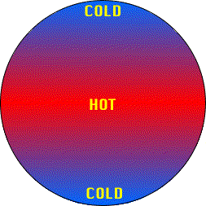
Uneven Heating of Earth
The consequence of the uneven
heating by the sun should be a global
temperature pattern like this:
Which is pretty close to reality,
but there’s more!
Notes:
All the hot air should be close to the equator and all the cold air at the poles, but there’s more!

Slide 6
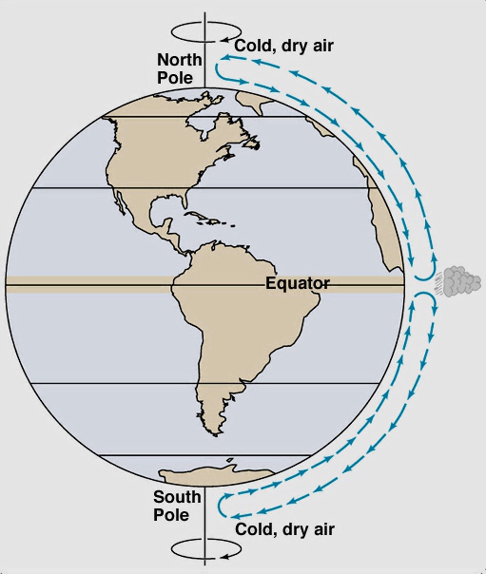
Basic Circulation Pattern
Earth’s oceans and atmosphere move
heat from the equator and cold air
from the poles.
Warm air (less dense) rises at the
equator and sinks as it cools (toward)
the poles.
This is what Earth’s circulation would
look like if it did not rotate.
Extra heat here needs to move toward poles
Notes:
Theoretical one cell circulation pattern if Earth didn’t rotate.

Slide 7
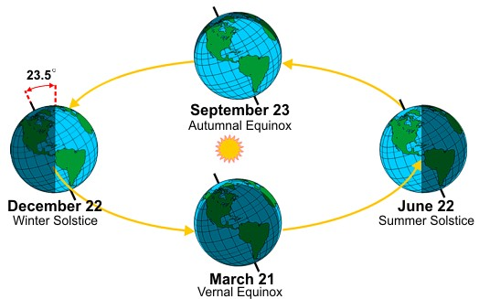
Factor 2: Revolution and Tilt
The seasons result from Earth’s tilt of 23.5 degrees relative to the sun and from Earth’s annual revolution around the sun.
Source: NOAA National Weather Service JetStream
Notes:
During the summer the sun angel is most direct and the days are longest. In the Northern Hemisphere the most direct sunlight and longest day is June 22.
During the winter the sun rises at a lower angle, with less direct light, and shorter days. In the Northern Hemisphere the least amount of sunlight is December 22.
Twice a year the sunlight is exactly 12 hours on the equator. This is called equinox, meaning equal night.

Slide 8
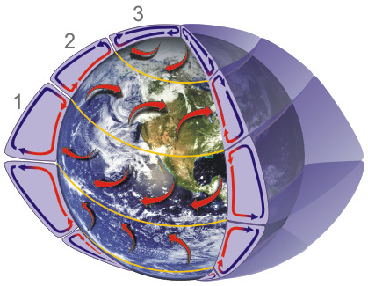
Factor 3: Rotation
Since Earth spins, air does not
flow in straight lines across the
planet.
The basic equator-to-pole
circulation is therefore broken
into three major circulation belts
in each hemisphere.
Between cells at the equator and
50-60° N/S latitude are bands of
low pressure.
Between cells at 30° N/S latitude and at the poles are areas of high pressure.
Source: NOAA National Weather Service JetStream
Notes:
The effect of the turning of air over long distances is called the Coriolis Force.
Most of the desert regions on Earth are located near the 30 degree N/S latitude due to the generally dry, high pressure conditions located here.

Slide 9
Major Circulation Patterns
1: Hadley Cell- Low latitude air
movement that heats and moves
poleward in the upper atmosphere.
The winds in this cell, called Trade
Winds, blow from the east.
2: Ferrel Cell- Mid latitude
movement poleward near the
surface and equatorward in the
upper atmosphere. The winds in
this cell are called westerlies.
3: Polar Cell- High latitude air movement equatorward near the surface and poleward aloft. The surface winds in this cell are called polar easterlies.

Slide 10
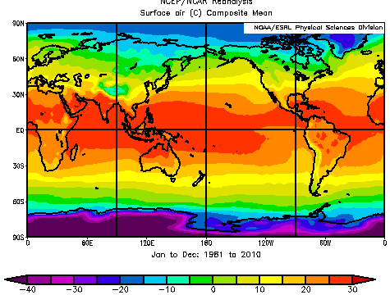
Factor 4: Latitude
Variation of sunlight affects temperature.
The equator has the least variation and is generally warm year round.
Mid-latitudes have more variation with warm summers and cool winters.
High latitudes have the variation with cool summers and cold winters.
Mean surface temperature (°C) Jan to Dec, 1981-2010.
Notes:
From NCEP/NCAR Reanalysis, Surface air (C) Composite mean
The image is showing global average temperatures from 1981-2010.
You can see the warmest temperatures at the equator and coldest at the poles, but there are some areas where the temperature gradient isn’t perfectly straight across the globe.

Slide 11
The Role of Latitude
Barrow, AK (71N)
July: Two straight
months of sun,
but not very
direct.
Avg temp: 41°F
Jan: Two straight
months of
darkness.
Avg temp: -13°F
Maracaibo, Venezuela (8N)
July: Avg temp: 83°F
Jan: Avg temp: 81°F
Mean surface temperature (°C) Jan to Dec, 1981-2010.
B
M
Notes:
Here’s a example of two locations, one near the equator and one in the Arctic Circle, that have very different climates due to their latitude.
Alaska has large variation in seasonal climate conditions, Venezuela is much more consistent.

Slide 12
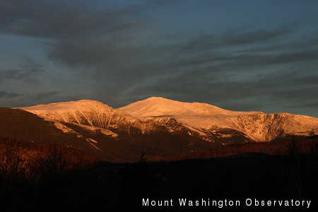
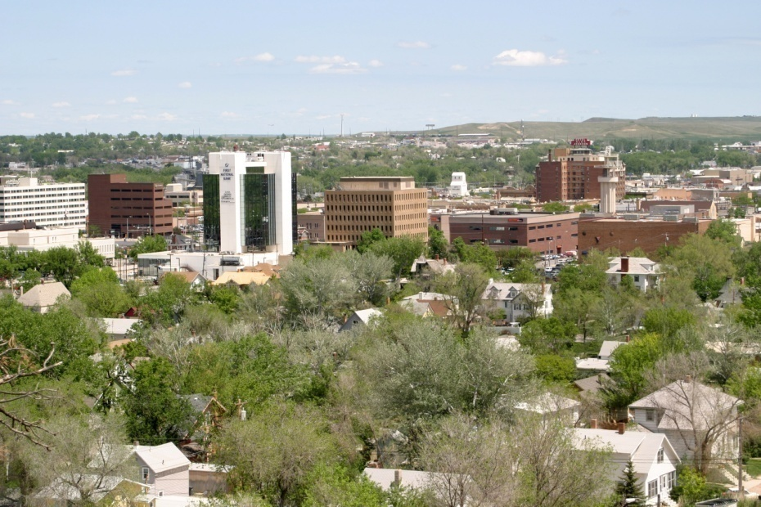
Factor 5: Elevation
In general the higher the elevation, the cooler and drier the climate.
Temperature typically decreases 5.4°F for every 1000ft change in elevation.
Often mountains have more precipitation on the windward side and less on the leeward side.
Mt Washington, NH (44N, 6288ft) Rapid City, SD (44N, 3,202 ft)
Annual temp: 27.3°F Annual temp: 46.3°F
Notes:
The mountain effect on precipitation we call the rain shadow.
These two locations are at about the same latitude but have a very different climate due to their elevation.
Mt. Washington is famous for having some of the most extreme weather conditions on Earth, often with high winds and cold temperatures.

Slide 13
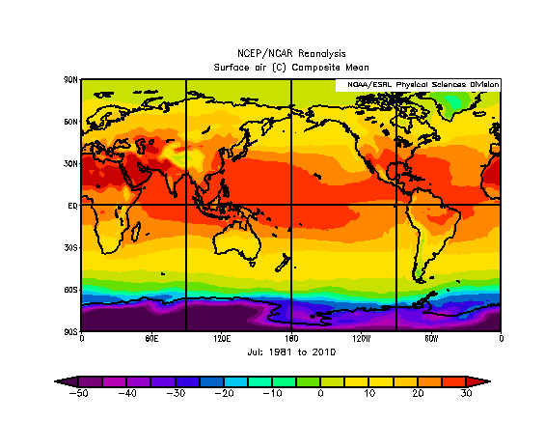
Factor 6: Land and Water are Different
Land surfaces heat and cool much more quickly than water/oceans.
Mean July surface temperature (°C), 1981-2010.
Notes:
Interior land is more variable than near the coast– proximity to oceans and the prevailing wind patterns are also important.
On this map you can see that Greenland, for example, is colder than surrounding ocean but areas of North America are warmer than surrounding ocean.

Slide 14
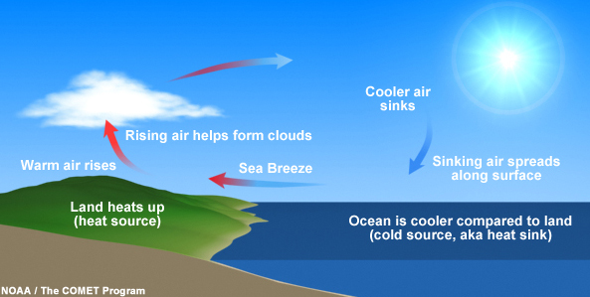
Coastal Impacts
The ocean moderates the temperature over land in coastal areas.
When the temperature is warmer over land, the air rises and an onshore breeze results; when the temperature is warmer over water, an offshore breeze results.
This wind pattern that often occurs daily in coastal locations is called the sea breeze.

Slide 15
Global Weather Patterns

Slide 16
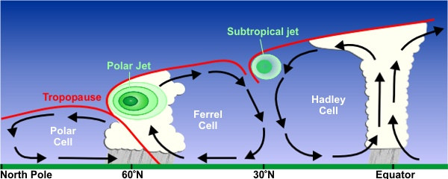
The Jet Stream
Jet streams are relatively narrow bands of strong wind in the upper atmosphere.
The wind blows west to east, but the flow can often shift north and south.
Jet streams follow the boundaries between hot and cold air.
The Polar Jet and Subtropical Jet are found between the general atmospheric circulation cells.
Source: NOAA National Weather Service JetStream
Notes:
In North America the polar jet can bring us very cold air in the winter when it moves to the south. In the springtime the subtropical jet is often responsible for bringing conditions favorable for severe weather to the Southern Plains.

Slide 17
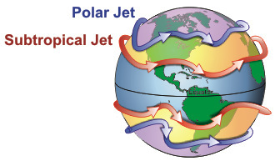
The Jet Stream
Ridge: Warm air usually
moves from the equator
towards the pole and is
associated with fair
weather, lighter winds,
and clearer skies.
Trough: Cold air usually moves from the pole towards the equator and is associated with active weather, stronger winds, clouds, and precipitation.
These ridges and troughs in the jet stream make a pattern around the world. Disruptions in one place can have distant impacts.
R
T
Source: NOAA National Weather Service JetStream
Notes:
A ridge represents typical hot and dry summer weather in the Southern Plains– this is the “heat dome” we often hear about from media.
Troughs represents the active weather in the Southern Plains, especially in the winter and spring.
Split jet stream flow can sometimes lead to the weather getting “stuck” like cut off low pressure bringing several days of rain and clouds.
For example an abnormally strong and persistent ridge in the jet stream over the west coast of the US typically leads to a deep trough over the eastern portion of the country. Such as during the winter of 2013-2014, areas of the Northern Midwest had one of their coldest winters in the last 100 years with many locations observing record or near record snowfall.

Slide 18
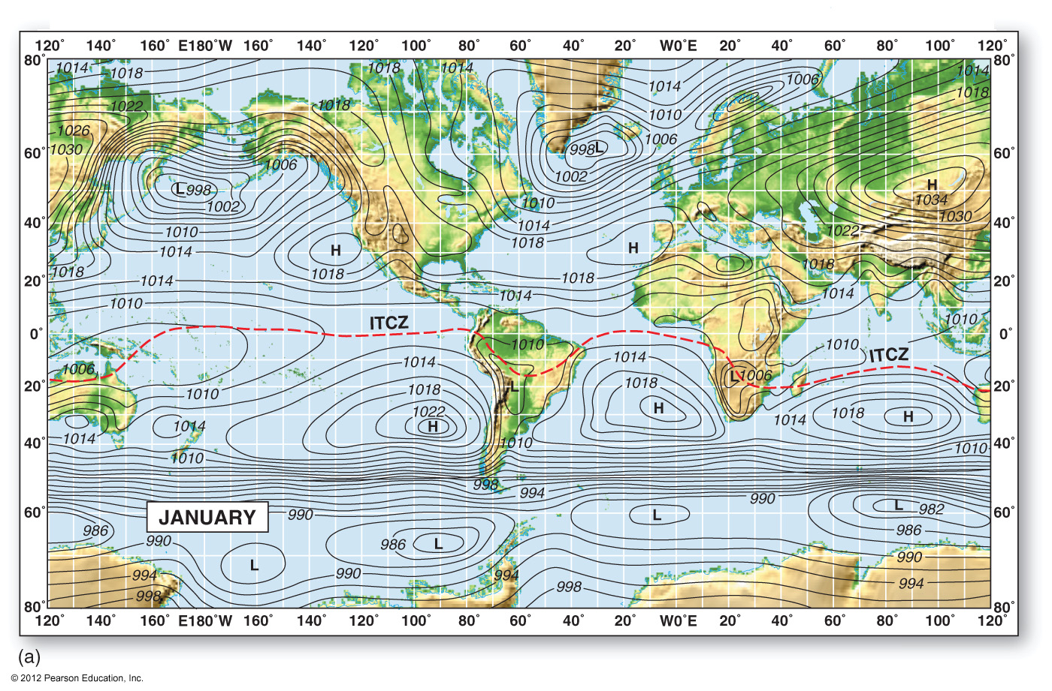
Global Barometric Pressure
Notes:
The map depicts typical regions of high and low pressure in January. Many N American storms form in N Pacific and N Atlantic. Tendency toward low pressure shown along the northern portion of the east coast and just a little in the lee of the Rockies.
Also note the dominant high pressure areas in the Southern Hemisphere (January is their summer) and the ever present active weather (low pressure) in the Southern Ocean.

Slide 19
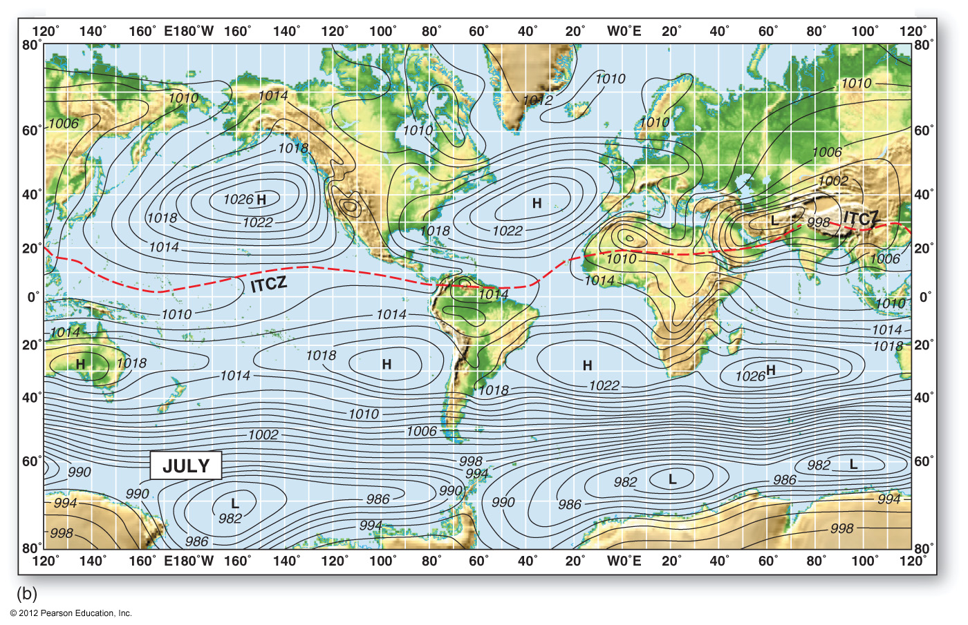
Global Barometric Pressure
Notes:
This is a similar pressure map, but for July. Note the dominant high pressure areas in the Northern Hemisphere summer.
Note the even more tightly packed contours and active weather across the Southern Ocean during their winter.
Remember, this is the climatological perspective. The actual weather on a given day would likely look very different.
Note the Intertropical Convergence Zone (ITCZ), the band of tropical thunderstorms near the equator, shifts to the north.

Slide 20
Teleconnections
A linkage between weather changes in widely separated regions of the globe.
Like dropping a pebble in a pond, ripples are created that spread to the surroundings.
The most well known teleconnection is the El Niño Southern Oscillation.

Slide 21
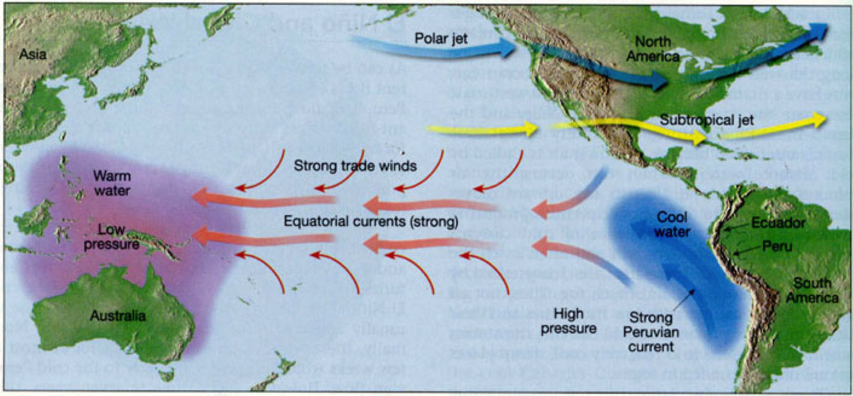
El Niño-Southern Oscillation
Under normal conditions trade winds and ocean currents result in warm water in the western Pacific and cool water in the eastern Pacific.
Notes:
The El Nino Southern Oscillation is the most commonly talked about teleconnection.
This circulation across the Pacific is called the Walker Circulation.
Under El Nino conditions the trade winds weaken and the warm water normally confined to the western pacific spreads eastward.
Under La Nina conditions the trade winds are stronger and cooler than normal water spreads westward across the Pacific.

Slide 22
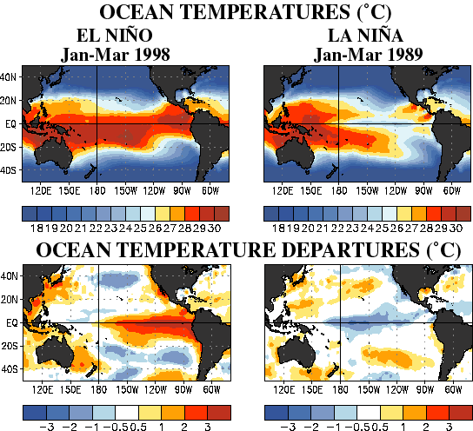
El Niño and La Niña
Equatorial Pacific temps significantly warmer than “normal”
Equatorial Pacific temps significantly cooler than “normal”
Notes:
These are sea surface temperature maps from a particularly strong El Nino and La Nina. On the top you can see the observed temperatures– warm water all across the equator during El Nino and warm water confined to the west during La Nina. Below are the temperature anomalies (or difference from normal). You can see the warm anomalies in the east Pacific for El Nino and the cold anomalies in the central Pacific for La Nina.

Slide 23
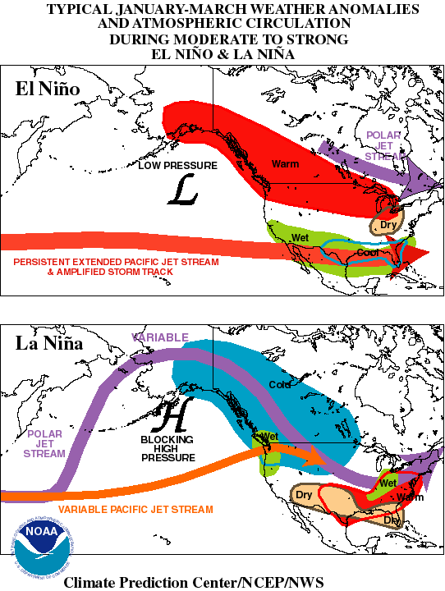
Typical ENSO Winter Effects
El Niño:
Lots of storms tracking west to east
across the southern half of the US.
Very wet across the southern states,
warm across the northern states.
La Niña:
Storm track shifts to the north and the
Southern Plains is mostly warm and dry.
The track can sometimes quickly jump
south, bringing cold air but still often
with sparse moisture in the Southern
Plains.
Notes:
The maps depict typical jet stream positions and observed weather during El Nino and La Nina conditions. Again, this diagram depicts the the general trends. Day to day weather may still look very different. Even a strong vs. weak El Nino could have large differences.

Slide 24
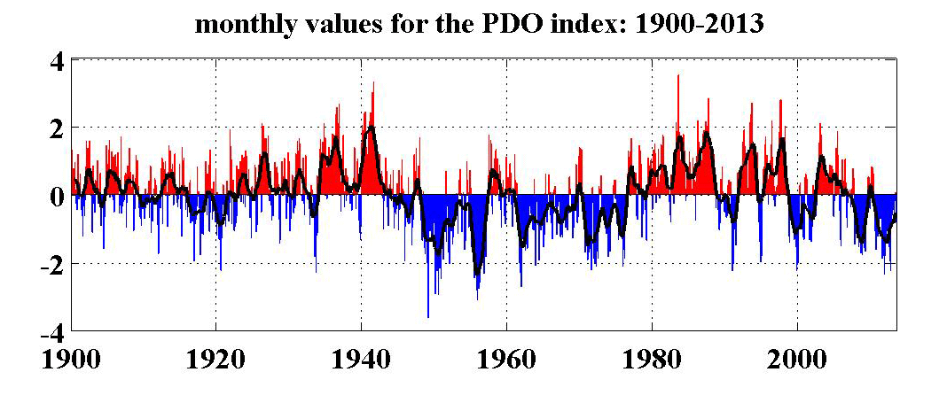
Other Teleconnections
Pacific Decadal Oscillation (PDO)
Subtle sea surface temperature changes in the northern and central Pacific, typically over a 20-30 year period.
Might be a contributor to extended drought patterns in central North America.
North Atlantic Oscillation (NAO)
Manifests in a pressure differential between Iceland and the Azores.
Has a strong impact on the North American east coast and Europe
tied to winter cold air outbreaks.
The Pacific-North American Oscillation (PNA) and the Arctic Oscillation (AO) are others.
Sea Surface Temperature Anomaly
Notes:
PDO index time series source: http://jisao.washington.edu/pdo/
The chart shows the 20-30 year period of PDO.

Slide 25
Measures of Climate

Slide 26
Climate Normals
Calculating climate normals are helpful when comparing specific conditions to the long term.
Involve measures of temperature and precipitation for periods of days, months and years.
A 30 year average constitutes the normal values and they are updated every 10 years.
The current time period used for the normals is 1981-2010.

Slide 27
September Rainfall in Oklahoma City
The average of all this is 4.07” which is the normal September rainfall at Oklahoma City.
The range is .59” to 11.85” = 11.29”.
Even though the average is about 4 inches, only a few years are very close to 4 inches.
The natural variability has a much wider range, especially over the entire period of record.
1981 | 1.48” |  | 1986 | 9.54” |  | 1991 | 11.85” |  | 1996 | 5.88” |  | 2001 | 5.55” |  | 2006 | 3.76”
1982 | 2.86” |  | 1987 | 4.58” |  | 1992 | 2.92” |  | 1997 | 1.66” |  | 2002 | 2.94” |  | 2007 | 5.73”
1983 | 0.90” |  | 1988 | 5.19” |  | 1993 | 7.17” |  | 1998 | 4.39” |  | 2003 | 1.98” |  | 2008 | 0.59”
1984 | 1.01” |  | 1989 | 4.51” |  | 1994 | 2.15” |  | 1999 | 4.88” |  | 2004 | 0.64” |  | 2009 | 4.62”
1985 | 4.59” |  | 1990 | 7.35” |  | 1995 | 6.05” |  | 2000 | 1.73” |  | 2005 | 1.89” |  | 2010 | 3.59”
Notes:
The example on this slide shows the September monthly rainfall values for Oklahoma City, OK from 1981-2010.

Slide 28
Climate Normals
All normals work the same way.
For Oklahoma City:
Normal September rainfall: 4.07”
Normal September temperature: 73°F
Normal September 26 high: 80°F
Normal first freeze of fall: November 4
All of these normals are based on 30 numbers recorded between 1981-2010.
Normals can also be calculated by averaging together observations over a spatial area such as a climate division, state or globally.

Slide 29
Climate Normals
Keep in mind that a normal value is just an average; it doesn’t mean “supposed to”.
It’s not “supposed to” rain 4.07” at Oklahoma City in September and it doesn’t “usually” rain 4.07” in September.
None of the Oklahoma City observations since 1896 have recorded exactly 4.07” in September.

Slide 30
Normal vs. “Supposed To”
From 1981-2010, the average OU-OSU score was OU 29, OSU 16.
This doesn’t mean OU is “supposed to” win 29-16 each following year OU has never won 29-16.
In 2011, OSU won 44-10.
Each year’s score (individual event) was decided by factors other than the 30 year normal.

Slide 31
Climate Normals
In the Southern Plains and many other places in the US, climate values are highly variable.
Large variability can make “supposed to,” “usually” and even “about” not very meaningful on a month-to-month basis.
However, for longer term rainfall (seasonal, annual, and beyond) departures from normal mean more.

Slide 32
So, why have normals?
People adjust their practices (agriculture, water resources, construction practices, etc.) based on recent history.
Normals indeed are recent history, about a generation of history.
Normals are a good diagnostic tool to put events into perspective.
Normals are also a great planning tool.

Slide 33
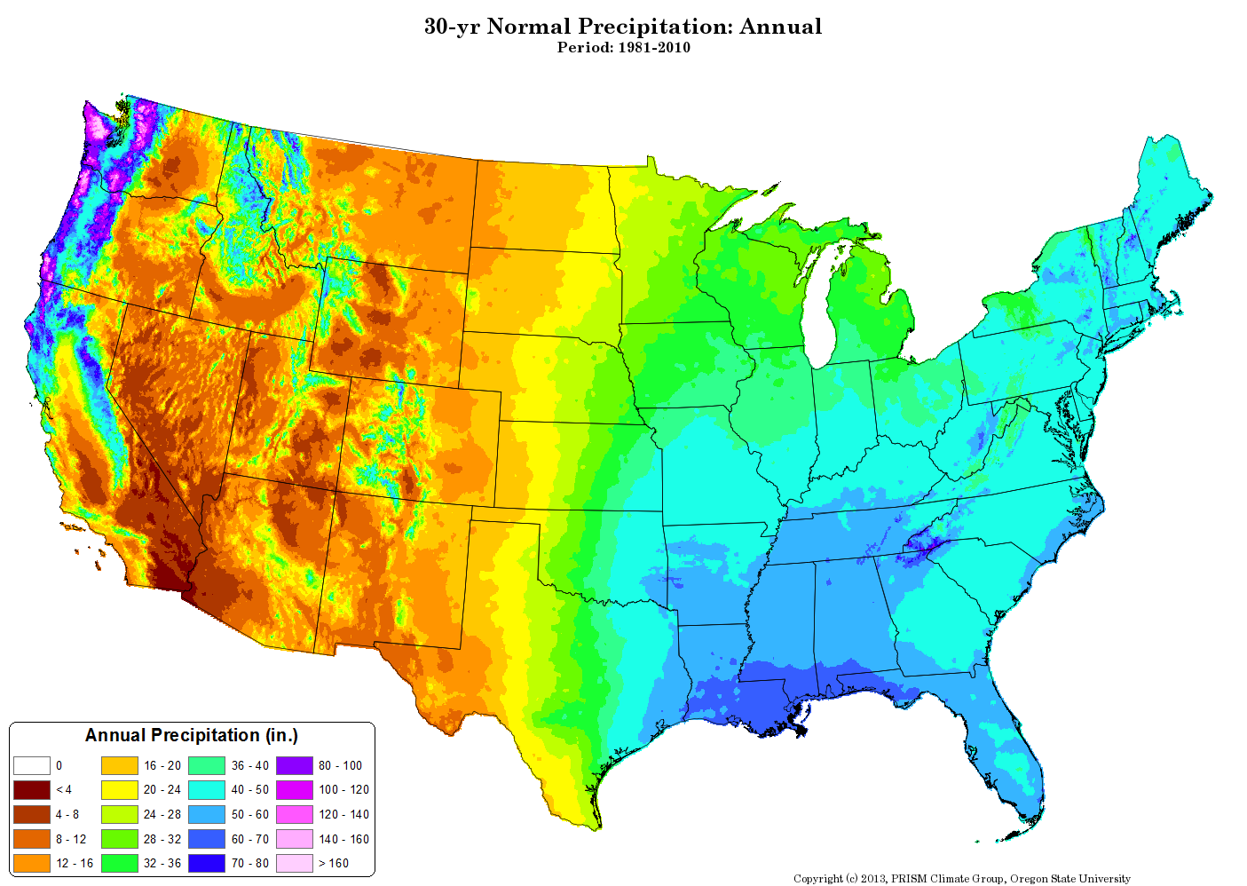
Contiguous US Normal Annual Precipitation
Notes:
The 30 year normals allow an image like this to be created. Note the east to west precipitation gradient across the Southern Plains and the spatial differences due to the mountains out west.

Slide 34
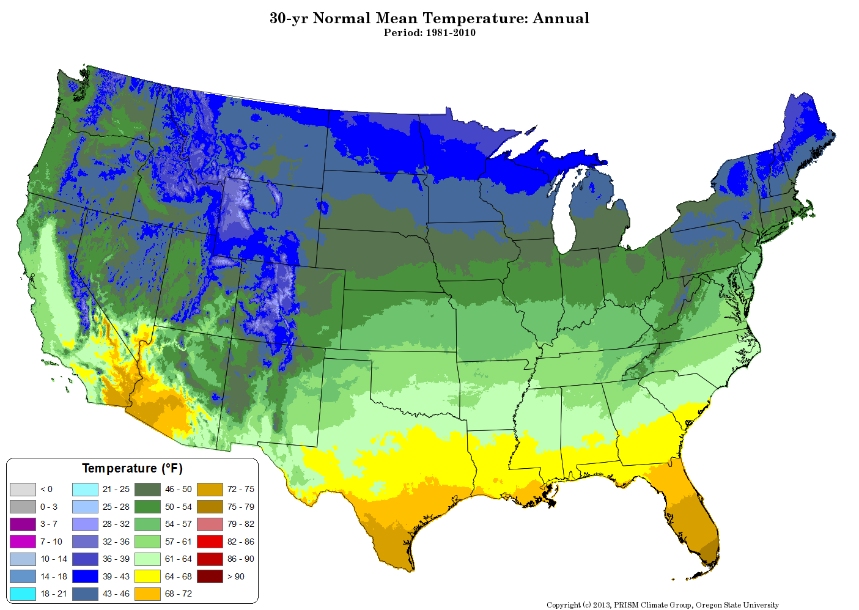
Contiguous US Normal Mean Annual Temperature
Notes:
Note the generally more gradual gradients, except in mountainous areas out west. You can also see the very warm average conditions in the Death Valley region.

Slide 35
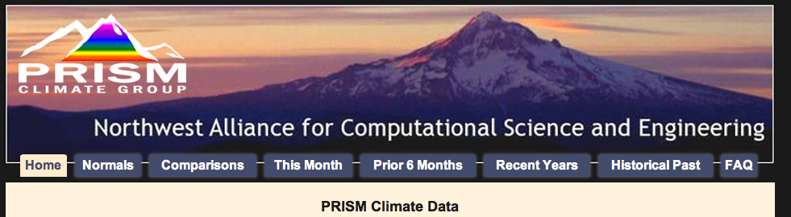
PRISM Climate Data
http://www.prism.oregonstate.edu
Notes:
These types of images for various spatial and temporal scales can be accessed from the PRISM website.

Slide 36
Southern Plains Climate Trends

Slide 37
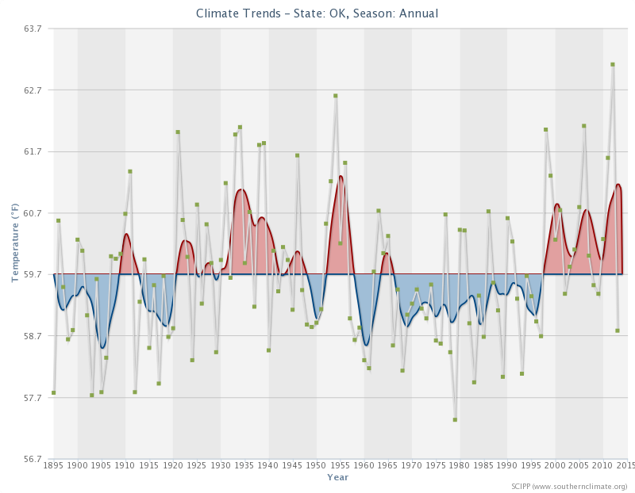
Oklahoma Annual Temperature
Notes:
The average line is based on the entire period of record (1895-Present).
Oklahoma had warm periods recently, in the 50s, and during the Dust Bowl in the 30s.
Note: These graphs can be produced for any state or climate division in the lower 48. You can access them by using SCIPP’s Historical Climate Trends Tool here: http://www.southernclimate.org/pages/data-tools.

Slide 38
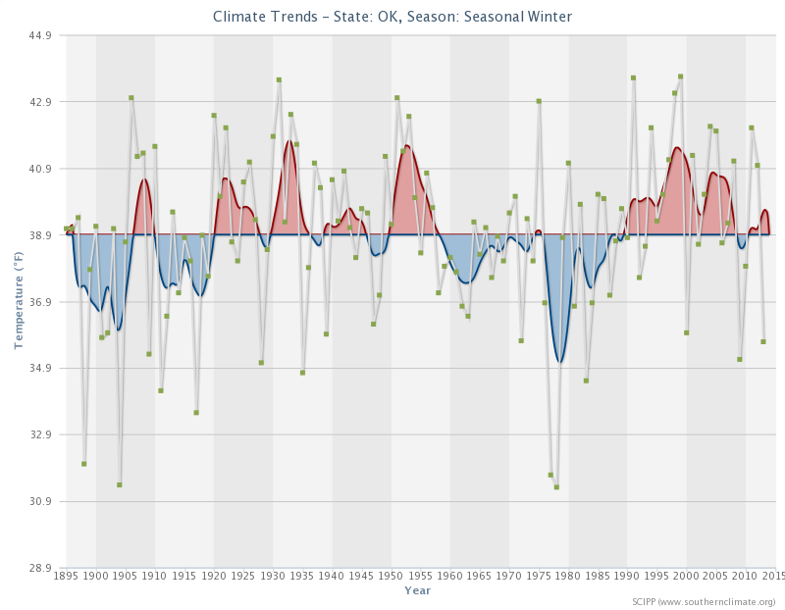
Oklahoma Winter Temperature
Notes:
Oklahoma winters of late have been warmer than the long term average. Note the very cold winters in the late 70s.

Slide 39
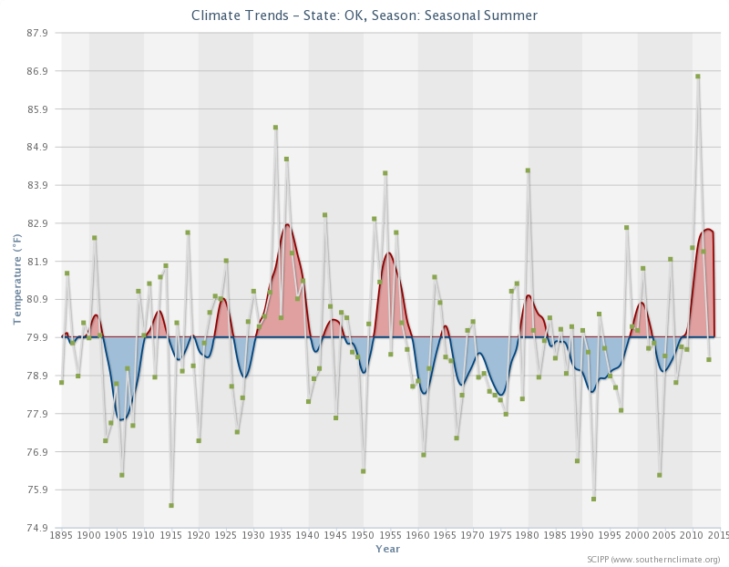
Oklahoma Summer Temperature
Notes:
Oklahoma’s warmest summer on record in 2011 really stands out. Also note the very warm summers during the Dust Bowl years in the 30s.

Slide 40
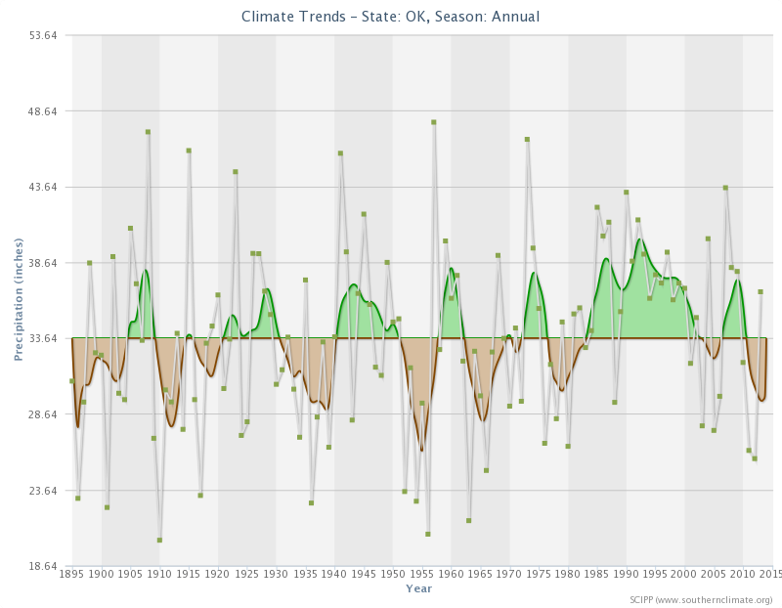
Oklahoma Annual Precipitation
Notes:
Oklahoma has a history of periodic droughts, though during the late 80s to early 2000s above average rainfall occurred.

Slide 41
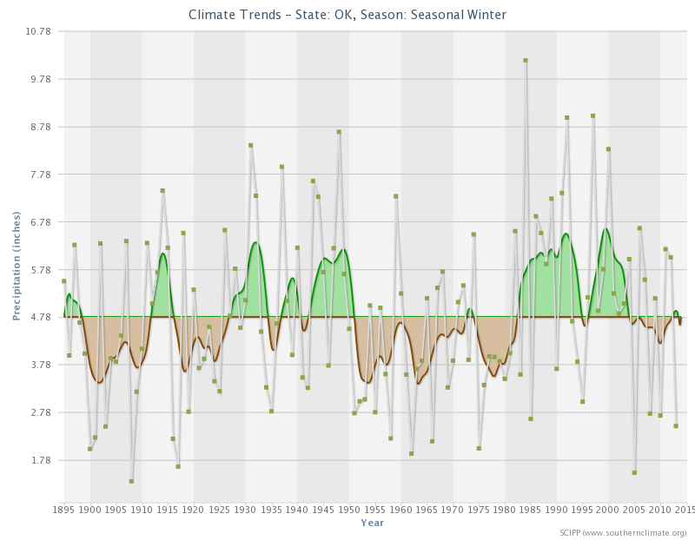
Oklahoma Winter Precipitation

Slide 42
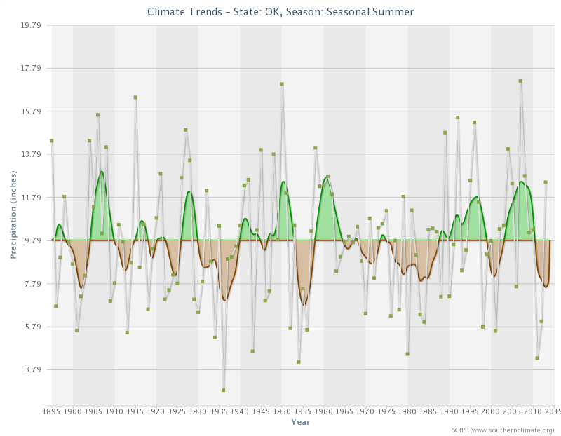
Oklahoma Summer Precipitation

Slide 43
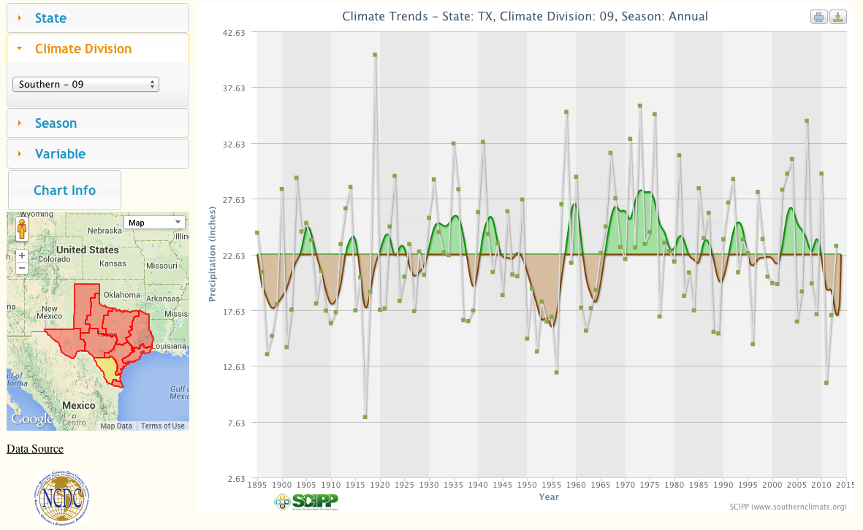
Southern Texas Climate Division (9)
Annual Precipitation
Notes:
The following few slides show an example of the precipitation and temperature trends for a climate division: Texas climate division 9 (highlighted in yellow on the map).

Slide 44
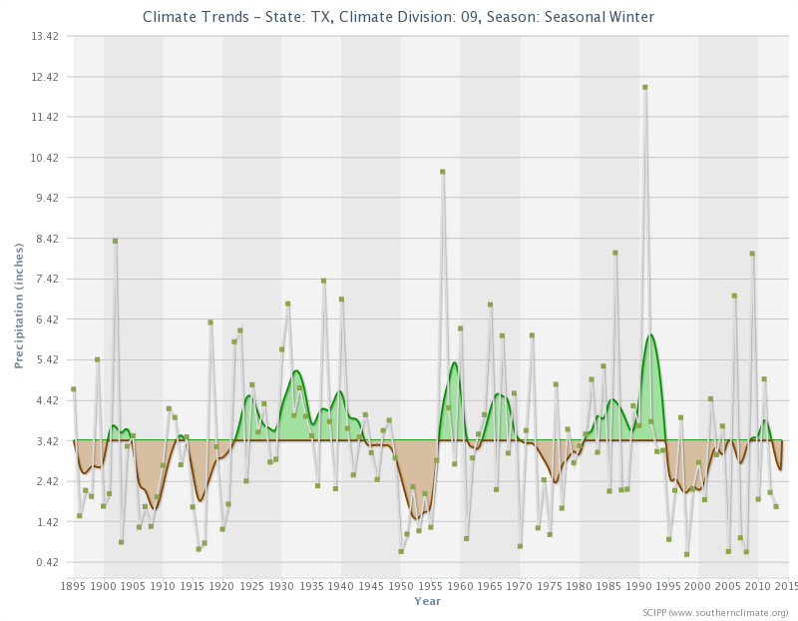
Southern Texas Climate Division (9)
Winter Precipitation

Slide 45
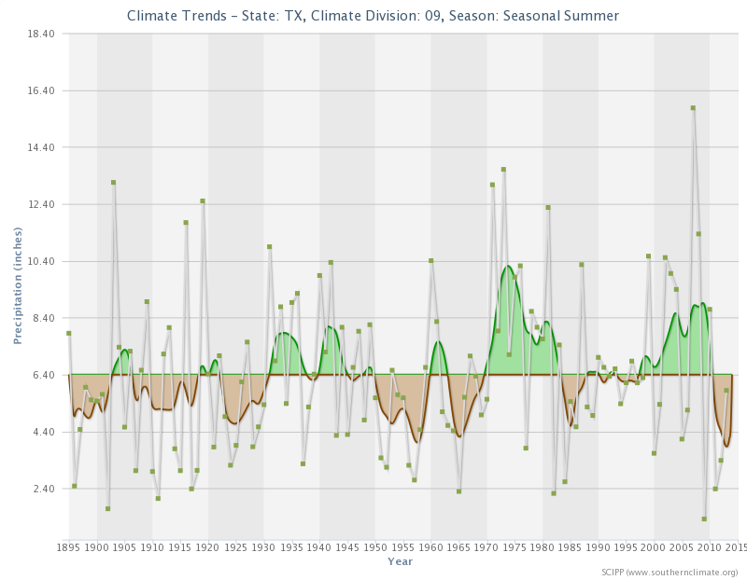
Southern Texas Climate Division (9)
Summer Precipitation

Slide 46
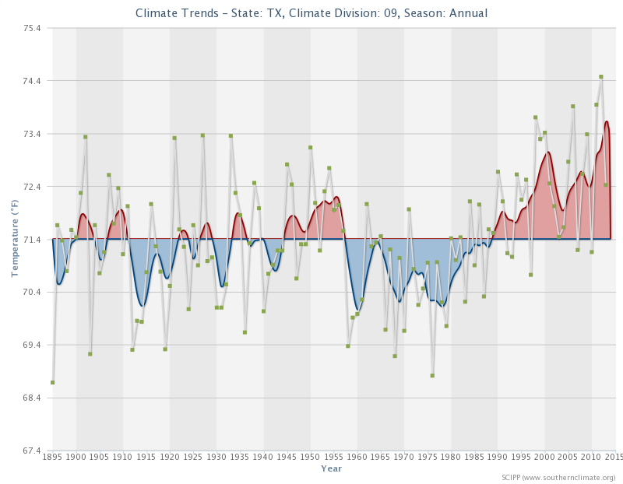
Southern Texas Climate Division (9)
Annual Temperature

Slide 47
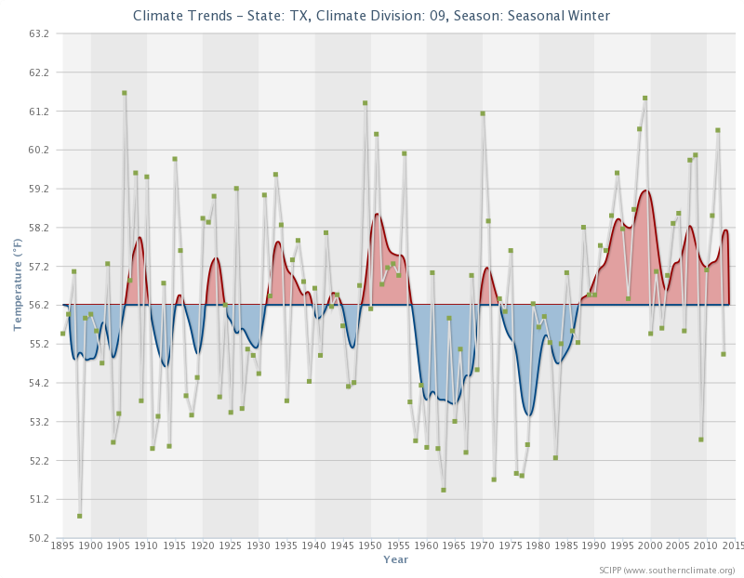
Southern Texas Climate Division (9)
Winter Temperature

Slide 48
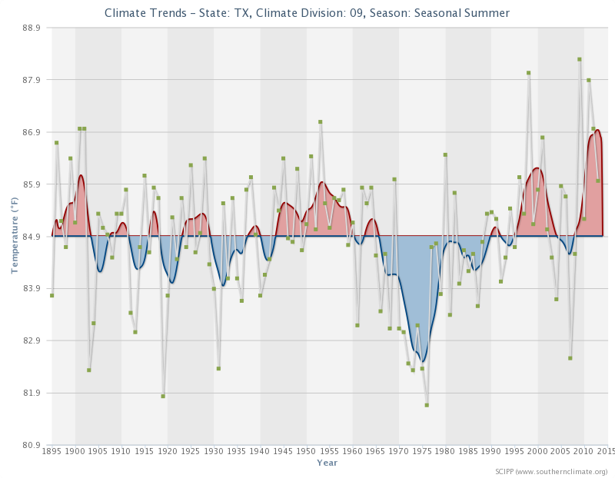
Southern Texas Climate Division (9)
Summer Temperature

Slide 49
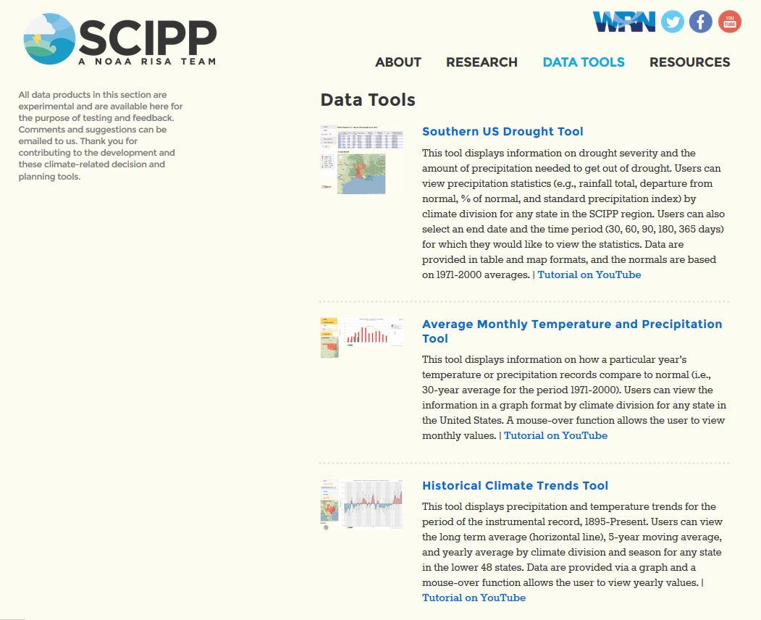
SCIPP Climate Trends Tool
http://charts.srcc.lsu.edu/trends/
Notes:
Temperature and precipitation charts for any state, climate divisions, year, season, or month can be accessed via the Data Tools tab on the SCIPP website, www.southernclimate.org.

