Slide 1
Weather Hazards and Hazard Climatology

Slide 2
Note: This slide set is one of several that were presented at climate training workshops in 2014. Please visit the SCIPP Documents page in the Resources tab on the SCIPP’s website, www.southernclimate.org, for slide sets on additional topics.
Workshop funding was provided by the NOAA Regional Integrated Sciences and Assessments program.

Slide 3
Extreme Events
Our climate is realized through extreme events.
Federal disaster declarations are a measure of significant economic impact, Oklahoma has 37 since 2000 - the most in the country (Texas has 20).
Heat waves, floods, and droughts have become more frequent
and intense .
Trends in hurricanes and severe storms, including tornadoes,
are uncertain.
Becoming more sensitive to extreme events, greater damage and economic losses.
Notes:
Let’s first look at some broad comments related to extreme events…
Nature does its business through extremes
Extreme events are part of our climate, for example OK observes an average of 20 Tornadoes each May. That’s part of our climate. In 2013 there were 56.
Nationwide there were 943 tornadoes in 2013 and that’s dramatically down from average of about 1500
Texas has had the 2nd most declared disasters since 2000 with 20 declared disasters. For example the tornado events in Oklahoma and north central Texas in 2013 resulted in a presidential disaster declaration.
Overall since 1953, Texas and Oklahoma lead the nation along with California in most federal disaster declarations.
It’s very interesting, given OK’s size and population relative to TX and CA.
Tornadoes are such localized and relatively rare events that year to year variability will outweigh any long term changes that may be happening for the foreseeable future. Future trends in hurricane activity is also uncertain, however there’s some confidence that the hurricanes that do form will be stronger due to warmer sea surface temperatures.
But what is certain… as our society becomes more built up… there’s just more stuff that could potentially be damaged which will lead to greater economic loss.
The 2013 Oklahoma tornado outbreak resulted in one of the billion dollar disasters in 2013, with economists at NOAA still trying to work on a more exact total… but the EF5 tornado that went through Newcastle, Oklahoma City and Moore is estimated to have caused about $2 billion in property damage.

Slide 4
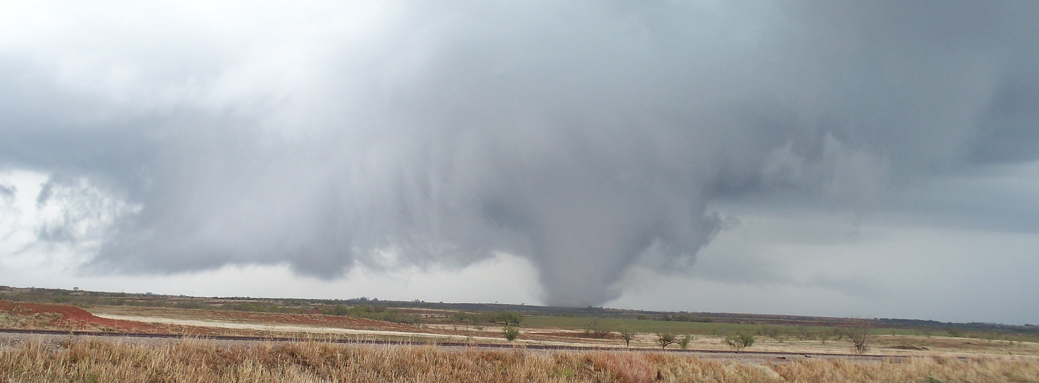
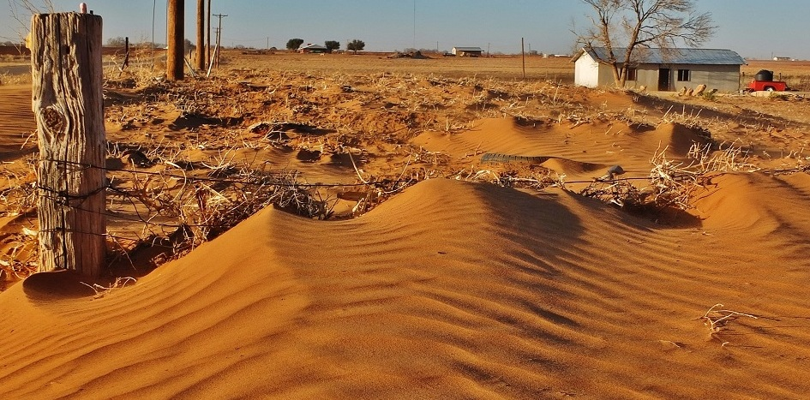
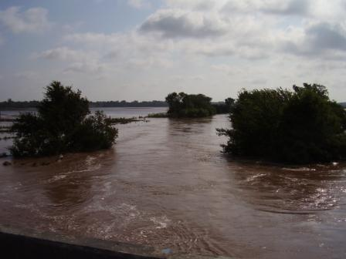
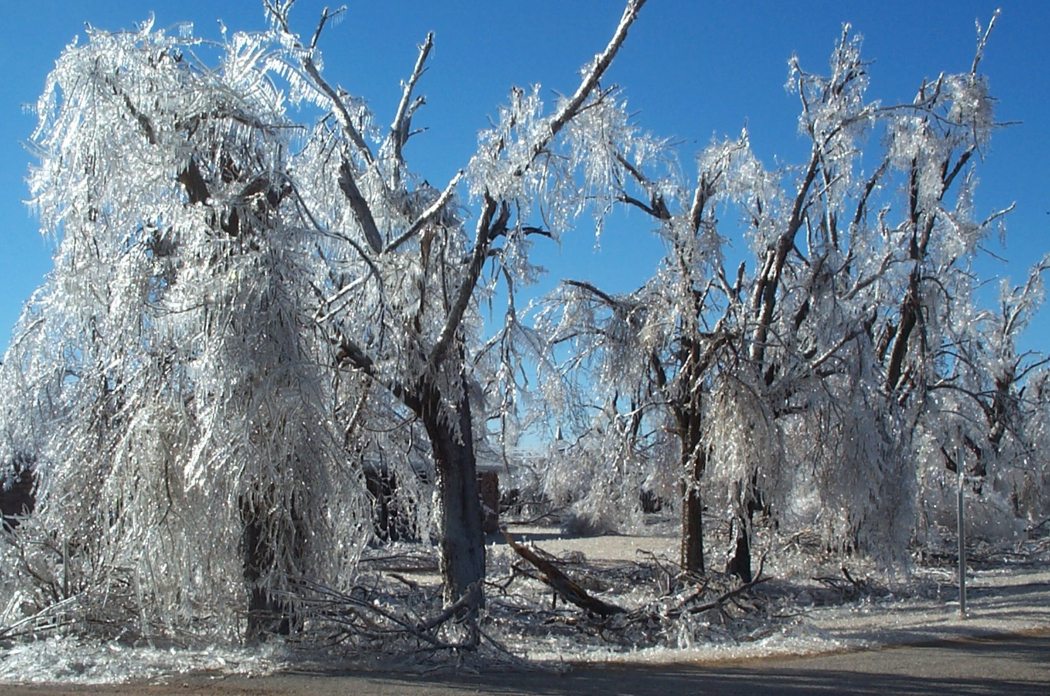
Extreme Events
Severe Thunderstorms
Tornadoes
Drought
Wildfires
Flooding
Extreme Heat
Winter Weather
Hurricanes
Notes:
These are all the different extreme events impacting weather in the Southern Plains.

Slide 5
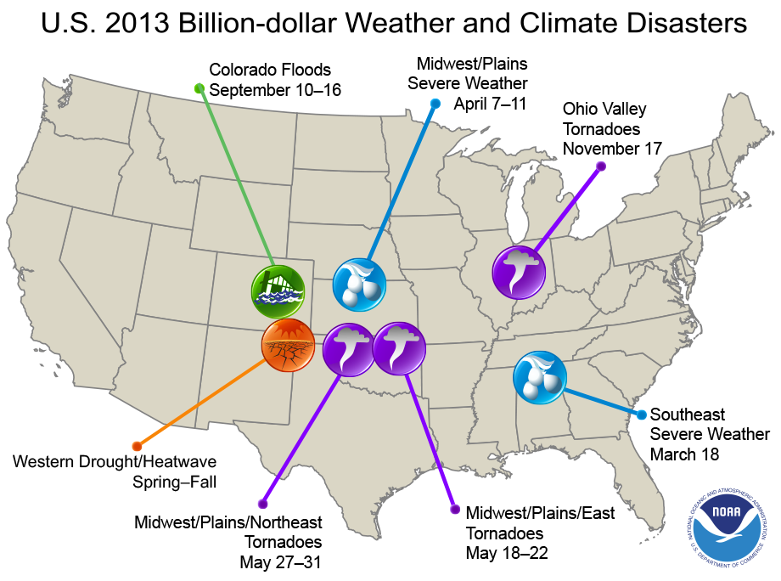
NOAA Billion-Dollar Weather and Climate Disasters
1- ?
2 - ?
3
4
5 - ?
6 - ?
7
8
9 - ?
10 - ?
Notes:
Another way of representing significant economic impact of weather/climate disasters is with this billion dollar event list as identified by NOAA since 1980. Through 2012 there have been 144 events with losses totaling 1B or more since 1980.
We’ll use this list to guide our talk today. First, what type of event do you think would occupy spots 1,2,5,6,9,10 on this list of most costly since 1980? Which event is the #1 costliest?
Hint: It’s not on this map!

Slide 6
NOAA Billion-Dollar Disasters
1- Hurricane Katrina 2005 $125B
2 – Sandy 2012 $65B
3
4
5 – Hurricane Andrew 1992 $27B
6 – Hurricane Ike 2008 $27B
7
8
9 – Hurricane Wilma 2005 $16B
10 – Hurricane Rita 2005 $16B
Notes:
These estimated costs are the value from the year the disaster occurred.
Inflation does have an impact, for example on the list Hurricane Andrew is qualified as costing $44.8 Billion in 2013 dollars based on the Consumer Price Index (CPI)

Slide 7
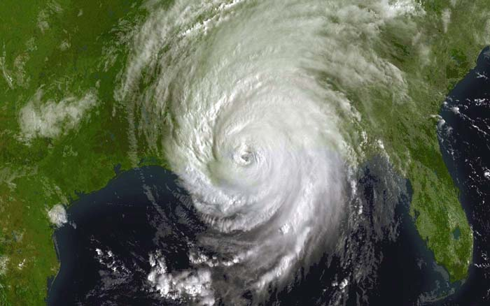
Notes:
Let’s talk about Katrina for a minute… it was the deadliest US storm since 1928 and the costliest on record. What was its category at landfall?
Cat 3
Where did the eye make landfall?
Buras, Louisiana way out along the Mississippi river delta. But the land that’s there was surely underwater at the time. Its second and true landfall was near the LA/MS border.
And where along the coast was the highest storm surge?
Mississippi--- Due to the size of the storm and local geography it came with an astonishing storm surge of 25-28 feet along the Mississippi Gulf Coast.
10-19 feet across parts of New Orleans, despite only Cat 1- Cat 2 winds over the city.
The point is that even though Katrina was an extremely devastating, and thankfully a relatively rare hurricane, it was not a direct hit to New Orleans or even the strongest of storms overall. But it did have an atypically high surge.

Slide 8
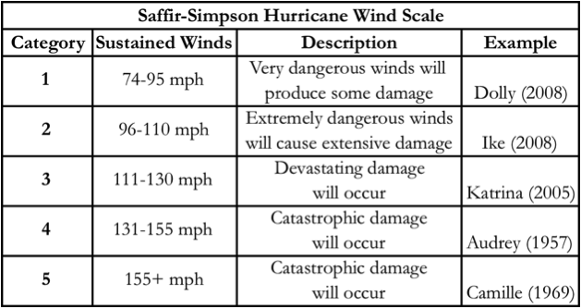
Tropical Storm: Winds 39-73mph
Tropical Depression: Winds 38mph or less
Notes:
In Oklahoma it’s really just tropical cyclone remnants that can sometimes impact us, usually bringing beneficial rain but sometimes flooding.
Though sometimes the flooding can bring very significant impacts.

Slide 9
Katrina: A Cascading Catastrophe
Victims of the hurricane were subject to 3 disasters:
1. The hurricane.
2. Flooding from levee failure.
3. The breakdown in emergency response.
Goal: Through proper planning and mitigation can we ensure that the next environmental disaster does not also become a social catastrophe.
Notes:
A little more about Hurricane Katrina.

Slide 10
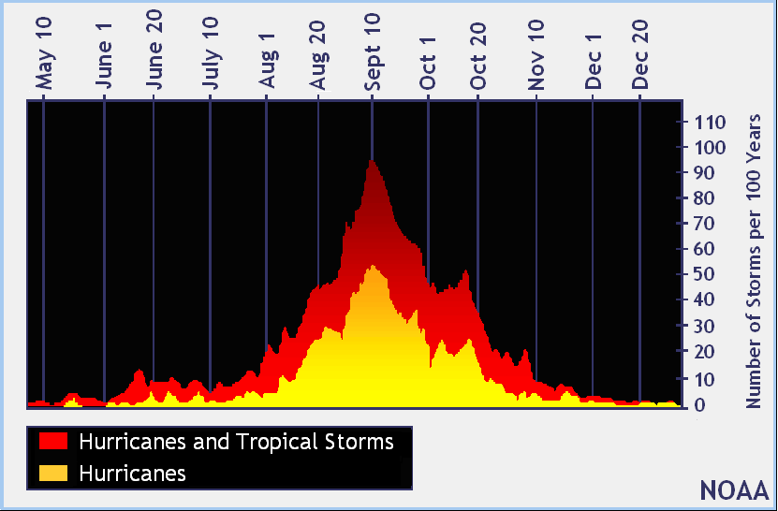
Notes:
This chart shows the hurricane climatology for the Atlantic basin: The number of storms per calendar day in the Atlantic Basin from the National Hurricane Center.
Officially, hurricane season is June 1 to November 30, when sea surface temperatures are warmest.

Slide 11
NOAA Billion-Dollar Disasters
1- Hurricane Katrina 2005 $125B
2 – Sandy 2012 $65B
3 - ?
4 - ?
5 – Hurricane Andrew 1992 $27B
6 – Hurricane Ike 2008 $27B
7
8 - ?
9 – Hurricane Wilma 2005 $16B
10 – Hurricane Rita 2005 $16B
Notes:
Let’s get back to our list and more Oklahoma-centric… spots 3, 4 and 8 are the same type of disaster. What could this one be?
Hint: It hits agriculture especially hard.

Slide 12
NOAA Billion-Dollar Disasters
1- Hurricane Katrina 2005 $125B
2 – Sandy 2012 $65B
3 – Drought 1988 $40B
4 – Drought 2012 $30B
5 – Hurricane Andrew 1992 $27B
6 – Hurricane Ike 2008 $27B
7
8 – Drought 1980 $20B
9 – Hurricane Wilma 2005 $16B
10 – Hurricane Rita 2005 $16B
Notes:
2012 is still the only year of the ongoing drought with a publicized total cost. None of the 2013 disaster totals have been released yet, they’re still working on accurately representing the damages. But the ongoing drought in the Southern Plains and western US is certainly still a billion dollar disaster this year and I expect it to appear towards the top of this list once the figures are released. Drought for example is extremely detrimental in terms of loss of ecosystem services, which can’t really be accounted for directly in cost. Ecosystem services are benefits we gain from nature like clean air to breath, clean water to drink, healthy plants to harvest, etc.
The dollar totals are quoted in terms of the year the event occurred. The 1988 drought for example is cited at $78.8 billion 2013 cost adjusted value

Slide 13
Drought
A normal and recurrent feature of our climate, which consists of a deficiency in precipitation over an extended period of time.
Meteorological Drought - below normal precipitation
Agricultural Drought - low soil moisture affects vegetation health
Hydrologic Drought - runoff and streamflow in watersheds and rivers greatly reduced
Socioeconomic Drought - a disparity between the supply and demand for water
Notes:
Drought has a multi-faceted definition.
Meteorological: Still, what’s below normal? In some marginal rainfall climates year-to-year variability is the name of the game to it’s really hard to uniformly say what’s below normal. (Like…. Western Oklahoma and Texas!)
Agricultural: When there’s no rain when plants are dormant, it’s not really a bad agricultural drought. Though only slightly less rain during a key stage of crop growth could be really bad.
Hydrologic drought: usually occurs more slowly, can impact downstream areas. Think mountain snowmelt.
Socioecomic drought: For example places like Las Vegas and southern California exist in a socioeconomic drought. The water utilities must go to great lengths to supply water for the population and support tourism. A simplified example might be when there is an Oklahoma Sooners football game happening in Norman, OK during a time of water stress or maybe even just a water main break.

Slide 14
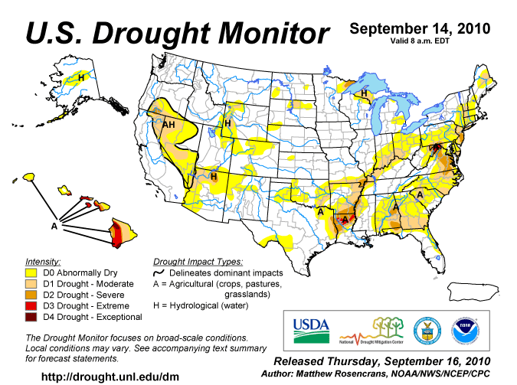
Notes:
Let’s take a brief walk through U.S. drought the past 3 years…
This is the US drought monitor, updated weekly and available online. You can get much more geographically specific by clicking on the map on the website. (Note: This tool is listed on the Climate Tools & Data handout).
September 2010 was before the current drought in the Southern Plains began. October 2010 in the high plains is when we started to observe rainfall departures

Slide 15
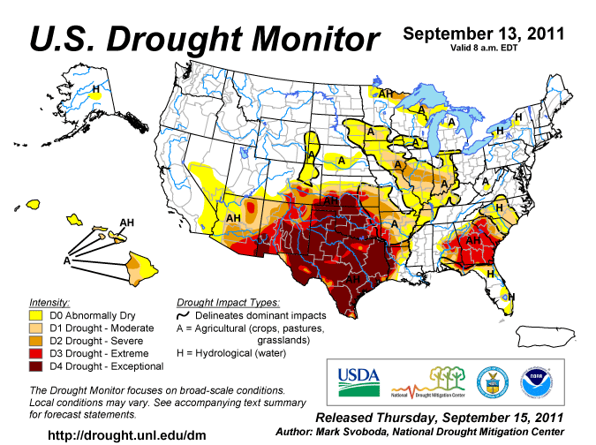
Notes:
The flash drought and heat during the summer of 2011 took over the Southern Plains with exceptional drought conditions

Slide 16
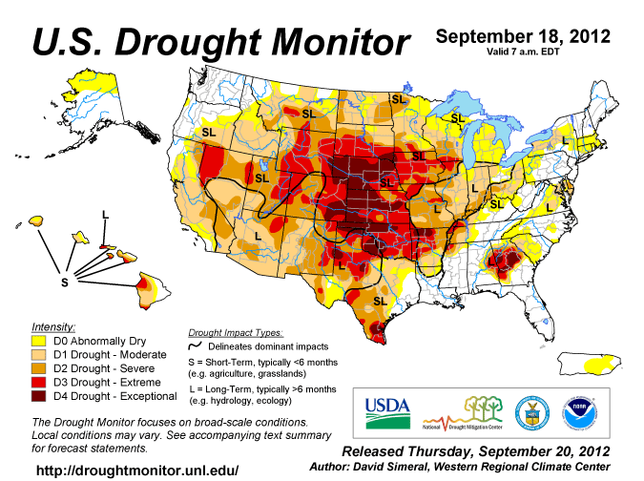
Notes:
During 2012 drought in the southern plains continued, but the epicenter shifted to the north a bit

Slide 17
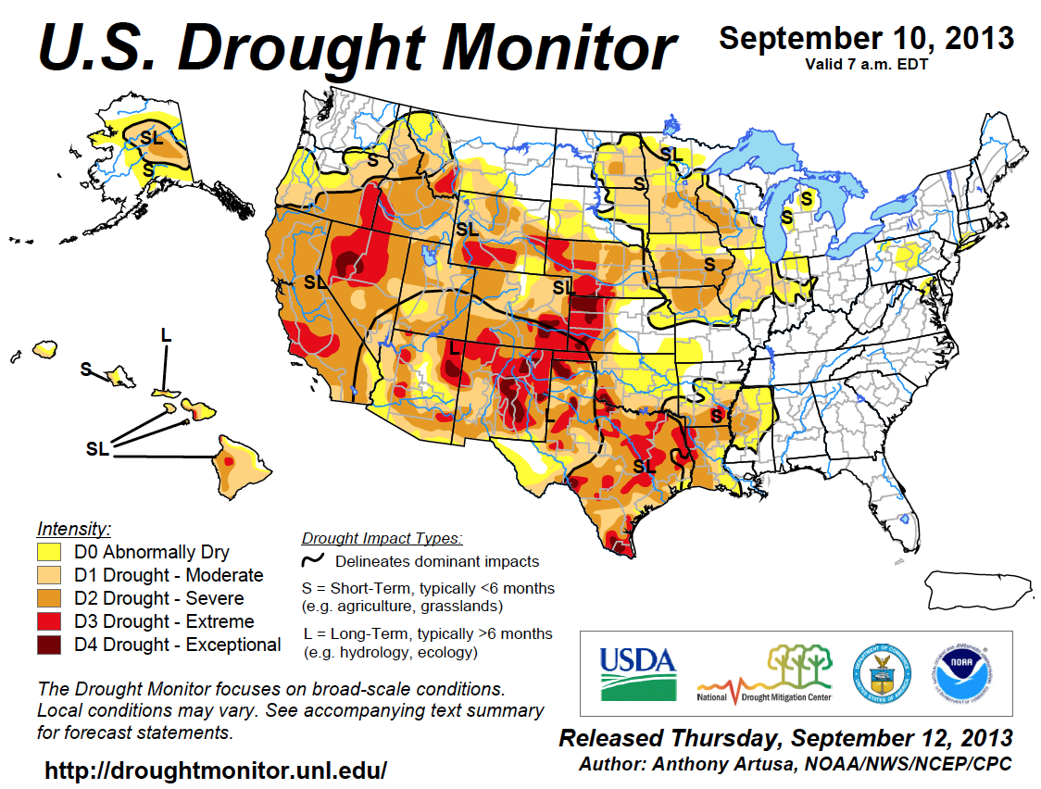
Notes:
2013 was the year the drought began migrating west, but note that areas of the southern plains remained entrenched in drought

Slide 18
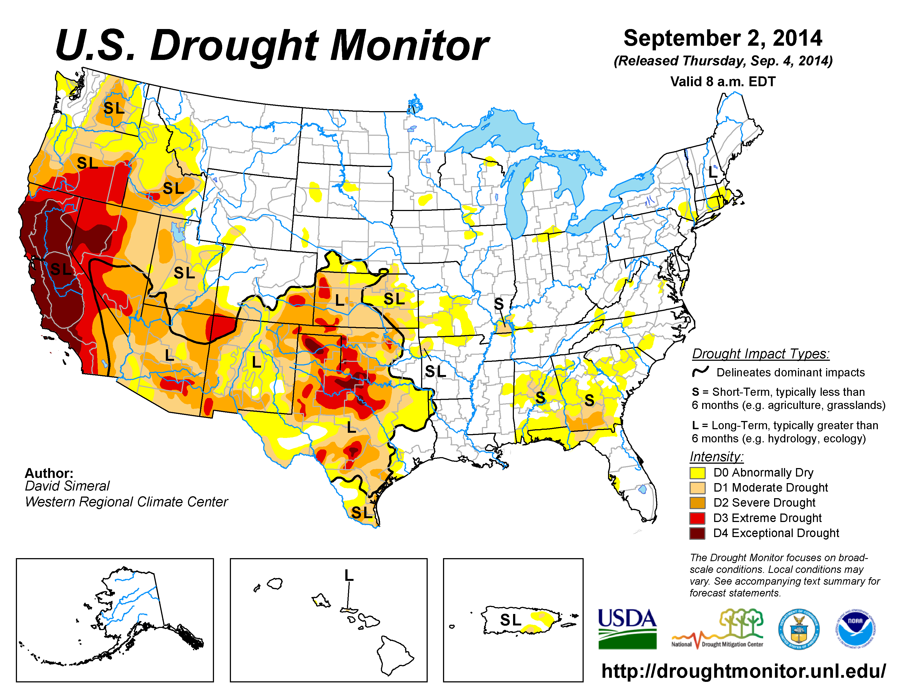
Notes:
In 2014 the western water crisis and drought in California has really grabbed the nation’s attention.
In the Southern Plains, despite recent rainfall, long term drought impacts from the past 3 and a half to 4 years remain.

Slide 19
Some Drought Impacts of 2011, 2012, & 2013
Reduced cattle herds due to poor grassland pasture conditions
During the 2011 summer 45 inches of water was required to raise a corn crop on the high plains (normally about 30 inches)
During 2011 TX fires burned total area the size of CT, RI, NYC combined
Extreme heat- OK summer 2011 hottest of any state on record
In Sept 2012 San Angelo, TX city officials said the community was within a few months of running out of water before relief from a big rain
In 2012 OK had 24 lakes with harmful blue green algae blooms
In 2013 municipal water quality and quantity threatened: Canton Lake and Oklahoma City, Wichita Falls
Reservoirs, especially out west are still low (Lake Altus at 12% capacity)
Notes:
Cattle: very low grass yield, even native grasses were dying
Corn: due to extremely high ET from heat, note that even the normal 30 inches is not sustainable for the high plains climate in the OK and TX panhandles and requires irrigation from the Ogalla Aquifer
Fire: that includes the Bastrop fire complex, the most destructive in TX history
Heat: TX broke its state record for hottest summer in 2011 as well
Algae: way above typically observed conditions
This year there are still areas dealing with exceptional drought impacts, as we just saw on the drought monitor map

Slide 20
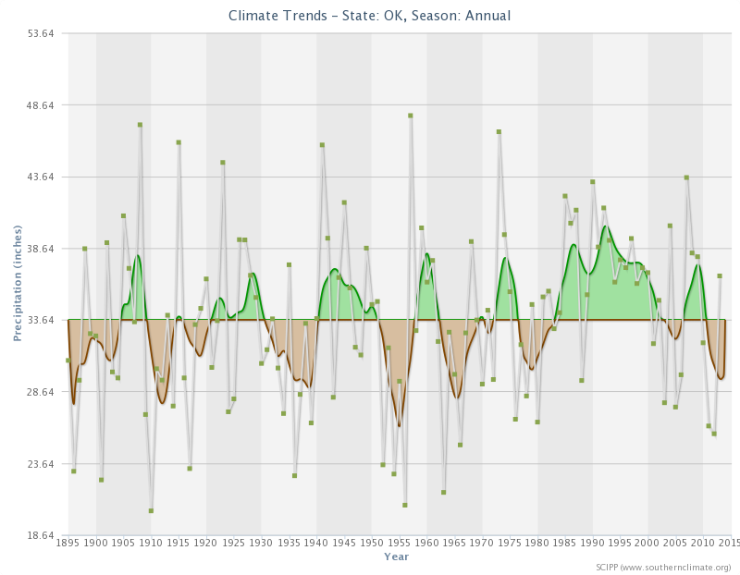
Notes:
This chart depicts the great droughts in Oklahoma since 1895. You’ll notice the periods that really stand out are the 1930s and 1950s. Look at the dry years of 2011 and 2012 back to back, even compared to other drought periods.
The 2011-2012 drought was more intense than even the dust bowl, but the dust bowl lasted longer… so far
Prior to the onset of the current drought, we had been in an approximately 30 year wet period. So we became accustomed to above normal precipitation and suffered drought memory loss.

Slide 21
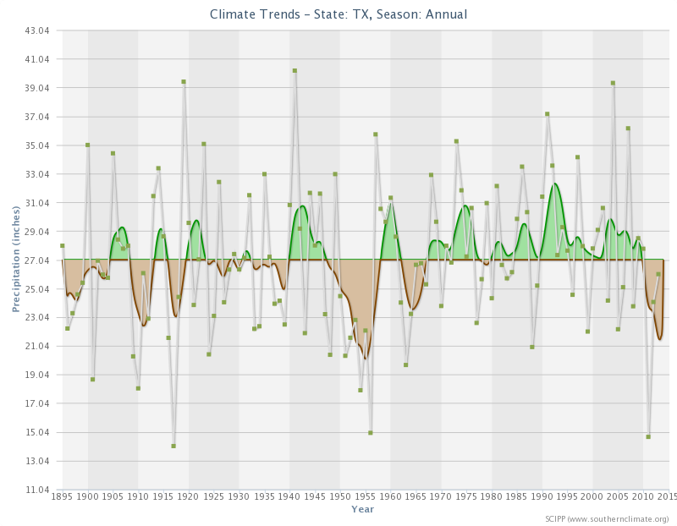
Notes:
A similar situation has occurred in the records for the state of Texas.

Slide 22
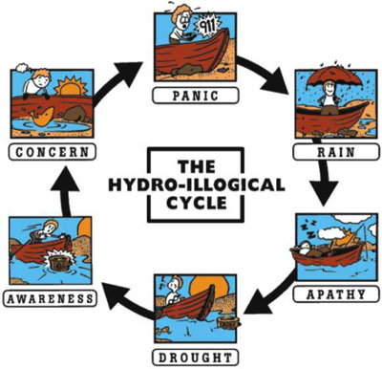
Notes:
The advance and retreat of drought can lead to what the National Drought Mitigation Center calls the Hydro-Illogical Cycle. It’s meant to convey that we should be sure to learn from past drought experiences and be responsible with water resources in anticipation of the next drought.
Drought is a creeping hazard and the onset can be very subtle, so sometimes impacts aren’t realized until drought has set in. So water conservation and responsible management is always a good idea.

Slide 23
NOAA Billion-Dollar Disasters
1- Hurricane Katrina 2005 $125B
2 – Sandy 2012 $65B
3 – Drought 1988 $40B
4 – Drought 2012 $30B
5 – Hurricane Andrew 1992 $27B
6 – Hurricane Ike 2008 $27B
7 - ?
8 – Drought 1980 $20B
9 – Hurricane Wilma 2005 $16B
10 – Hurricane Rita 2005 $16B
Notes:
Back to our list one last time. What type of event is sitting at #7? Can you think of the event itself?

Slide 24
NOAA Billion-Dollar Disasters
1- Hurricane Katrina 2005 $125B
2 – Sandy 2012 $65B
3 – Drought 1988 $40B
4 – Drought 2012 $30B
5 – Hurricane Andrew 1992 $27B
6 – Hurricane Ike 2008 $27B
7 – Midwest Flooding 1993 $21B
8 – Drought 1980 $20B
9 – Hurricane Wilma 2005 $16B
10 – Hurricane Rita 2005 $16B

Slide 25
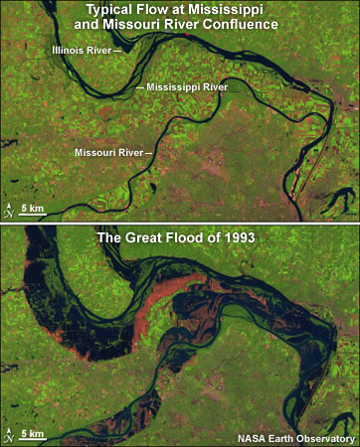
The Great Flood of 1993
Interruption of rail, highway, and river transportation.
Displacement of low income residents.
Levees and natural flood plain.
Notes:
A false color enhanced satellite image of the typical size of the Mississippi and Missouri River confluence compared to during the Great Flood of 1993 (NASA Earth Observatory)
The rivers at their confluence, normally under a mile wide, expanded to 20 miles.
The water from both rivers bottlenecked at St. Louis and during the height of the flood a flow rate of 1.08 million cubic feet of water per second passed in front of the city. That is enough water to fill the current Dallas Cowboy Stadium every 96 seconds.
In south St. Louis it was low income neighborhoods that were in flood prone areas along a tributary and flooded out.
Much like maintaining coastal wetland works to reduce hurricane flooding, allowing rivers to claim their natural floodplain can reduce impacts.
Levees prevent a river from filling a natural flood plain, forcing higher crests. In a dramatic example a major levee was breeched on the Missouri River in St. Louis County just two days before the crest along downtown St. Louis. Before the breech the river was expected to match the top of the flood wall along the south side, surely causing it to fail. But the crest was about a foot lower due to the breech upstream.

Slide 26
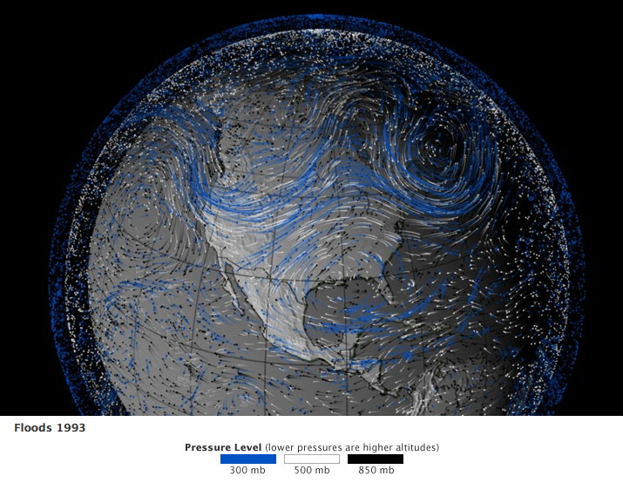
NASA Earth Observing System reanalysis
Notes:
Impressive climate set up for the flooding. Low level moisture from the gulf and an active upper level jet stream.
The arrows represent the average wind speed and direction aloft from May – July 1993.
You can also see the 850mb flow from the Gulf of Mexico, and upper level winds show the jet stream… the storm track

Slide 27
Flooding
On average over the past 30 years in the US flooding results in about $8.17 billion in damages and 89 deaths per year.
In a given year 40-50% of deaths are vehicle related, from people driving through flood waters.
Contributing factors: antecedent conditions, precipitation rate, topography, shape of watershed, soil type, impermeable surfaces, urbanization.
Notes:
Nationwide stats.

Slide 28
Some Oklahoma Flood Events
Tulsa Flash Flood May 26-27, 1984
During Memorial Day weekend up to 15 inches of rain resulted in the worst flash flood in Tulsa history.
Flooding left 14 people dead, and damaged or destroyed 5,500 homes and over 7,000 vehicles.
Summer of 2007
Oklahoma’s wettest June on record led to river flooding in July, Lake Texoma overtopped the spillway, and remnants of tropical storm Erin alone resulted in 6 deaths and $4 million in damage.
Oklahoma City Flash Flood May 31-June 1, 2013
During and immediately following a tornado outbreak parts of Oklahoma City received over 7 inches of rain leading to the deadliest flash flood in city history.
Flooding left 13 people dead, 12 in Oklahoma City.
Notes:
2013 OKC flash flood was the deadliest in Oklahoma since the 1984 flood in Tulsa

Slide 29
Two General Types of Flooding
River Flooding – when a river rises to its flood stage and spills over the banks. The excess water can be from persistent rainfall, rainfall far upstream, or snowmelt.
Due to slow onset and widespread nature, the primary threat is usually economic and property damage.
Flash flooding - when the precipitation rate becomes so large that local drainage cannot evacuate the runoff.
Due to quick onset, primary threat is usually human life and safety.

Slide 30
Recurrence Interval and the 100 Year Flood
The 100 year flood is a 1% probability that a flood of a certain magnitude will occur (25 year flood: once every 25 years or 4% chance in a given year).
This parameter is just based on the frequency and magnitude of prior events, so a flooding event is still equally likely to occur at any time.
Changes in land use, land cover, drainage and levees can alter areas susceptible to flooding and the levels to which they flood.
Higher intensity downpours, which is one impact from a warming climate, would also change flooding susceptibility.

Slide 31
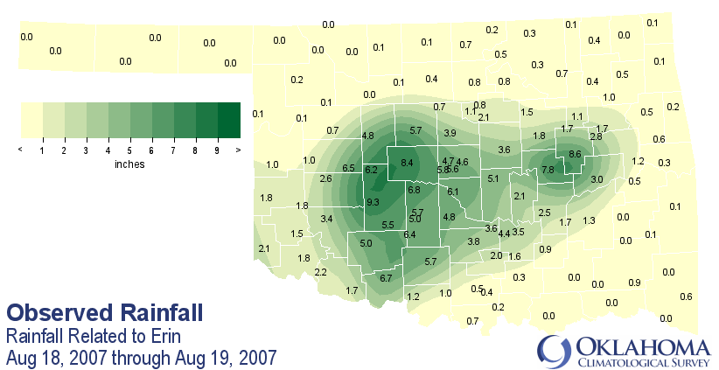
Notes:
These next couple maps give you an idea of just how spatially discontinuous precipitation can be.
This a rainfall chart from the Erin event in 2007
Note the sharp precipitation gradient in some areas.

Slide 32
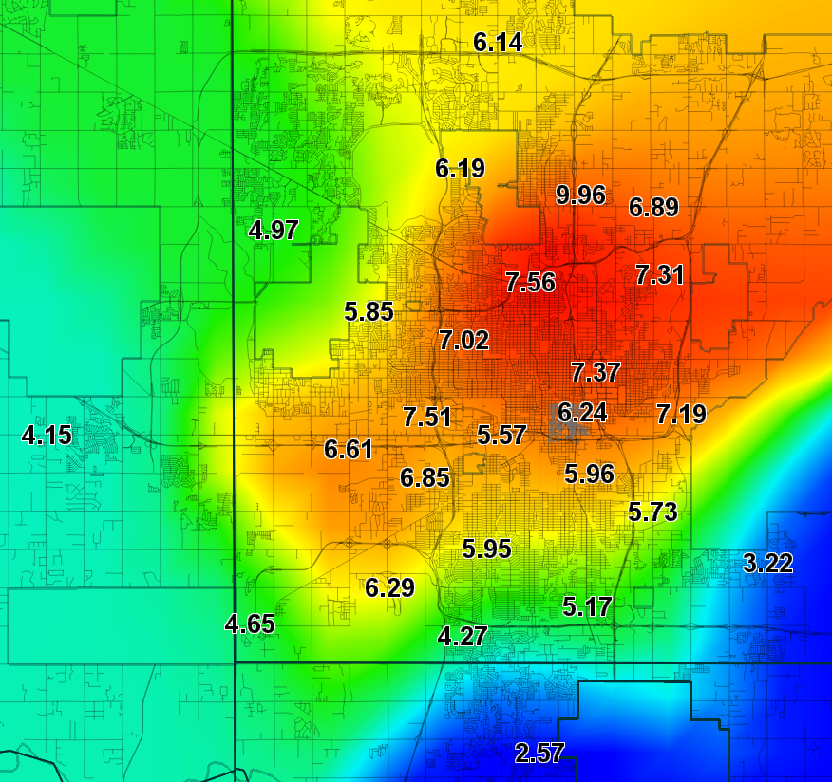
June 14, 2010 Oklahoma City 12 hour rainfall amounts
Notes:
Rainfall over a 12 hour period June 14, 2010 during the Oklahoma City flash flood.

Slide 33
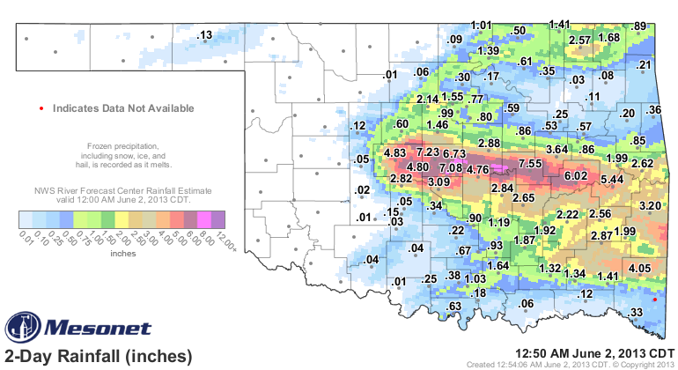
Notes:
Nearly all of this rain was May 31 – June 1, 2013
The message isn’t anything new… situational awareness and responsible flood plain management is important for reducing losses due to these events.

Slide 34
Extreme Heat

Slide 35
Extreme Heat
The National Weather Service lists heat as the #1 weather-related killer in the US, current 10 year average is 123 deaths per year.
The Centers for Disease Control cites an average of over 600 deaths per year as associated with excessive heat .
Those most as risk include people without access to air conditioning, chronically ill, elderly, very young, socially isolated and disabled.
Effects are enhanced in urban areas due to the heat island.
Asphalt and concrete effectively absorb and retain heat, preventing cities to cool down as much at overnight.
A Chicago area heat wave in July 1995 killed more than 700 people.
Compared to other weather events, a heat wave onset can be subtle.
Notes:
Fortunately, several health studies indicate that monitoring and assisting those at risk really can reduce lives lost! Cooling centers, neighborhood checks, utility bill relief, and PR campaigns for heat awareness really help.

Slide 36
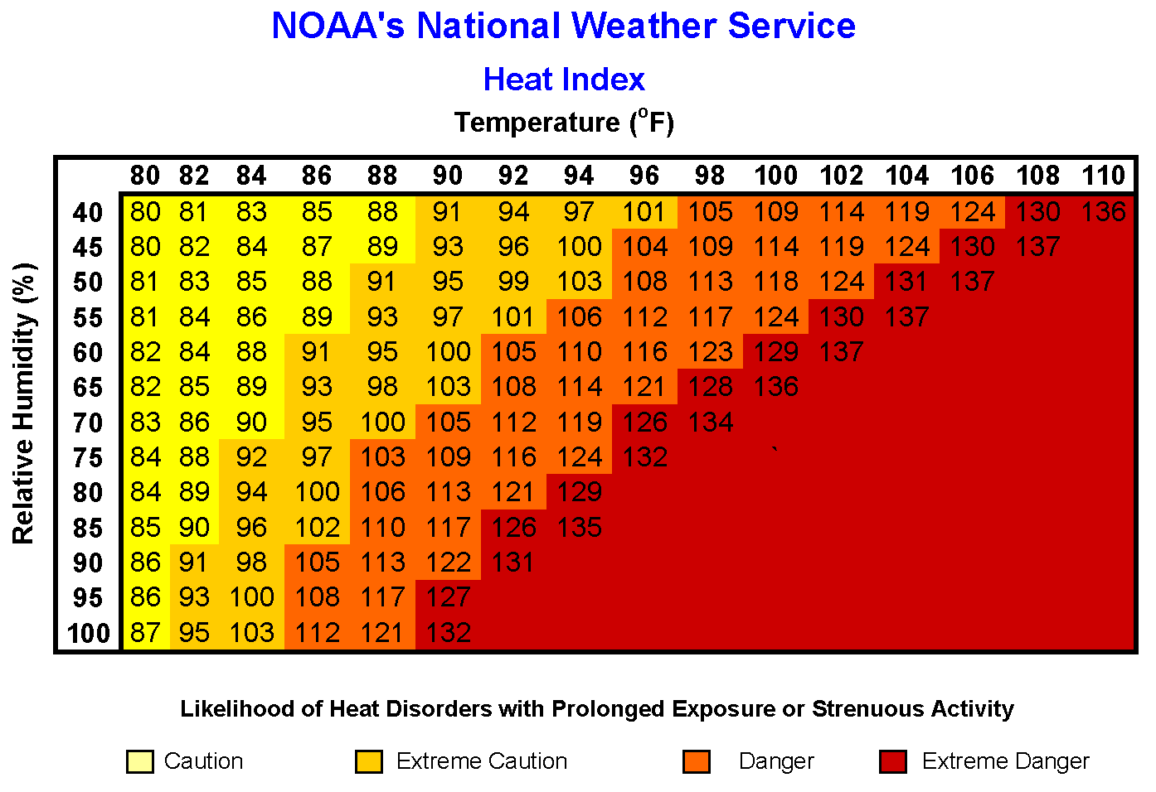
Extreme Heat
Atmospheric moisture contributes greatly to human heat stress.
Heat index- A measure of the apparent temperature the human body experiences due to high humidity and lack of cooling by evaporation.
Notes:
Keep in mind the air temperature and heat index values are always measured in the shade!

Slide 37
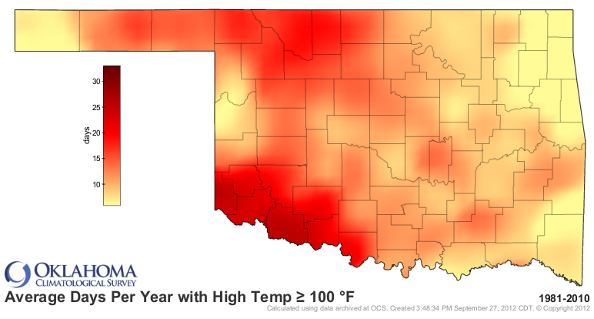
Extreme Heat
Notes:
Generally western Oklahoma, especially in the southwest, observes more days above 100 than eastern Oklahoma.

Slide 38
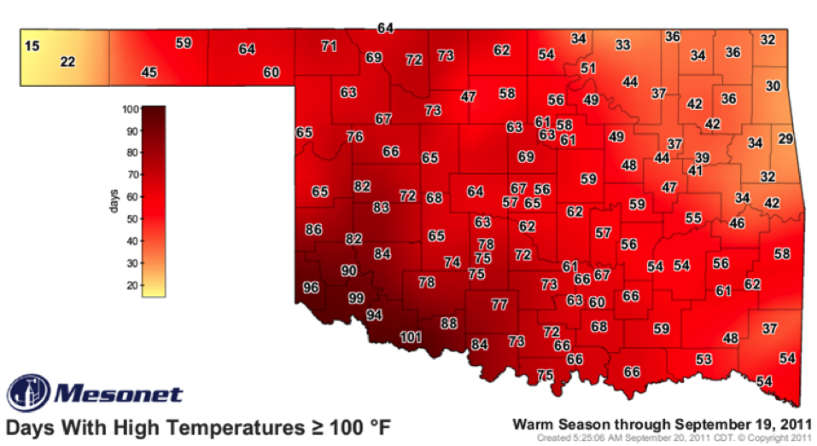
Extreme Heat
Notes:
And now let’s look back at the summer of 2011, when average was irrelevant.

Slide 39
Extreme Heat
Oklahoma has the record for hottest month of any state (since 1895) with a statewide average during July 2011 of 89.1 ºF.
The hottest Oklahoma summer on record was 2011 with a statewide average of 86.8 ºF.
The state record of 120 ºF has been reached six times (four times in 1936, once in 1943 and once in 1994).
Hot summers with long durations above 100 ºF often occur during droughts, but extreme heat is still dangerous with high humidity and temperatures in the 90s as demonstrated by the heat index.
Notes:
Summer heat waves, extreme temperatures and their impacts have a storied history in Oklahoma, as demonstrated by the state records.

Slide 40
Wildfires

Slide 41
Wildfire
Key ingredients: Low humidity, relatively high temperatures, moderate to strong winds, and dry fuels (leaves, twigs, vegetation).
Wildfire conditions can develop quickly any time of the year, though the majority of wildfires in Oklahoma occur in the late fall through winter into early spring. This coincides with dormant vegetation and the dry season.
The urban-wildland interface, where human structures and development meet and intermingle with undeveloped wildlands, is particularly susceptible to wildfires.

Slide 42
Wildfire
In May 2014 a wildfire near Guthrie spread quickly in windy and hot conditions before firefighters got it under control. It burned over 3,500 acres and 30 structures.
Drought conditions in August 2012 led to wildfires in Oklahoma, destroying 603 homes and burning more than 58,500 acres.
During the 2005-2006 winter season in Oklahoma, wildfires were especially destructive with about 2,800 fires resulting in nearly 700 damaged homes and over 550,000 acres burned.

Slide 43
Winter Weather

Slide 44
Winter Weather
All winter storms are similar to regular storms but in a cold environment.
Winter weather can cause disruption to travel and damage to infrastructure due to snow or ice.
While blizzards are relatively rare in Oklahoma, they occur when falling snow combines with high winds to reduce visibility to near zero.
Ice storms cause the most damage, toppling power lines and vegetation.
Most fatalities associated with winter weather are due to traffic accidents.
Notes:
Regular tree trimming around power lines can help reduce damage from an ice storm.

Slide 45
Winter Weather
Since 2000 a series of major ice storms have plagued Oklahoma winters.
The December 2007 ice storm brought up to 4 inches of precipitation across both the Oklahoma City and Tulsa metro areas, causing the largest power outage in state history.
About 700,000 customers were left without power (the actual number of people without power much larger).
There are two waves of impact during an ice storm for electric utilities; first from the initial ice accumulation and wind stress, then later from the rapid recoil of lines as ice melts and falls.

Slide 46
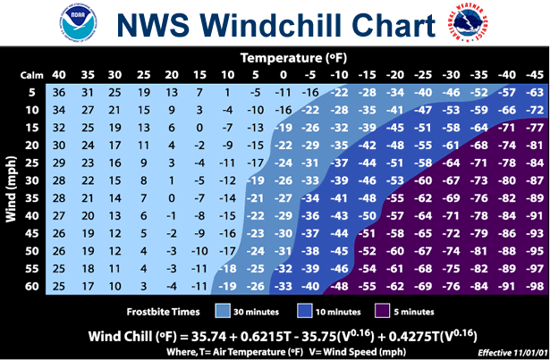
Winter Weather
Wind chill- the apparent temperature experienced on exposed skin due to heat loss from wind.

Slide 47
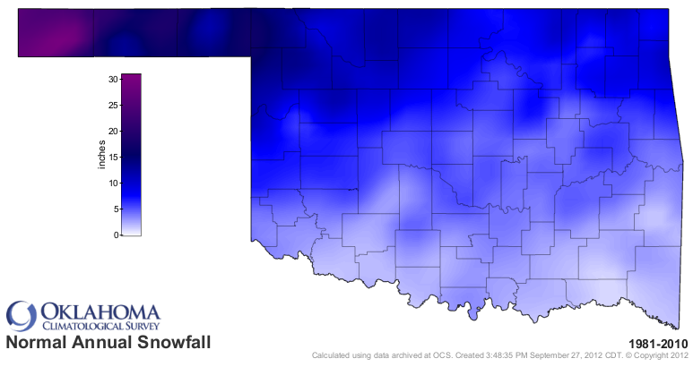
Winter Weather
Notes:
The gradient of average snowfall across Oklahoma increases from less than two inches in the extreme southeast to 30 inches in the western panhandle. The frequency of snow events increases along the same gradient.

Slide 48
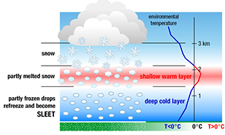
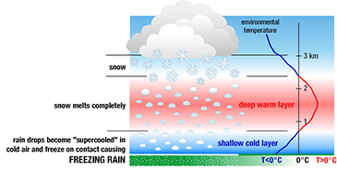
Winter Weather
Precipitation falls as snow when the temperature is below freezing from the cloud to the ground.
Sleet occurs when snowflakes melt as they fall, then refreeze before reaching the ground.
Freezing rain occurs when snowflakes melt completely before reaching the surface, then fall through a shallow cold layer and refreeze upon contact with anything below freezing.

Slide 49
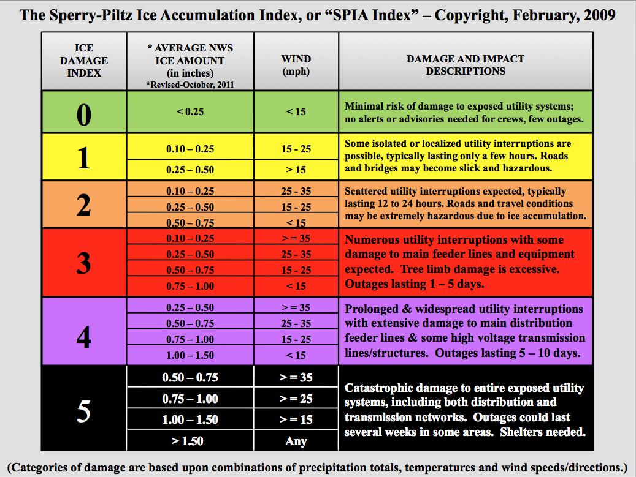
Winter Weather
Notes:
An index scale used by the utility industry to anticipate impact and damage of an icing event to transmission lines is the Sperry-Piltz Ice Accumulation Index. As a tool for risk management and winter weather preparedness, the index uses NWS forecast parameters to predict the spatial coverage, total ice accumulation, and potential damage from ice storms.

Slide 50
Tornadoes and Severe Weather

Slide 51
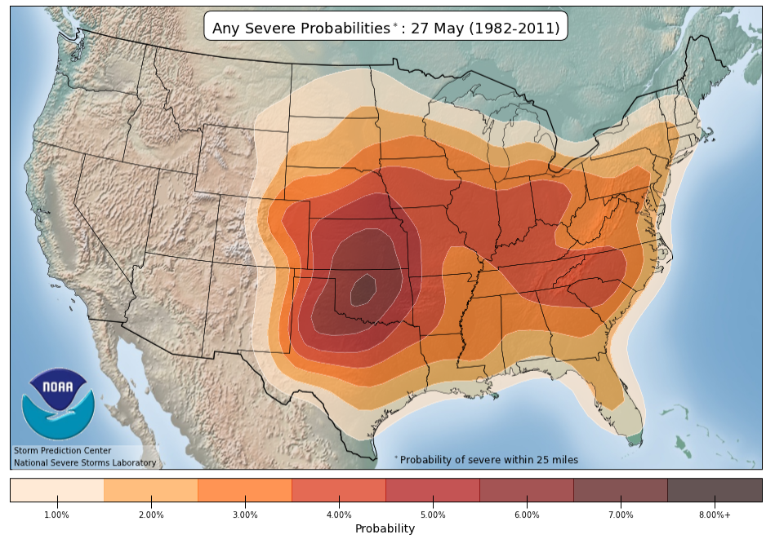
Severe Weather Climatology
Notes:
This is the weighted 15 day severe weather probability for the end of May for a given year. What this map shows really well is the peak of Oklahoma’s climatological storm season at the end of May. As you can see the best chance for severe weather anywhere in the county at the end of May is across the southern plains, specifically Oklahoma. That’s of course why our part of the county is called tornado alley. The highest probabilities do shift though, further south earlier in the spring, and the threat shifts to the north later in the summer.

Slide 52
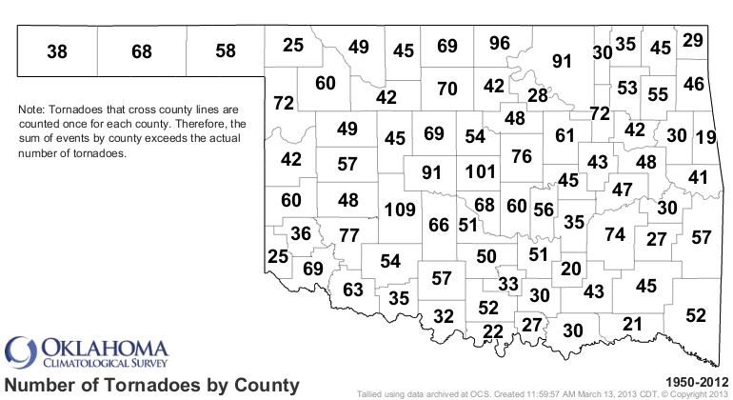
Tornado Climatology
Notes:
You can see the number of tornadoes for each Oklahoma county since 1950 here. County size and population density has some effect… Osage county has a high number since it’s so large, so do Oklahoma and Tulsa counties… in more rural areas a weak tornado might go unreported if there is no obvious damage.

Slide 53
Tornado Climatology
Notes:
In Oklahoma by far most of our tornadoes occur in May, with the general tornado season March through June. There is only one May on record – in 2005 when Oklahoma didn’t have any tornadoes. This chart represents another reason why the southern plains is termed tornado alley… our seasonal peak during the month of May is really high compared to the rest of the year.

Slide 54
Tornado Climatology
The most Oklahoma tornadoes in one year was 145 in 1999.
The fewest Oklahoma tornadoes in one year was 17 in 1988.
May 2005 was the only May since 1950 with no tornadoes in Oklahoma.
The most May Oklahoma tornadoes was 91 in 2010.
Since 1950 Oklahoma has had 65 violent tornadoes (F/EF 4 or 5).
Violent tornadoes have occurred in every month except July, August and December.
Notes:
Here’s a list of some interesting tornado stats for Oklahoma…
The F scale is the Fujita scale, which rates the intensity of a tornado’s wind speeds from F0 to F5 based on the damage that occurred. A few years ago scientists updated the correlation of wind speed to damage indications and that’s why we call it the EF scale or enhanced fujita scale now.
Those months have still had tornadoes occur, just not yet any EF 4 or 5 rating.

Slide 55
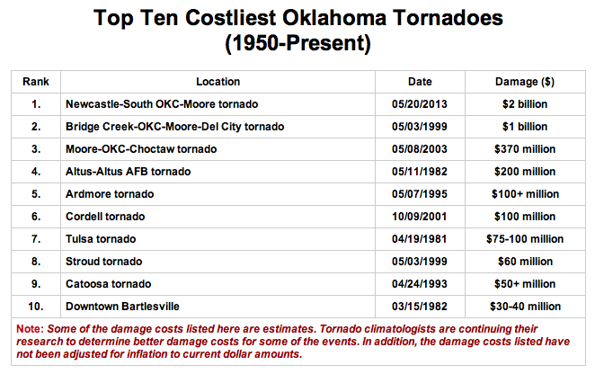
Tornado Climatology
Notes:
Here’s a list of our top 10 costliest tornadoes in Oklahoma. You’re notice that most of these are pretty recent. Like I talked about earlier, larger towns and more buildings lead to more property damage from a tornado.
Not posted here, but of the top 10 deadliest tornadoes in Oklahoma, all were historical events prior to 1950 with the exception of May 3, 1999 (36 deaths, #6 on list) and May 20, 2013 (24 deaths, #9 on list). Oklahoma’s deadliest tornado was the April 9, 1947 Woodward tornado that occurred after dark and killed 116.
In general far less people are killed from tornadoes now than in the past, however the threat is still there. Our worst fear as meteorologists is a tornado threat at a large event like an outdoor concert, festival, baseball or football game.

Slide 56
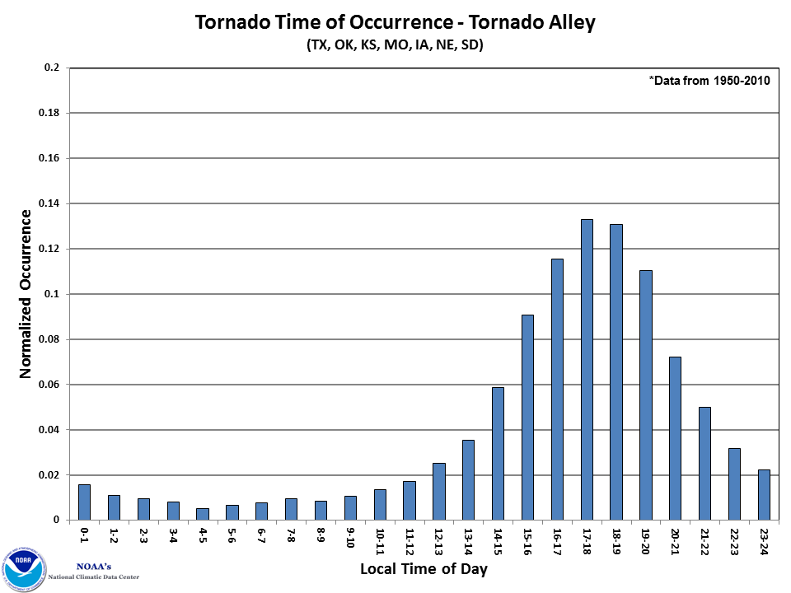
Tornado Climatology
Notes:
Here’s the time of day occurrence of tornadoes across the plains states. Note the times listed along the bottom are in military time.
As you can see really 3-8 pm is the peak-- especially for our violent tornadoes-- but they can still occur at anytime.
During some events it’s common for central Oklahoma to have the storms in the evening and for eastern Oklahoma to have them after dark as they track to the east.

Slide 57
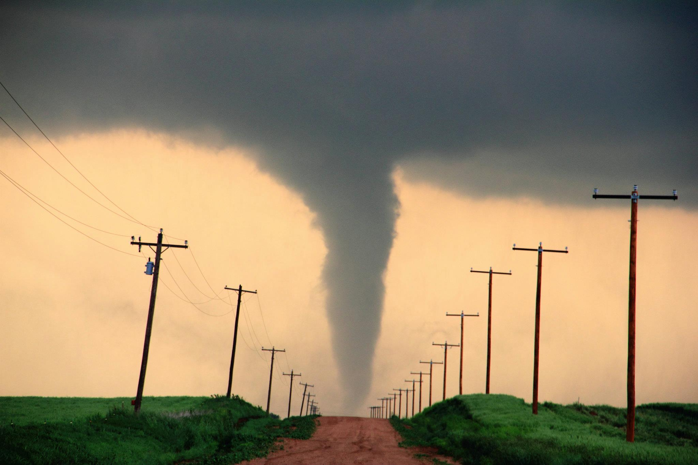
Ben Herzog
Notes:
So… what is a tornado? Are we all on the same page? Can everyone identify it on the picture?
Generally it’s pretty self explanatory what a tornado is, but sometimes visibility can be obscured.
From Northern Oklahoma April 14, 2012

Slide 58
Tornado Reminders
May last only a few seconds or over an hour.
Variety of shapes and sizes from thin ropelike circulations to large wedge shapes over a mile wide.
May move with very slow or quick forward speeds.
Generally move SW to NE in Oklahoma, but can travel in any direction.
Notes:
The circulation must be in contact with the ground for it to be a tornado.

Slide 59
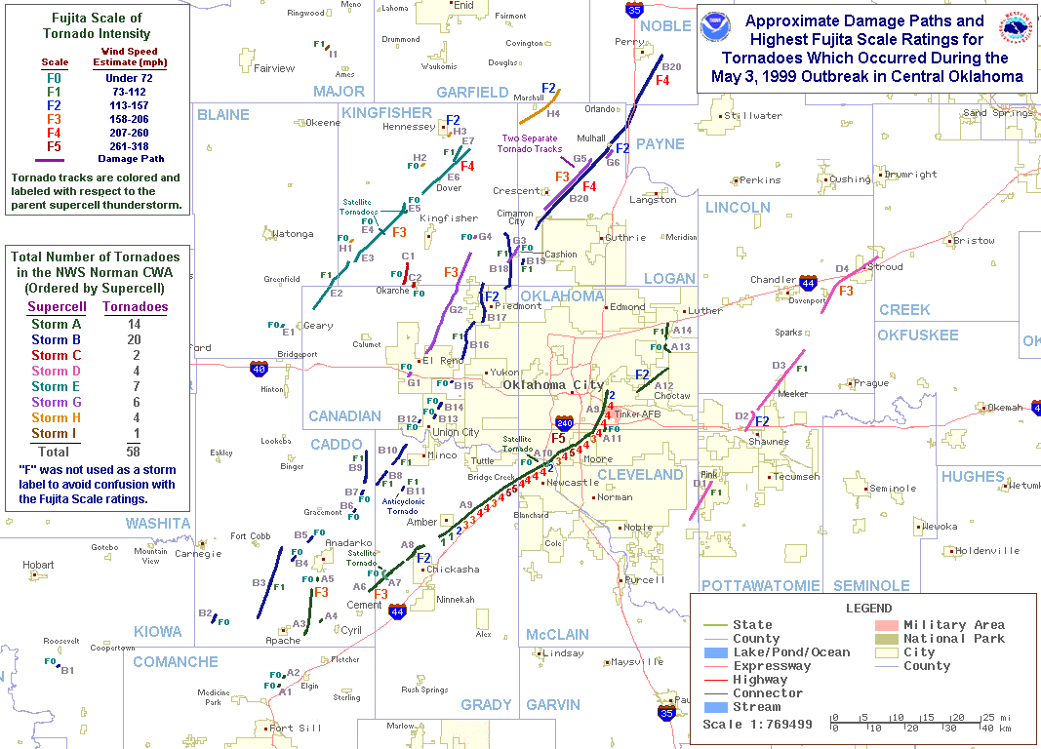
Notes:
Here’s a map of the central Oklahoma tornadoes from the May 3, 1999 outbreak and you can see most traveled generally from SW to NE

Slide 60
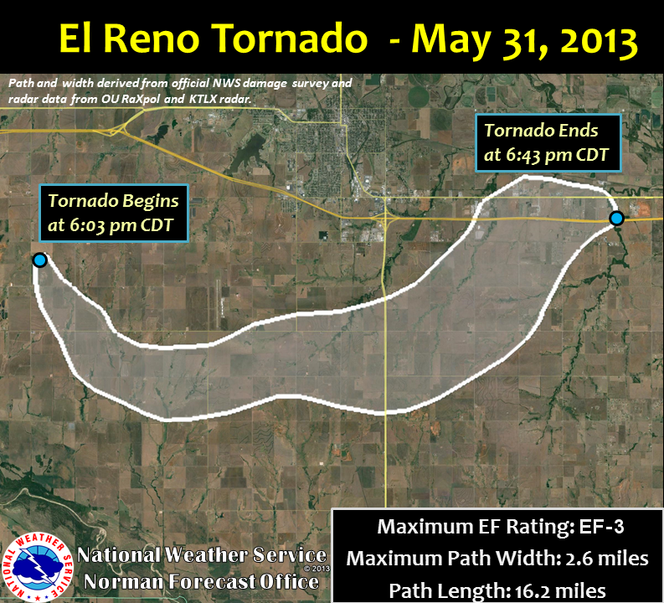
Notes:
A big recent exception was the May 31, 2013 El Reno tornado. This is a map of it’s track, it traveled in an uncharacteristic curved path first to the south, then due east, then to the north. This tornado at it’s widest point was wider than Manhattan and is the widest observed tornado on record.

Slide 61
What is a severe thunderstorm?
Specific criteria:
Hail one inch in diameter or larger
Winds of 58 mph or greater
A supercell is a rotating thunderstorm with a strong, sustained updraft. These storms produce most tornadoes.
Other thunderstorm hazards: lightning, heavy rain and low visibility.
Although dangerous and typically present, do not constitute a severe thunderstorm.
Notes:
A tornado is a type of hazard we get from a severe thunderstorm, but lets look at just what is a severe thunderstorm.

Slide 62
Severe Thunderstorm Ingredients
Shear – winds change direction and increase in speed aloft
Notes:
Let’s go thought the atmospheric conditions necessary for a severe thunderstorm.
Speed shear, on the left, is when wind increases as you go aloft. Directional shear, on the right, is when wind changes direction as you go aloft.

Slide 63
Severe Thunderstorm Ingredients
Lift – a trigger like a warm front, cold front or dryline
L
Notes:
Cold Front, Warm Front, Dry line
Tornadoes love boundaries and little warm fronts.

Slide 64
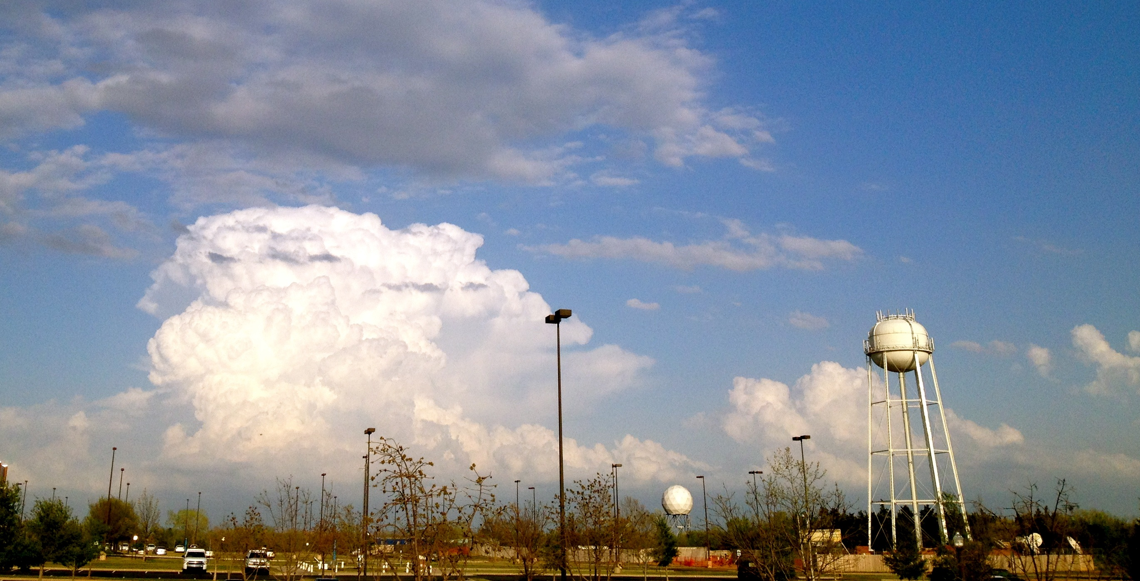
Severe Thunderstorm Ingredients
Instability – warm air at the surface, cold dry air aloft
Notes:
Here you can see some big cumulus clouds in the distance and a growing thunderstorm cloud.

Slide 65
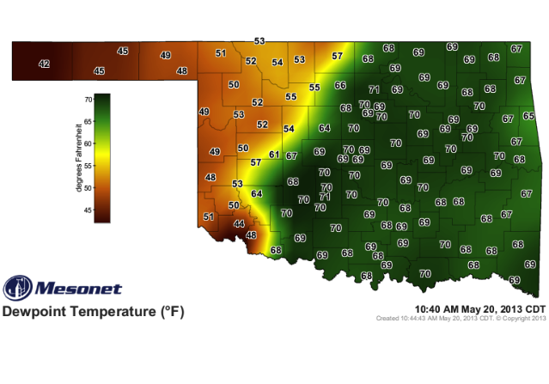
Severe Thunderstorm Ingredients
Moisture – humid air from the Gulf of Mexico (high dewpoint)
Notes:
The gradient on the map here is a dryline, and this is the dewpoint map that shows the dryline the morning of May 20, 2013. You can see that slightly darker area of high dewpoints and kink in the dryline, which is where the Moore, OK storm began to form.

Slide 66
Severe Thunderstorm Ingredients
Shear – winds change direction and increase in speed aloft
Lift – a trigger like a warm front, cold front or dryline
Instability – warm air at the surface, cold dry air aloft
Moisture – humid air from the Gulf of Mexico (high dewpoint)
Notes:
The acronym is SLIM.
Shear is the necessary ingredient for severe storms because that is what can lead to a sustained tilted updraft and the rotating supercell thunderstorms
On days where these ingredients come together just right across the southern plains, that’s when we have a severe weather outbreak.

Slide 67
Weather Organizations
National Weather Service: weather.gov
Weather forecast offices provide operational forecasts and warnings for their local area of responsibility.
Storm Prediction Center: spc.noaa.gov
Provides forecasts and watches for severe thunderstorms for the contiguous US.
Media Partners- your favorite TV weatherperson, radio, newspaper
Notes:
There are 122 local NWS offices nationwide. In Oklahoma we have two offices that cover most of the state. The eastern part of Oklahoma is the Tulsa office area of responsibility and the central and western parts of the state are the Norman office area of responsibility. The Amarillo office covers the panhandle and the Shreveport office covers McCurtain Co. All local 7 day weather forecasts and tornado or severe thunderstorm Warnings come from these offices
There is only one Storm Prediction Center and it’s at the National Weather Center in Norman, OK. Among other roles, their main responsibility is to provide forecasts and watches specifically for severe thunderstorms across the contiguous US.
And then there’s the media. TV weathercasters are critical for getting weather information out to the public and add a lot of awareness value on severe weather days. Almost all the time they are sharing the same message as from the National Weather Service.

Slide 68
Watch and Warning Statements
Severe Thunderstorm Watch: atmospheric conditions are favorable for severe thunderstorms in the watch area
Severe Thunderstorm Warning: a severe thunderstorm is imminent or already occurring as indicated either by Doppler radar or a local report
Tornado Watch: atmospheric conditions are favorable for tornadoes in the watch area
Tornado Warning: a tornado is imminent or already occurring as indicated either by Doppler radar or a report of a spotted tornado
Notes:
Watches usually last for several hours and cover several hundred square miles.
Warnings typically last for about an hour or less and covers the area about the size of a county.
Again, watches are issued by the SPC and warnings are issued by the local NWS office and are relayed through TV stations and radio.

Slide 69
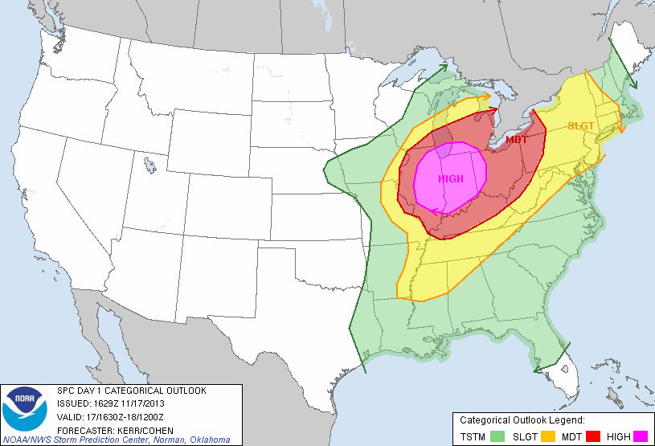
SPC Categorical Outlooks
Notes:
Here is the SPC categorical severe weather outlook from the November 17 outbreak that had the bad tornadoes in Illinois in 2013. This is an example of the Categorical outlooks product issued by the SPC

Slide 70
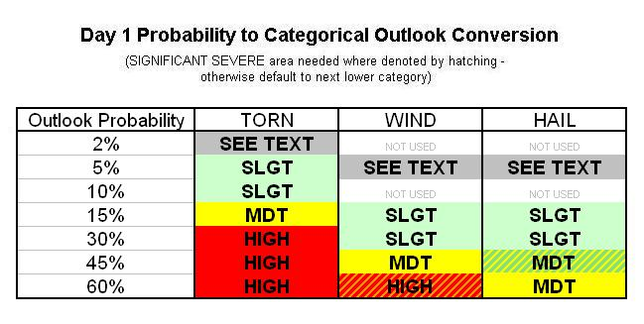
SPC Categorical Outlooks
Notes:
The different categories - slight, moderate, and high correspond with probabilities of severe weather within 25 miles of a given point.
The storm prediction center really gets busy once a severe weather threat enters the three day window. They are responsible for issuing categorical outlooks

Slide 71
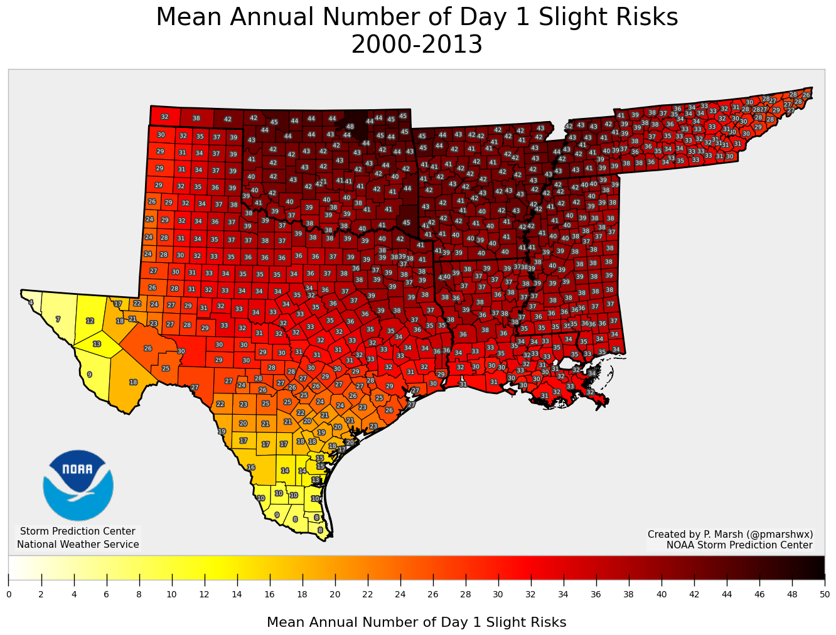
How often are we in a Slight Risk?
Notes:
So just how often are we in slight risk days from the Storm Prediction center? These are days where there is really any chance of organized severe weather. Storms still have the chance to be bad on these days, such as the Granbury tornado in north Texas in 2013. The threat on these days just isn’t all that particularly widespread spatially or has low confidence from a forecast standpoint.

Slide 72
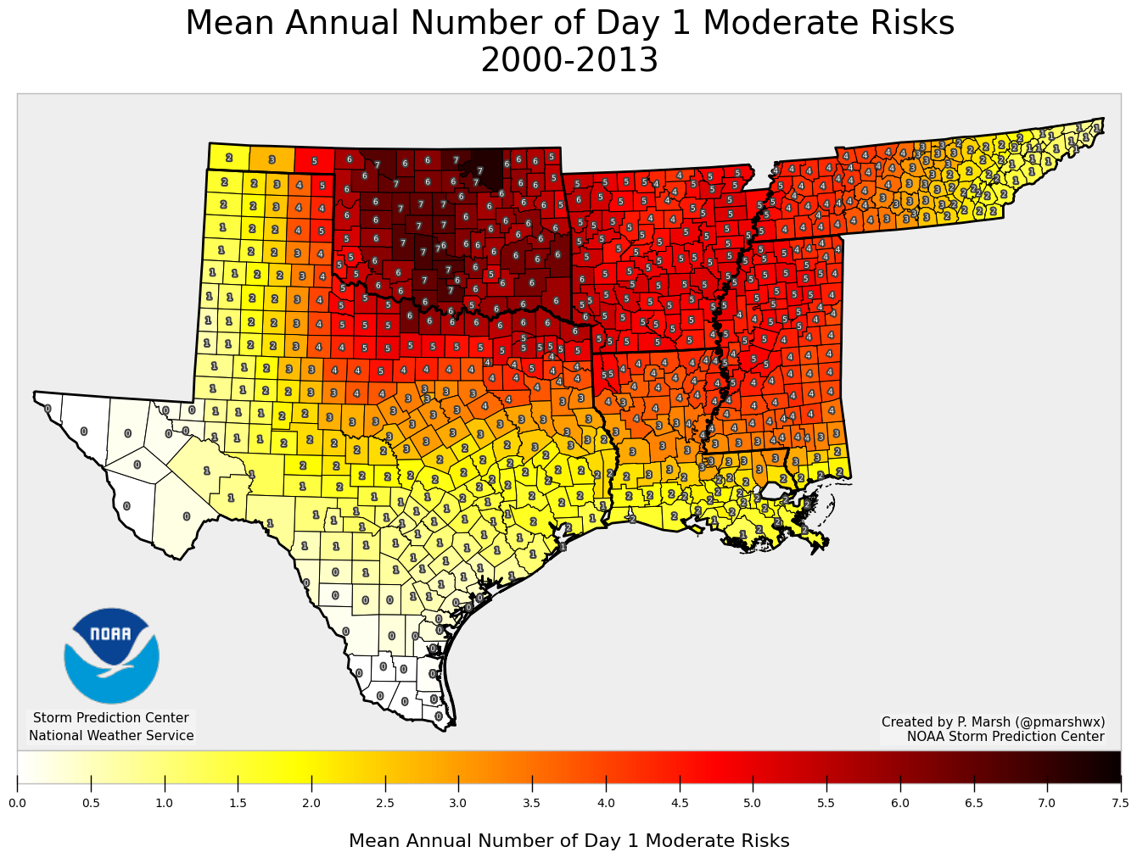
How often are we in a Moderate Risk?
Notes:
A moderate risk forecast from the SPC though means they are forecasting widespread coverage of severe storms… this is a forecast of a severe weather outbreak. And these days typically occur about 6-8 times a year in Oklahoma.
The high risk occurrence map I didn’t include here, but that’s about once per year. Really the main difference between a moderate and high risk is that there is even more confidence by the forecasters in the outbreak and even more anticipated spatial coverage of the storms.

Slide 73
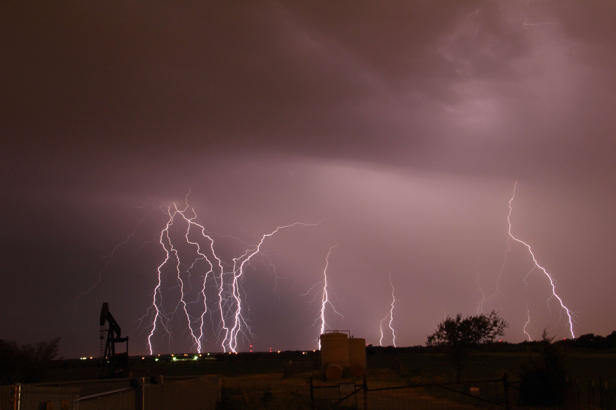
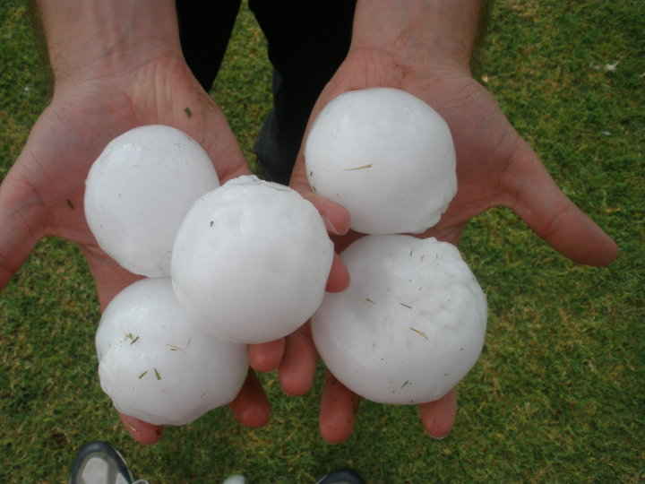
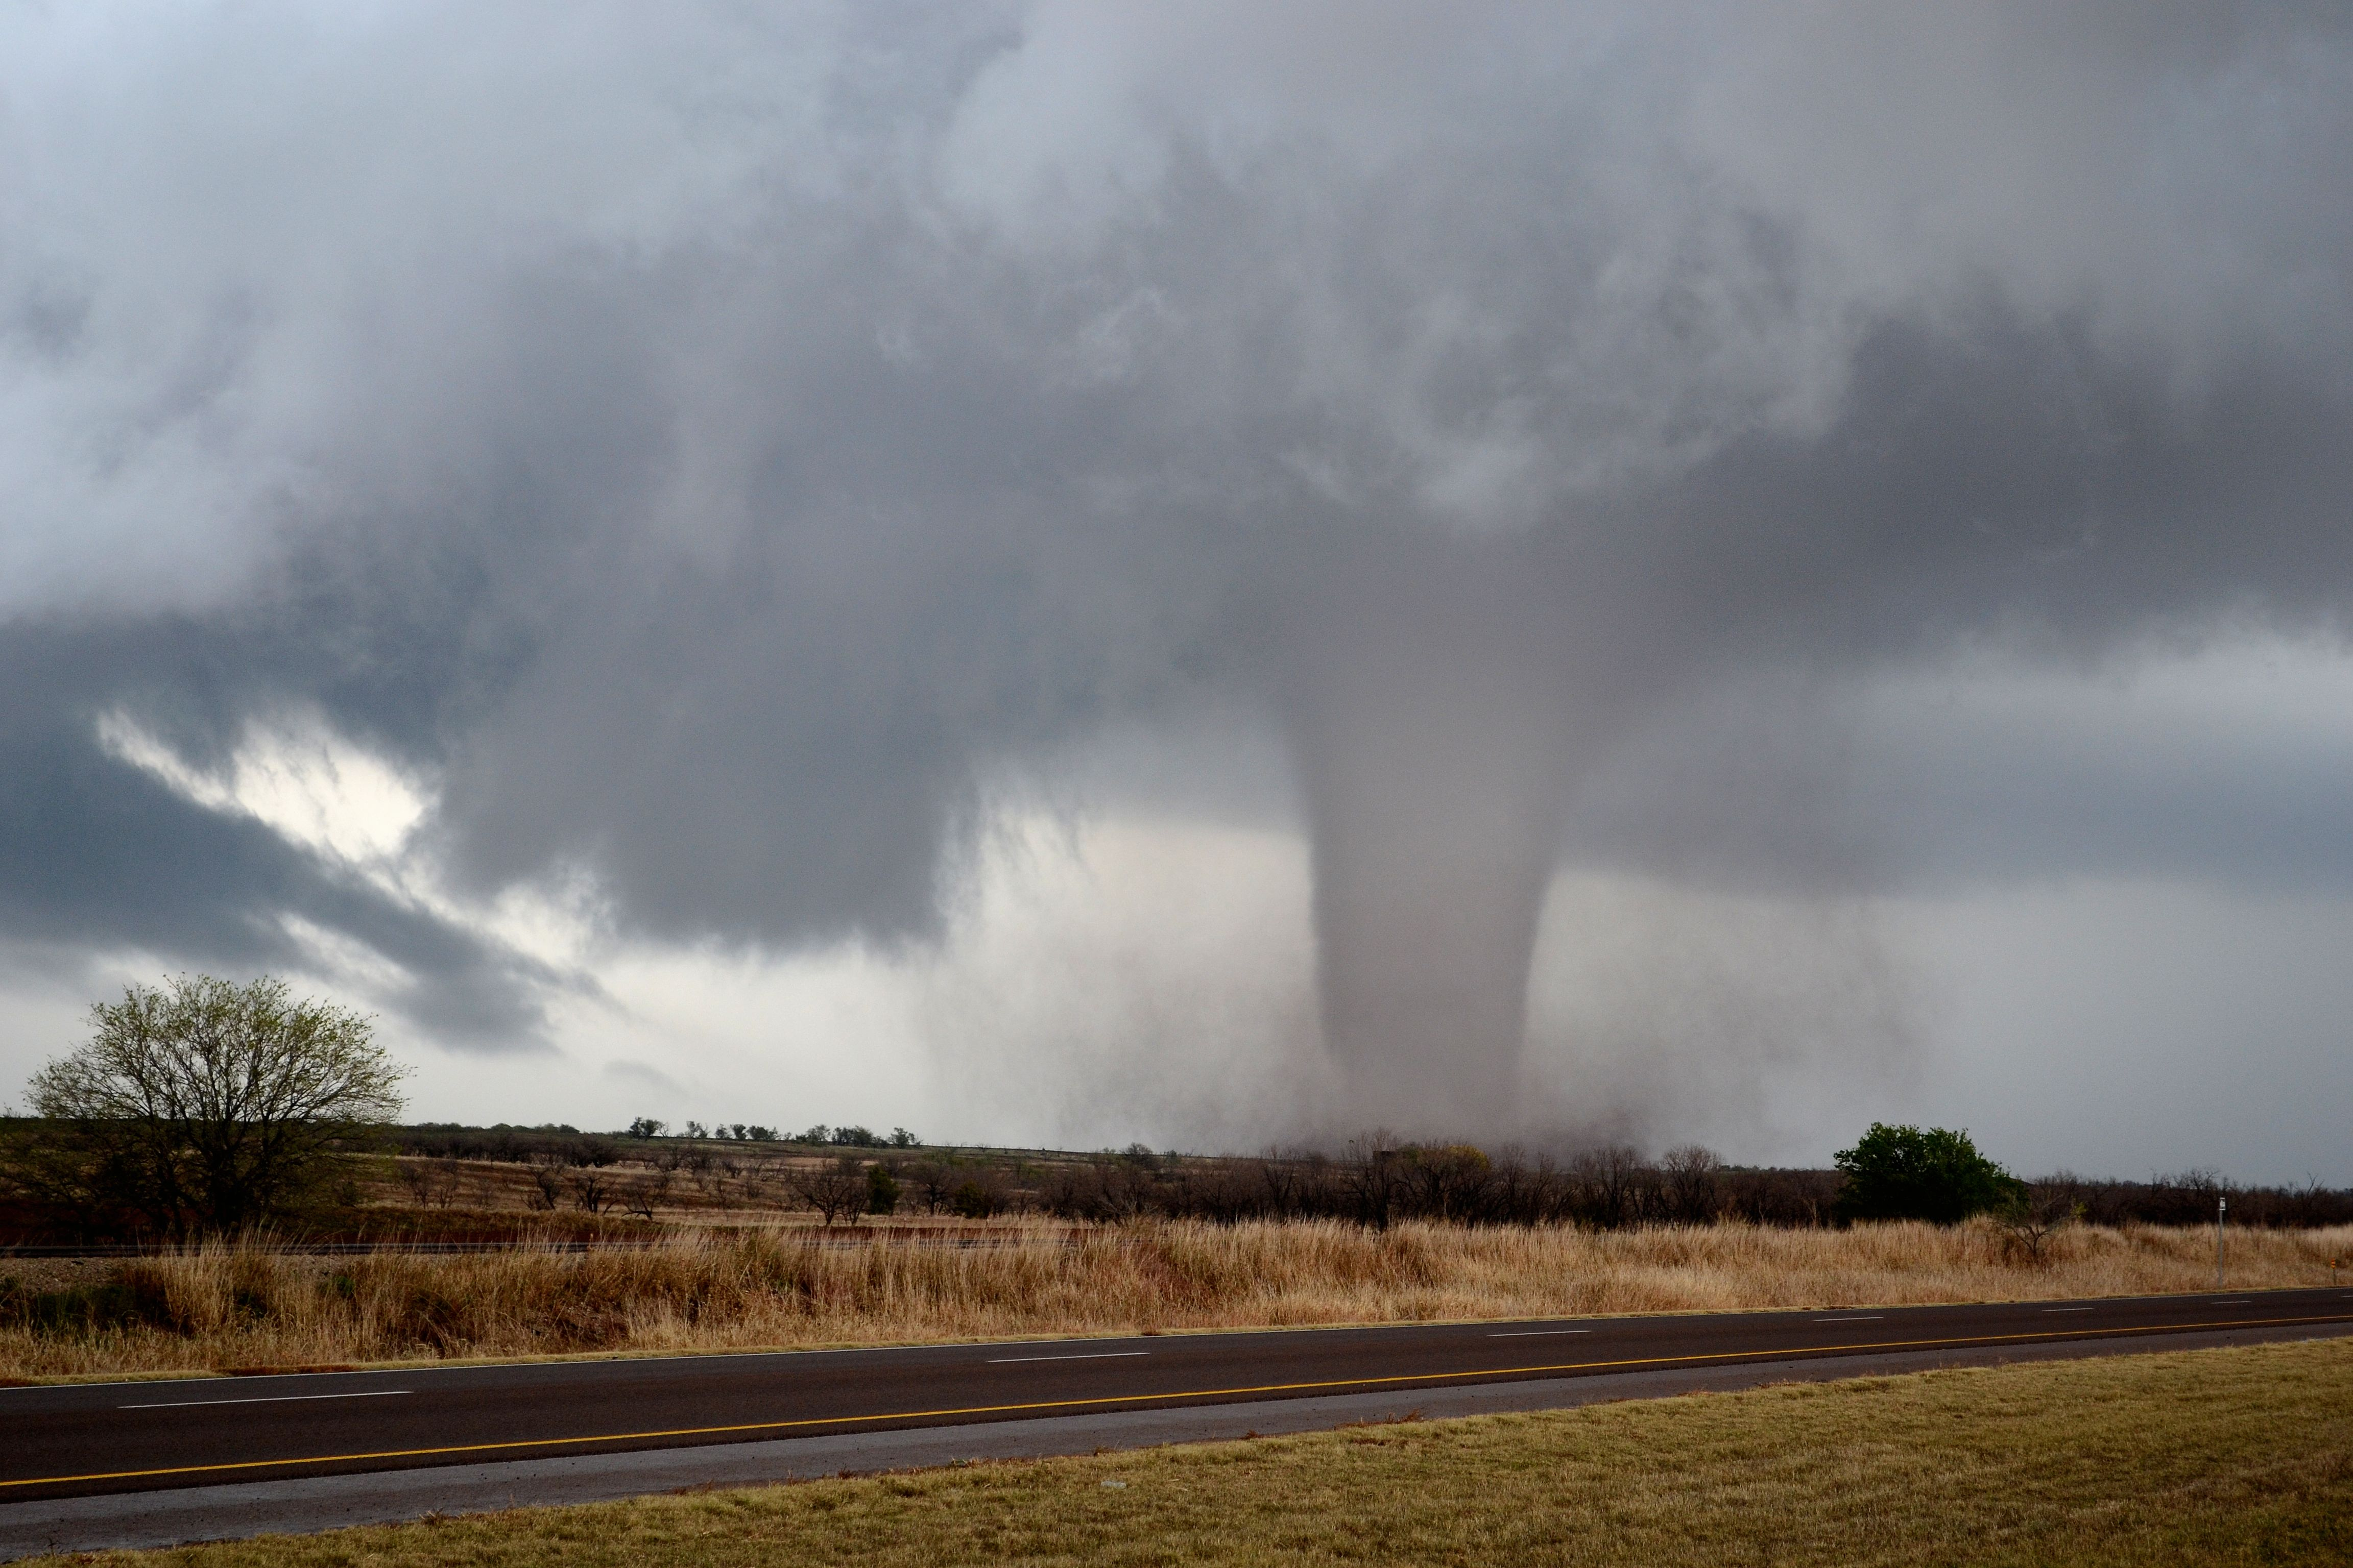
Ben Herzog
Peter Veals
Notes:
Just remember, severe weather can pose a range of hazards from lightning to large hail to high wind to tornadoes.
Keeping weather-aware can go a long way towards staying safe.

