Slide 1
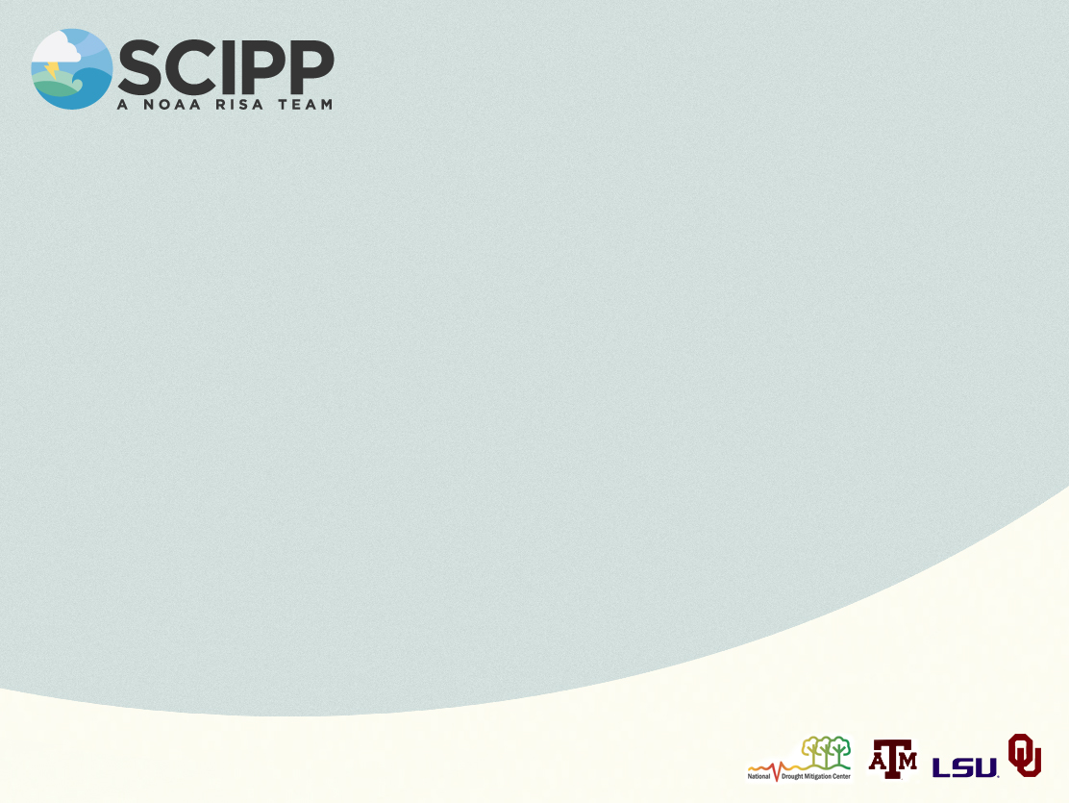

Past Climate Reconstruction and Climate Proxies

Slide 2

Note: This slide set is one of several that were presented at climate training workshops in 2014. Please visit the SCIPP Documents page in the Resources tab on the SCIPP’s website, www.southernclimate.org, for slide sets on additional topics.
Workshop funding was provided by the NOAA Regional Integrated Sciences and Assessments program.

Slide 3

Paleoclimate
Paleoclimatology is the study of past climate before humans began collecting instrumental observations.
Annual records of climate are preserved in tree rings, coral reefs, ice, pollen and sediment.
Natural recorders of climate are called proxy climate data since they substitute for modern instruments like thermometers and rain gauges.

Slide 4
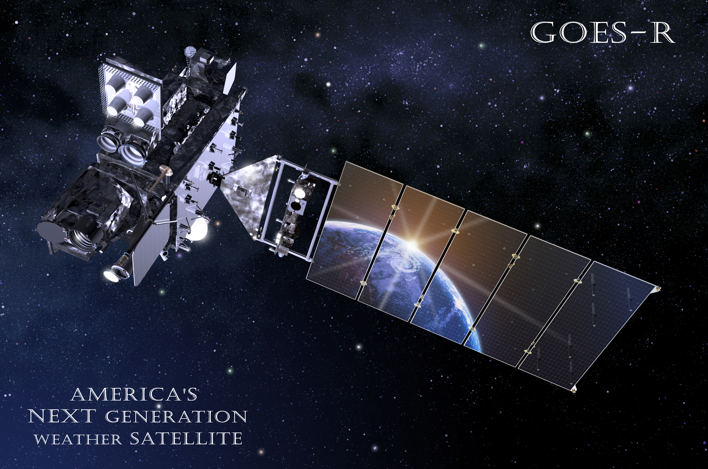
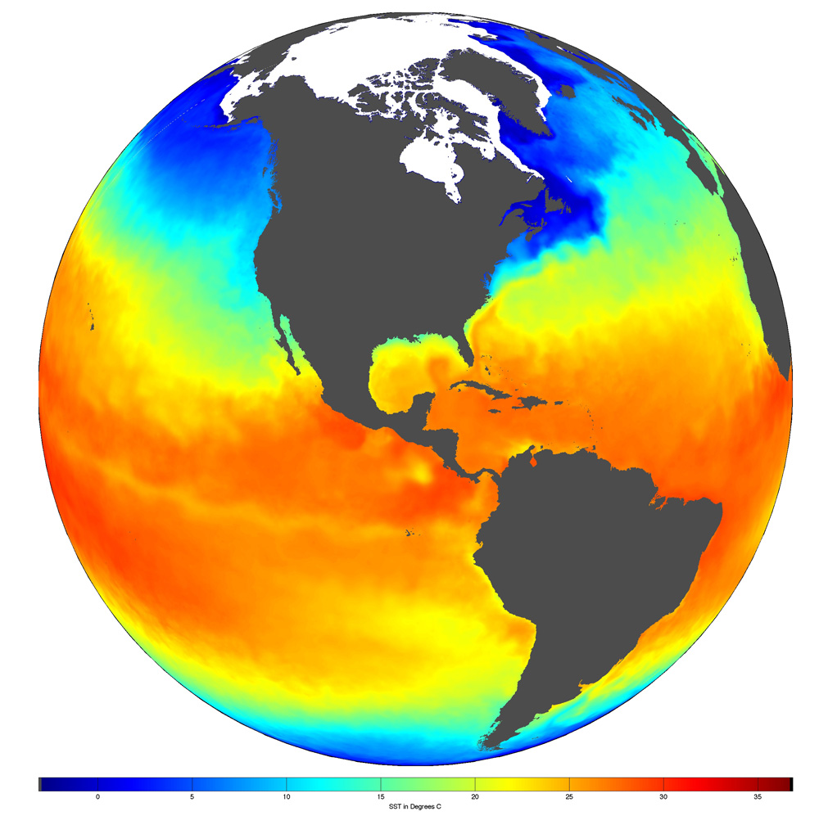
The Satellite-derived Temperature Record
Satellite measurements have been used to construct global atmospheric temperatures since 1979.
Provides a much more spatially uniform perspective.
Allows for measurements over hard-to-sample areas like the ocean and ice caps.
Source: NOAA
Source: NOAA
Notes:
Our youngest record

Slide 5
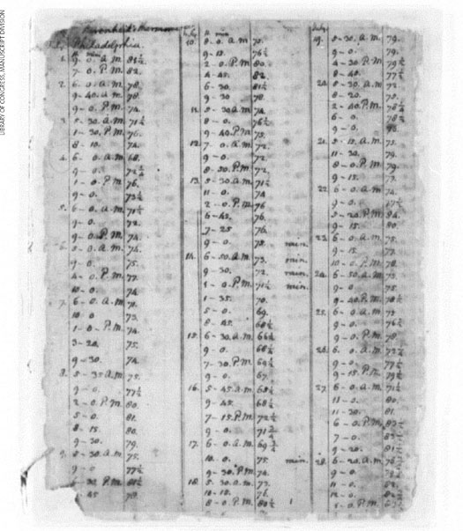
The Instrumental Record
The earliest records of temperature measured by thermometers are from western Europe in the late 17th century and by the early 20th century records were being collected in almost all regions. Records from polar regions began in the 1940s.
The National Climatic Data Center
maintains a collection of temperature
records from over 7,000 stations
worldwide, about 1,000 go back to the
19th century.
Temperature observations the first 2 weeks of July 1776 in Thomas Jefferson’s Weather Memorandum Book
Notes:
These direct measurements of our environment really don’t go back that far when we think about how long the Earth has been around.

Slide 6
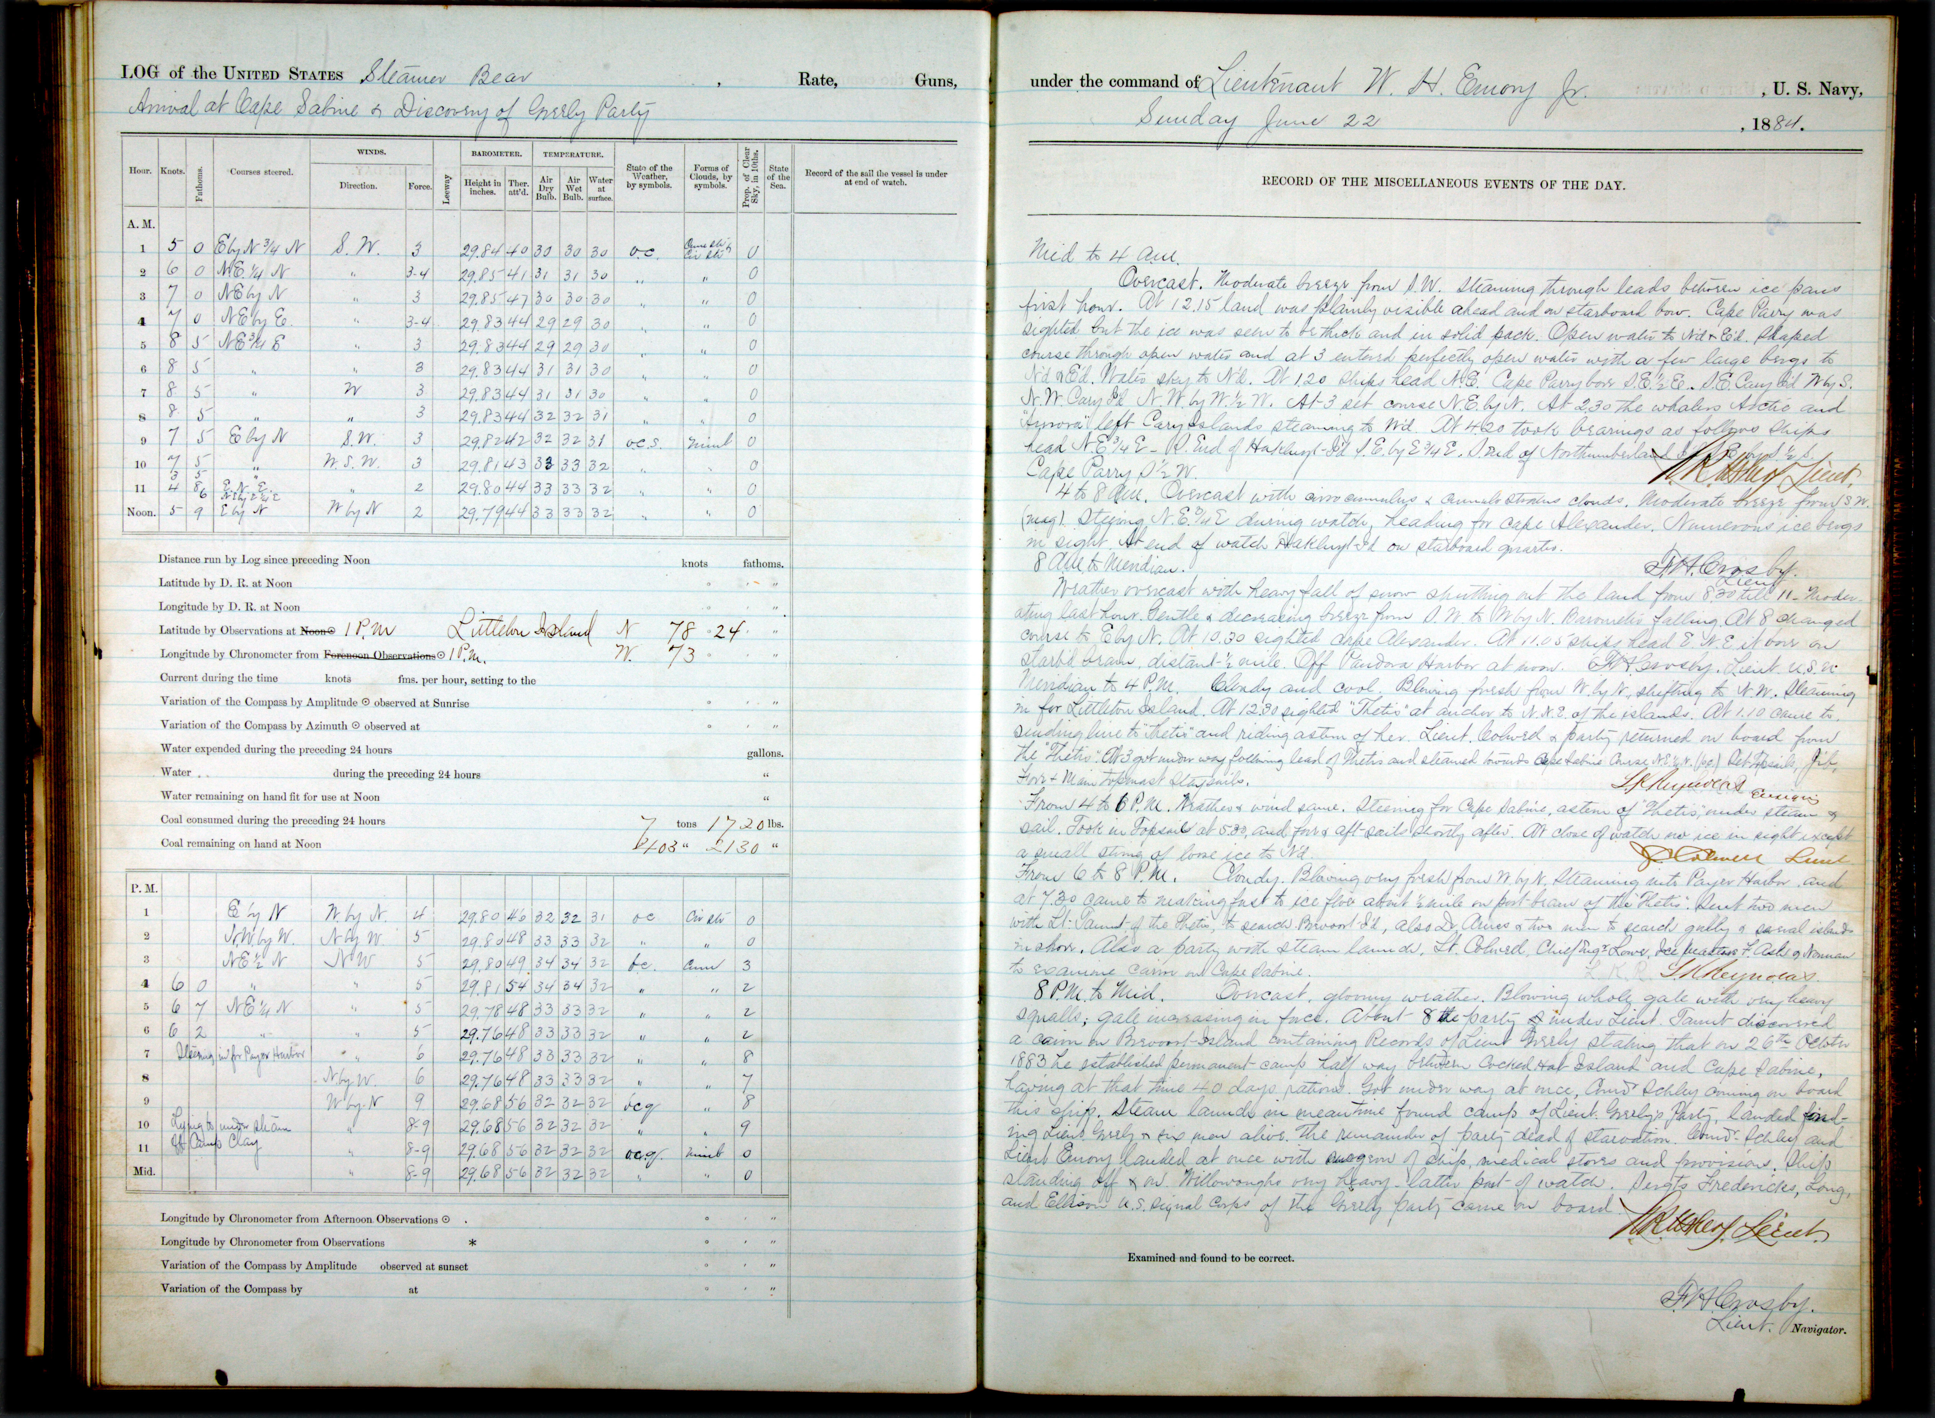
Historical Data
Historical documents contain past weather and climate information.
Ship logs are particularly useful for accounts of sea ice, storms, and hurricanes.
Farmers’ logs can include
useful information such as
planting or harvest dates
and overall crop health.
Personal diaries are
another resource.
Notes:
Historical documents can get us back just a bit further.

Slide 7
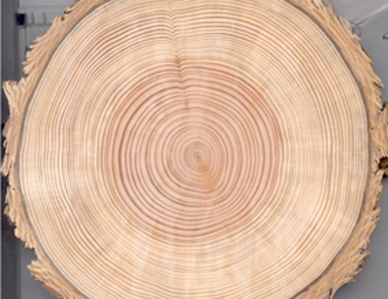
Tree Ring Record
Crossdating of tree rings can provide exact date matches between trees with different ages or from different locations.
Major events such as fire, flood, avalanche, drought, and insect infestation can all be evident.
The regular year to year variations in rings provide indications of past temperature, precipitation and
streamflow.
Using petrified or fossilized wood,
tree ring records go back more than
10,000 years in some locations.
Source: NOAA
Notes:
Proxy representations of past climate can start to get us back much further, like with tree rings.

Slide 8
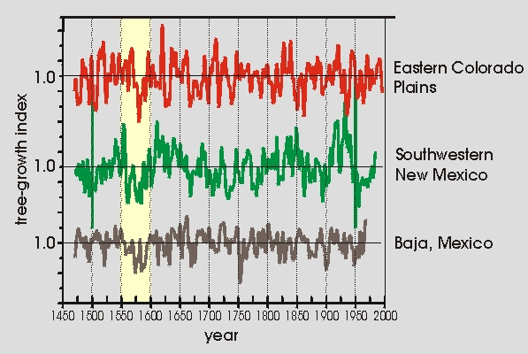
Tree Ring Record
A several decade long North American drought in the late 16th century is apparent from tree ring records.
Source: NOAA
Notes:
This is just a quick tree ring example. The tree-growth index decreased around 1550-1580 in three distinct locations, which signifies drought.

Slide 9
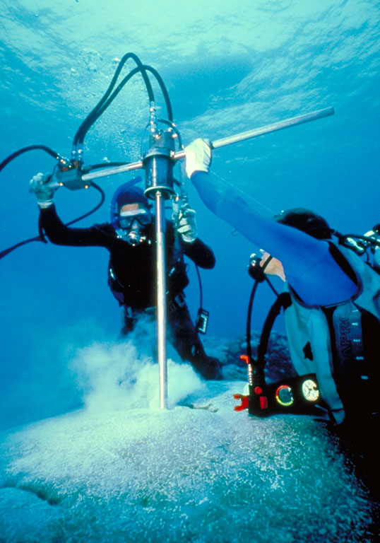
Coral Record
Coral is a colony composed of hundreds of
thousands of tiny animals called coral polyp.
Coral polyp deposits calcium carbonate, which
forms the reef skeleton.
Within the reef skeleton are indications of
when it formed, based on density, and growth
bands dependent on temperature and cloud
cover conditions.
A long core of old coral skeleton might cover hundreds of years and exact dates can be determined based on counting the growth bands.
Coral records also help us understand the tropical climate system, which is a strong driver of global climate.
Source: NOAA
Notes:
Coral is also sensitive to ocean acidification, from which we can infer CO2 content, and sea surface temperatures.

Slide 10
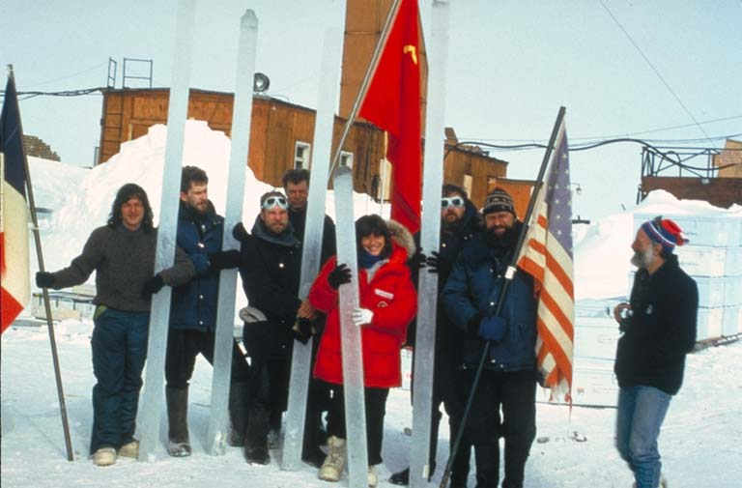
Ice Core Records
The Greenland ice sheet is nearly two miles thick and provides climate history going back 200,000 years.
Parts of the Antarctic ice sheet are even thicker, going back over 400,000 years.
Layers of dust might be present in an ice core from past summers or could represent a past
volcanic eruption.
Tiny fossil air bubbles are
even trapped in the ice.
The ice can also be tested for
its acidity level.
Source: NOAA
Notes:
Even though these aren’t direct air temperature measurements, these ice cores give us very specific clues to Earth’s past climate.
Mountain glaciers all over the world also provide equally valuable clues, but are quickly vanishing.

Slide 11
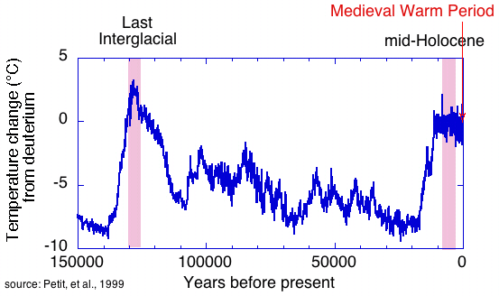
Ice Core Records
Temperature change for the past 150,000 years from an Antarctic ice core based on a hydrogen isotope proxy.
Notes:
Temperature change for the past 150,000 years at the VOSTOK site in Antarctica, based on the deuterium proxy found in ice cores.

Slide 12
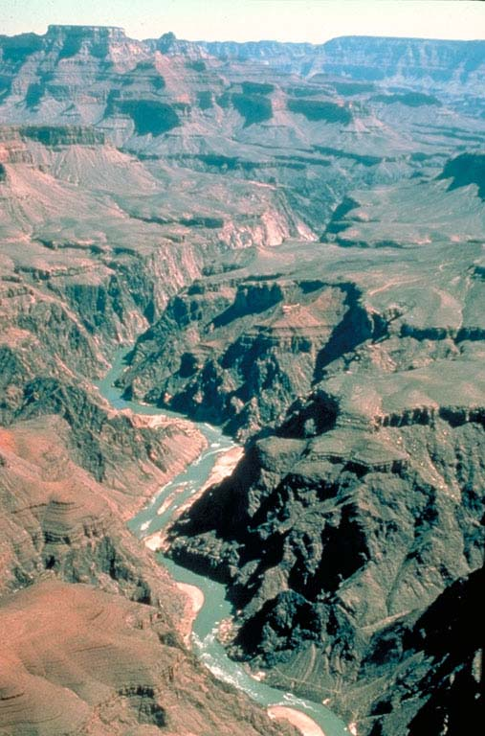
Other Proxy Records
The geologic, fossil and sediment record
also provide indications of Earth’s past
climate.
Pollen grains are especially well preserved
in sediment layers, like at the bottom of a
lake or ocean.

Slide 13
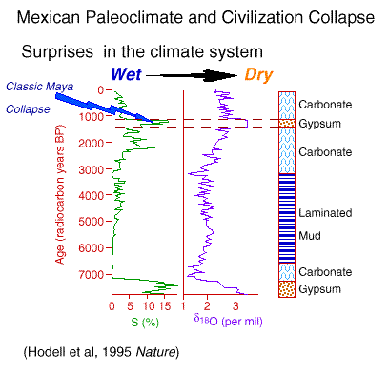
Sediment Record
Sediment cores from closed basin lakes in the Yucatan Peninsula indicate evidence of an intense period of drought that coincides with the collapse of the Classic Mayan
Civilization.
An archaeological mystery,
southern Mayan cities were
abandoned between 800 and
900 AD.

