Slide 1
Climate Tools & Data
Notes:
The purpose of this presentation is to provide an overview of some climate tools and data that are available for your use on the internet.

Slide 2
Note: This slide set is one of several that were presented at climate training workshops in 2014. Please visit the SCIPP Documents page in the Resources tab on the SCIPP’s website, www.southernclimate.org, for slide sets on additional topics.
Workshop funding was provided by the NOAA Regional Integrated Sciences and Assessments program.

Slide 3
Why use climate data?
Provides physical evidence of what climate was like before we were born or can remember.
Observations do not change whereas our memory of particular events or time periods might change.
Can provide supporting material that is required for a project report, grant application, legal proceeding, etc.
A way to measure past events.

Slide 4
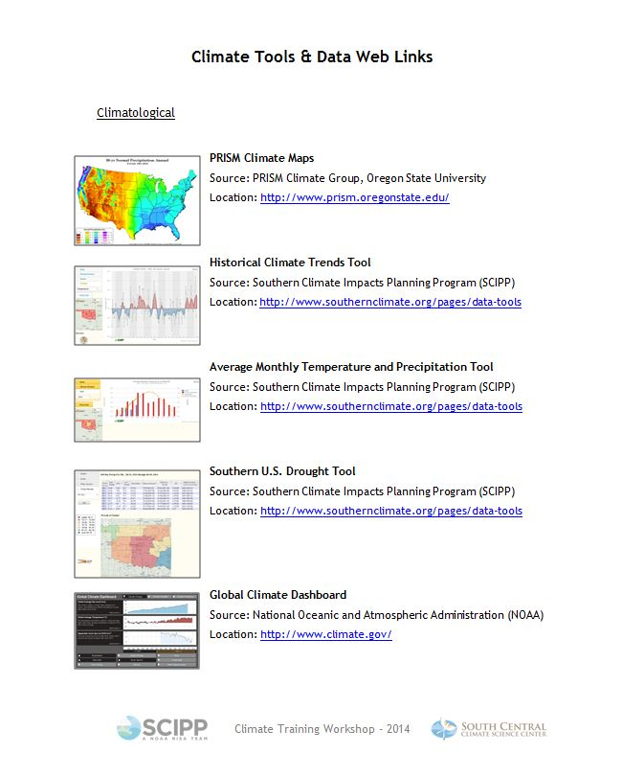
See Tools & Data handout for URLs.
Notes:
Note: There are a few tools on the handout that are not described in this presentation because of time constraints.

Slide 5
Climatological Tools
Past Conditions
Notes:
First let’s look at some climatological tools. These are tools you could use to look at past conditions.

Slide 6
Already Mentioned
PRISM Climate Maps (PRISM Climate Group, Oregon State)
Historical Climate Trends Tool (SCIPP)
Notes:
We’ve already mentioned these tools today – the PRISM Maps, which are available from the PRISM climate group at Oregon State University and the Historical Climate Trends tool which is available on the SCIPP Website.
PRISM: http://www.prism.oregonstate.edu/
Historical Climate Trends Tool: http://www.southernclimate.org/pages/data-tools

Slide 7
Average Monthly Temperature and Precipitation Tool (SCIPP)
Description:
This tool displays information on how a particular year’s monthly temperature or precipitation records compare to normal (i.e., 30-year average for the period 1981-2010.)
Notes:
Another tool that is available on the SCIPP website is the Average Monthly Temperature and Precipitation Tool: http://www.southernclimate.org/pages/data-tools. This tool displays information on how a particular year’s monthly temperature or precipitation records compare to normal.
Let me explain how to use this tool:
There are three parameters you will need to select when using this tool: state, climate division, and year. State is the state from which you are interested in viewing data, and the year is the year you are interested in comparing to the 30 year average. If you were interested in seeing how this year’s monthly temperatures compare to normal, you would choose 2014, for example. Let’s take a look at how you decide which climate division to use, though.

Slide 8
Oklahoma Climate Divisions
Notes:
Here is a map of Oklahoma’s climate divisions. Each state has these and they are assigned by the National Climatic Data Center. Each state has anywhere from 3-10 divisions. Knowing which climate division you’re in will be helpful for a variety of tools. Today we are located in climate division [X].
Link to Texas climate divisions: http://www.cpc.ncep.noaa.gov/products/analysis_monitoring/regional_monitoring/CLIM_DIVS/states_counties_climate-divisions.shtml.

Slide 9
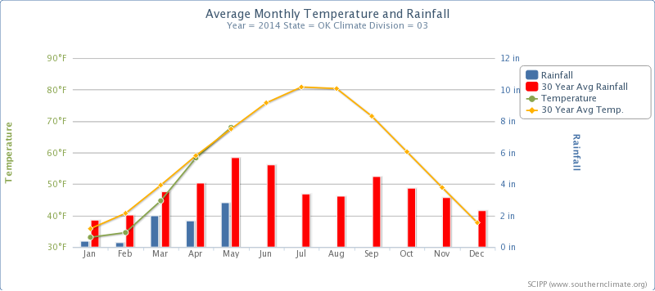
How to use it
Choose a
State →Oklahoma
Climate Division → 3
Year → 2014
Notes:
[Use laser pointer when necessary to point out particular features on the map]
So for example, if you wanted to look at how this year’s monthly rainfall and temperatures in northeast Oklahoma compare to normal, you should choose Oklahoma, CD 3, 2014. You will then see the following graph. The blue bars are the 2014 monthly rainfall totals and the red bars are the 30 year average rainfall totals for each month. You can see that for Jan-May of this year northeast Oklahoma received quite a bit less rainfall than normal.
Alternatively, the green dots represent the average temperature for each month in 2014, and the yellow dots represent the 30 year average for each month. You can see that the year started out a little below normal, but temperatures in April and May were right around normal.
Moving your mouse over the points on the graph will show you the specific value for that point.

Slide 10
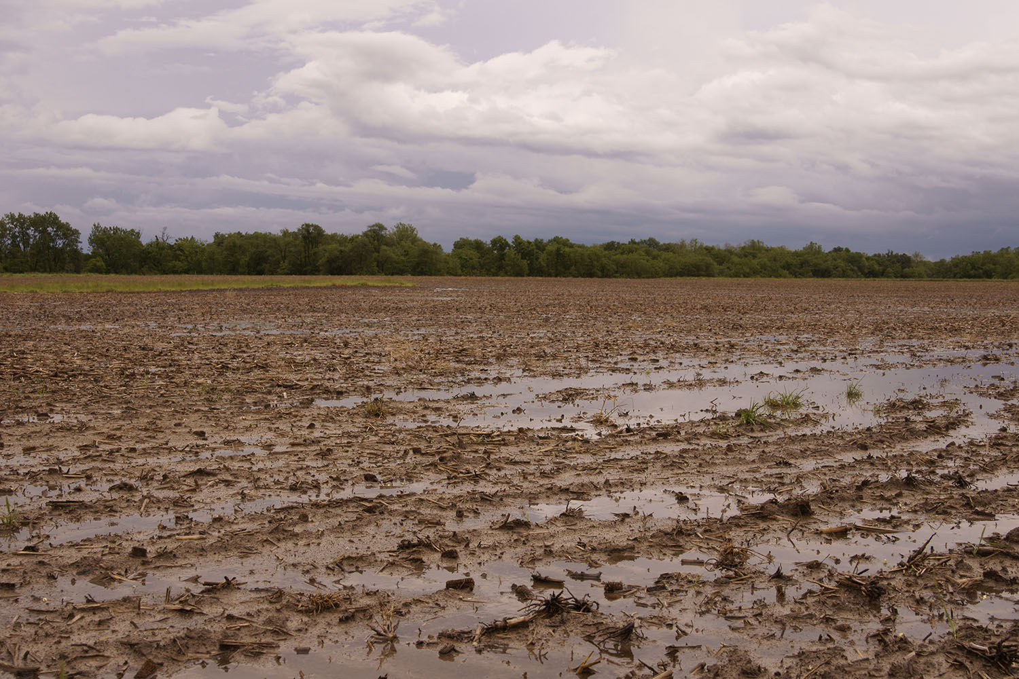
Example Applications of the Tool
Determine if your area is behind or ahead on rainfall and the impact that could have on water quantity and quality.
Temperatures can also impact water quantity and quality.
Potential for algal blooms.
A rainfall deficit leads to drier vegetation and drought development.
Determine if past months and years of perceived significance were actually significant.
Example: Was summer 2007 as wet as I think it was?
Rain-soaked farmland in June 2007.
Source: ARM Climate Research Facility

Slide 11
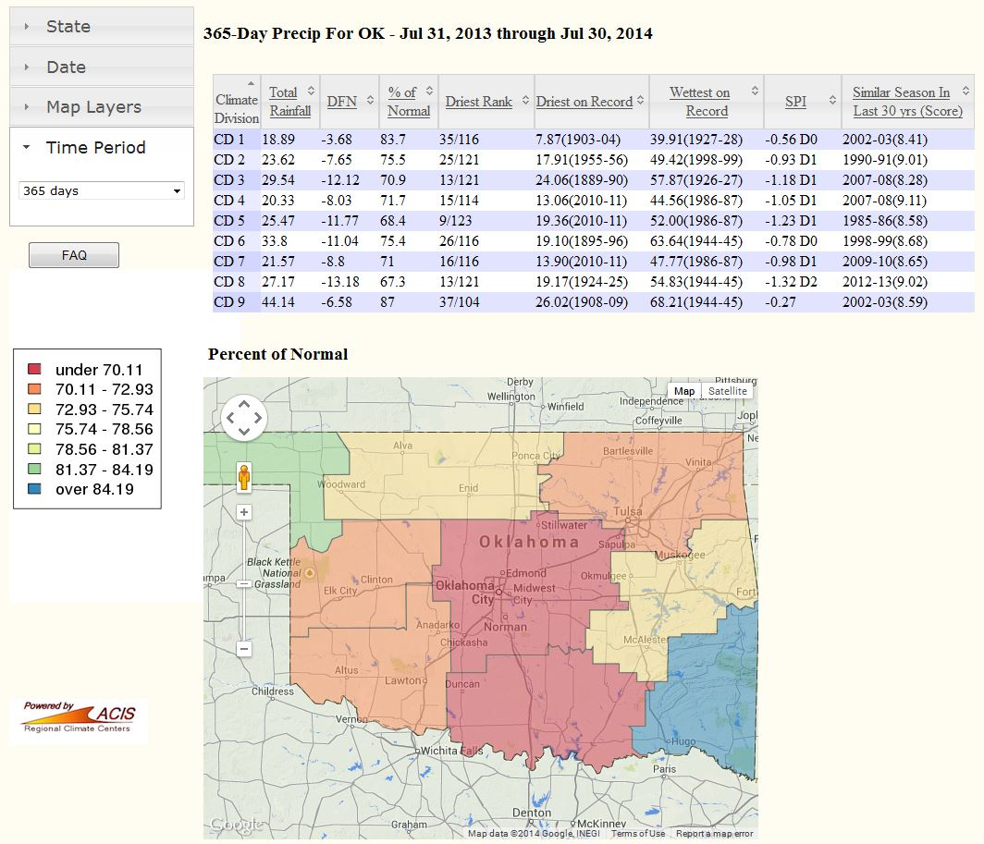
Southern U.S. Drought Tool (SCIPP)
Description
Displays information on drought severity and the amount of precipitation needed to get out of drought.
Useful for understanding precipitation deficits, or lack thereof, over a relatively short period of time (365 days or less).
Users can view precipitation statistics by climate division.
Notes:
Southern U.S. Drought Tool: http://www.southernclimate.org/pages/data-tools

Slide 12
How to use it
Notes:
Choose a:
-State
-Date (ending date for the period)
-Map Layer: rainfall total, departure from normal, % of Normal, Standard Precipitation Index
-Time period: 30, 60, 90, 180, or 365 days
Map provides visual of the layer you chose to view – note the legend off to the left. The table provides the exact numbers for a variety of variables. The table is sortable by clicking on the arrows in the first row. The information in the table and map may help put the precipitation patterns over a relatively short time span in perspective with the longer climatological record.
We have short video tutorials for all of these tools on the SCIPP website: http://www.southernclimate.org/pages/data-tools.

Slide 13
Global Climate Dashboard (NOAA)
Description:
Interactive display gives viewer a look at global climate conditions over different periods of time such as temperature, carbon dioxide, spring snow cover, sea level, arctic sea ice and more.
Notes:
Another climatological tool is this Global Climate Dashboard, which is located on NOAA’s climate website, climate.gov. It’s on the front page of their website: http://www.climate.gov/.
This tool is useful for general awareness of global climate conditions and how they compare to the past.

Slide 14
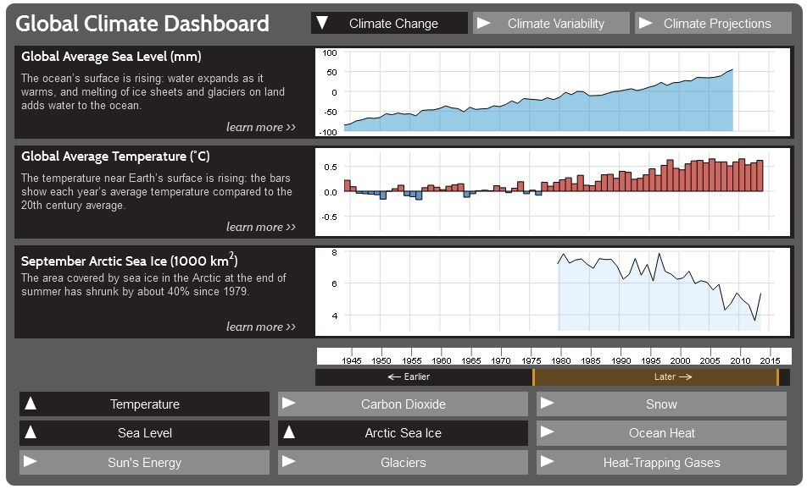
Notes:
Application: General awareness of global climate conditions. Many of the indices and measurements shown are what you’ll hear about on the national news. For example, you might hear someone or a news anchor talk about global carbon dioxide levels being near 400 ppm (parts per million). You can see how that number compares to the historical record (note: never before in modern history has it been this high).
There is an interactive display in which you can choose to look at climate change, climate variability or climate projection variables, and the time period in which you are interested. You can choose what time period you would like to view by moving the slider on near the bottom of the dashboard.

Slide 15
Drought Risk Atlas (NDMC)
Purpose:
To provide “a wide range of decision makers with historical drought information and a web-based tool to visualize and assess their risk to drought.” (NDMC)
Notes:
The next tool I’m going to talk about is the Drought Risk Atlas: http://droughtatlas.unl.edu/. This is a new tool and is run by the National Drought Mitigation Center, which also houses the U.S. Drought Monitor. This tool is fairly complex, and will require some time to learn how to navigate and use it. We certainly don’t want to scare you from using it but just know that quite a bit of data are contained in it and it will require a bit of time to understand all of the parameters, unlike some of the SCIPP tools, for example, where you click on 3 items and the tool spits out a graph.
This tool produces a variety of maps and graphs. The image shown is just one, of Drought Monitor designations for Mangum, Oklahoma, between 2000 and 2014. (Note that the USDM began in 2000.) So in this example, you can see a graphical depiction of how drought designations have changed over the years across the same periods in the years, for Mangum.

Slide 16
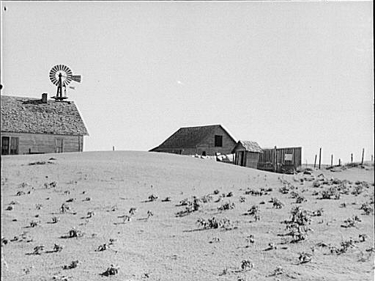
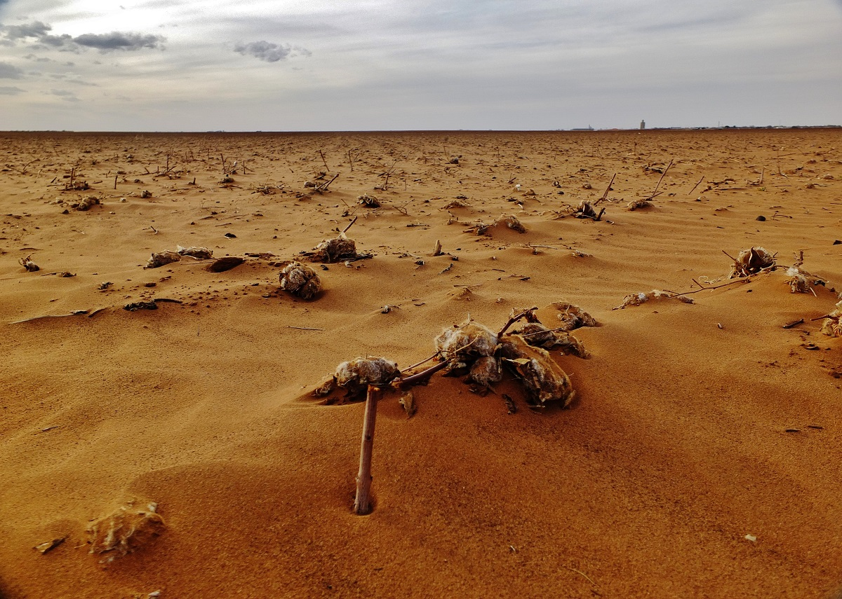
Drought Risk Atlas (NDMC)
Applications of the tool:
Compare a current or past drought to another past drought (e.g., How did the 2010-current drought compare to the drought during the Dust Bowl?).
Can view the U.S. Drought Monitor and other drought indices such as PDSI, SPI, etc.
Farm in Texas Panhandle during Dust Bowl. Source: Library of Congress, Farm Security Administration-Office of War Information Collection.
Dusty cotton field in Texas, March 2014. Source: Tim Benson

Slide 17
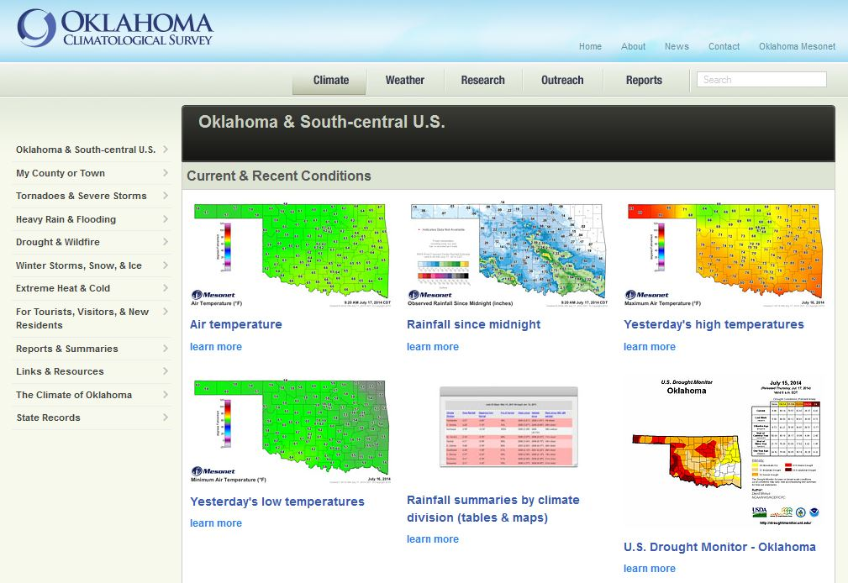
Oklahoma’s Climate: Long-Term Averages and Extremes (OCS)
Description:
Maps and graphs that provide long-term data on temperature, precipitation, snowfall, tornadoes, etc. for Oklahoma.
Notes:
Now, if you’re interested in just Oklahoma data, and you want some nice maps portraying our climate, you can visit the Oklahoma Climatological Survey’s website: http://www.climate.ok.gov/. Click on the Climate tab, and it’s the first page that shows up. You can also get to the page by clicking on “Oklahoma & South-central U.S.” There are a bunch of pre-produced maps on this page. The longer-term climate maps are on the bottom half of the page.
For data from the Texas state climate office, go here: http://climatexas.tamu.edu/.

Slide 18
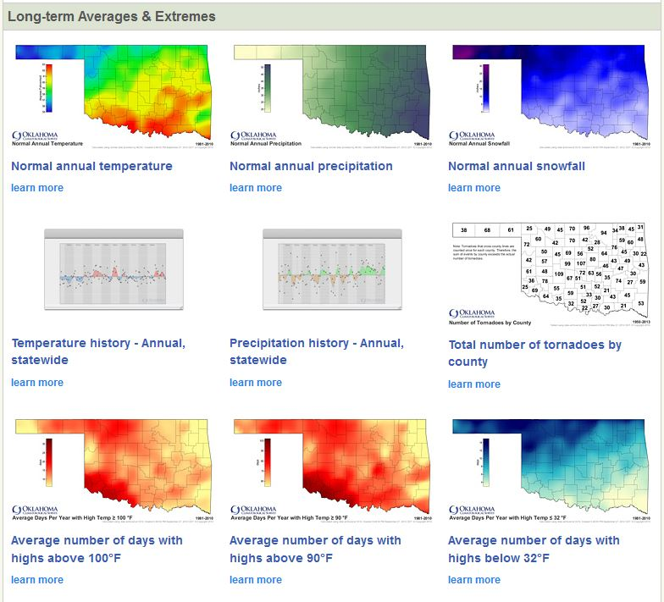
Notes:
Here are some maps that display information about some long-term averages and extremes of Oklahoma’s climate.
Note that the “learn more” links provide more detail about what the maps show.
These maps are useful if you’re looking for general data for your area or want to see how your area compares to other parts of the state. They wouldn’t be very useful if you’re looking for specific data or if you need exact #’s.

Slide 19
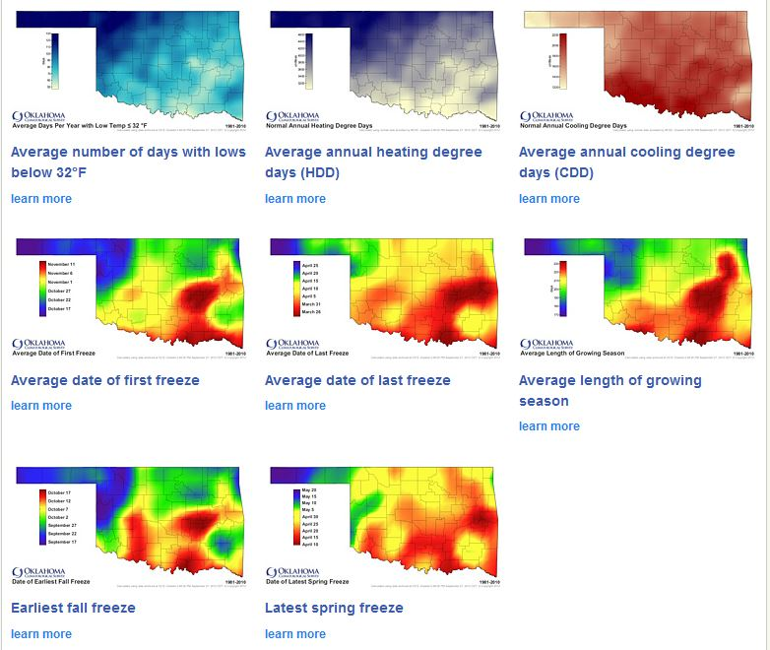
Notes:
Here are some more maps…

Slide 20
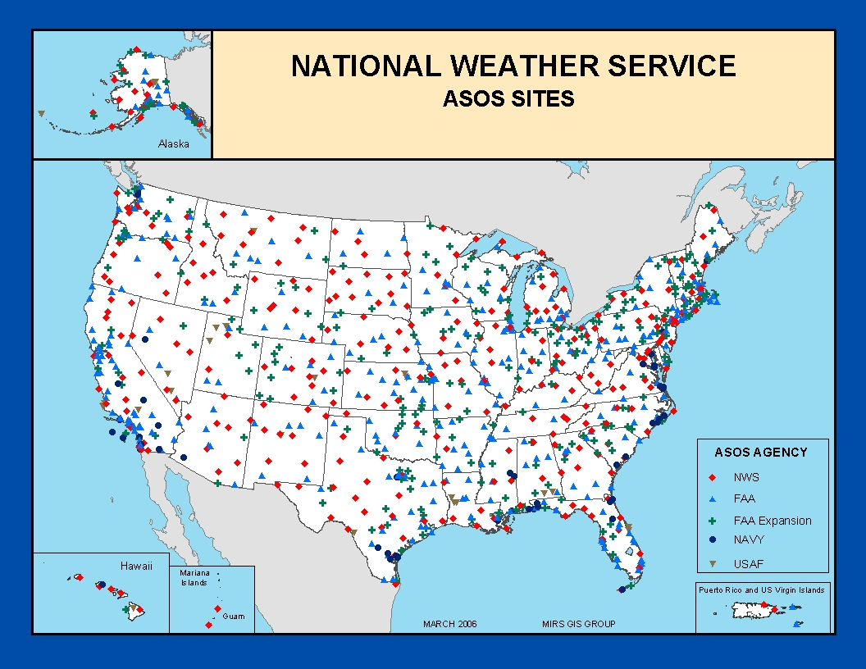
Weather Observation Networks
ASOS – Automated Surface Observing System
The nation’s primary surface weather observing network.
A joint effort between the National Weather Service, Federal Aviation Administration, and Department of Defense.
Operates 24/7, 365 days per year.
NOAA
Notes:
So far we’ve talked a lot about various climate parameters and maps and tools and whatnot. Well now I’d like to talk a little bit about where the data that are used to create those maps and graphs come from.
-Briefly introduce some weather observations networks that contribute to climate records. The following is not an exhaustive list.-
ASOS operate 24/7, 365 days a year
Located at airports
Record basic weather elements:
-Sky condition: cloud height and amount (clear, scattered, broken, overcast) up to 12,000 feet
-Visibility (to at least 10 statute miles)
-Basic present weather information: type and intensity for rain, snow, and freezing rain
-Obstructions to vision: fog, haze
-Pressure: sea-level pressure, altimeter setting
-Ambient temperature, dew point temperature
-Wind: direction, speed and character (gusts, squalls)
-Precipitation accumulation
-Selected significant remarks including- variable cloud height, variable visibility, precipitation beginning/ending times, rapid pressure changes, pressure change tendency, wind shift, peak wind.
ASOS Primer: http://www.nws.noaa.gov/asos/

Slide 21
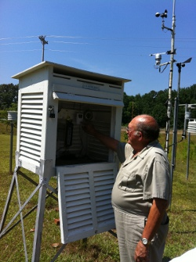
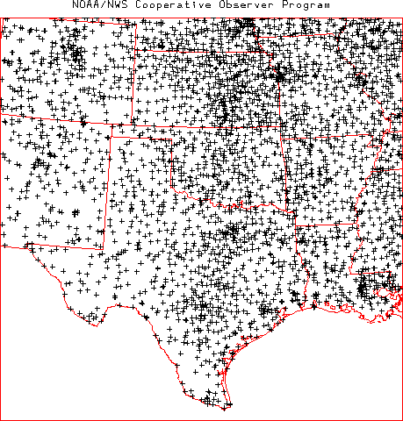
Weather Observation Networks
COOP (Pronounced “co-op”) – NWS Cooperative Observer Program
Program dates back to 1870.
Consists of almost 11,000 volunteers across the nation.
Daily max/min temperature, snowfall, and 24-hour precipitation totals.
NWS
Notes:
COOP Primer: http://www.nws.noaa.gov/om/coop/

Slide 22
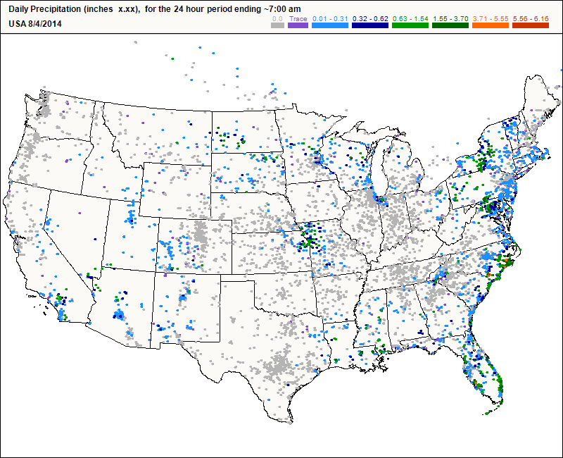
Weather Observation Networks
Cocorahs – Community Collaborative Rain, Hail & Snow Network
“Volunteers working together to measure precipitation across the nation.”
Established in 1998.
Precipitation record.
Notes:
Cocorahs Primer: http://www.cocorahs.org/
Cocorahs is similar to COOP but the focus is just on precipitation. Cocorahs was established in 1997 after devastating floods in Colorado.

Slide 23
Monitoring Tools
Current Conditions
Notes:
Now I’m going to show you a few monitoring tools that might be of interest. These tools give you a snapshot of current weather and climate conditions.

Slide 24
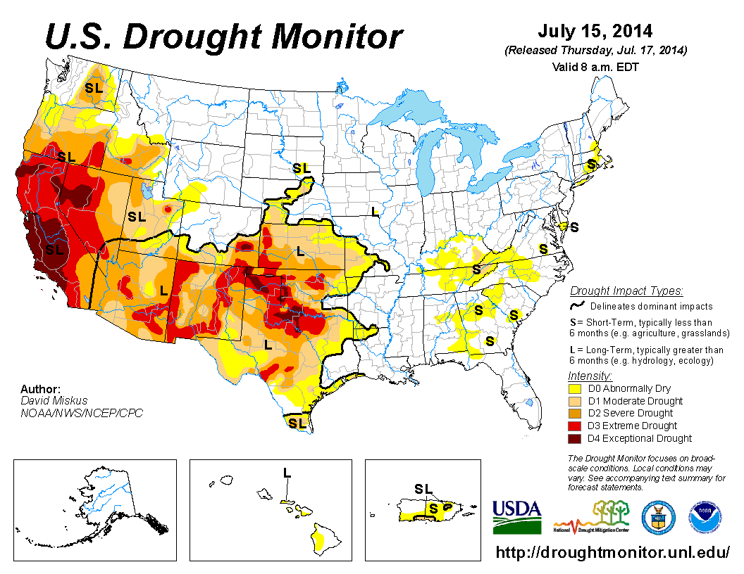
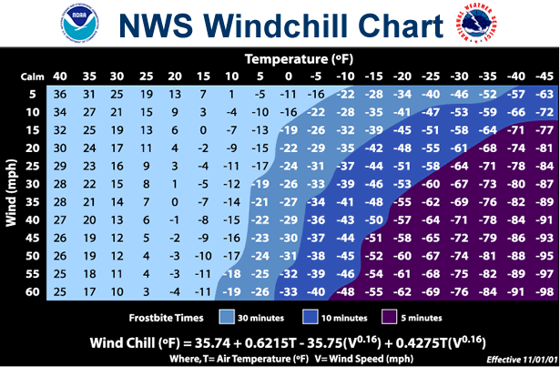
Already Mentioned
U.S. Drought Monitor (NDMC)
Heat Index and Wind Chill Charts (NWS)
Notes:
One monitoring tool that was already mentioned is the U.S. Drought Monitor, http://droughtmonitor.unl.edu/, which is housed at the National Drought Mitigation Center. Extreme heat and cold were also mentioned, as were the heat index (http://www.nws.noaa.gov/os/heat/index.shtml) and wind chill (http://www.nws.noaa.gov/os/windchill/index.shtml) charts that are available from the National Weather Service.

Slide 25
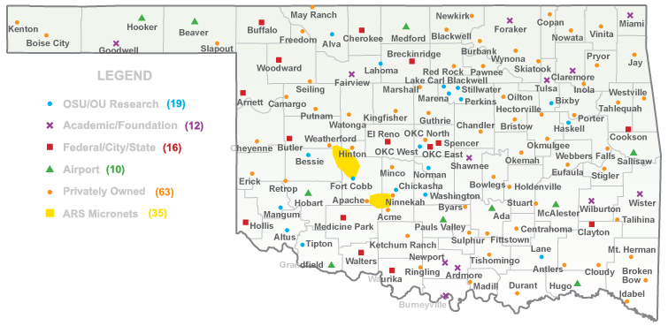
Oklahoma Mesonet - Oklahoma Weather Observation Network
Notes:
Now, for monitoring weather conditions across the state, we wanted to mention the Oklahoma
The Oklahoma Mesonet is a statewide network of more than 120 weather stations. By the way, SCIPP’s office is in the same location as the Mesonet.
Can you find the closest station to your hometown? Each of the colored dots on the map represent one of our 10 meter weather towers. They are solar powered and most connect via radio link back to the National Weather Center. All this data… all of these measurements are quality assured in real time and posted every 5 minutes on our maps and charts online.
We are really lucky to have this resource in Oklahoma and it has often been called the gold standard observation network.
The Oklahoma Mesonet is part of what makes the atmosphere above Oklahoma the most studied in the world.
Some other states also have mesonets. For example, west Texas: http://www.mesonet.ttu.edu/.

Slide 26
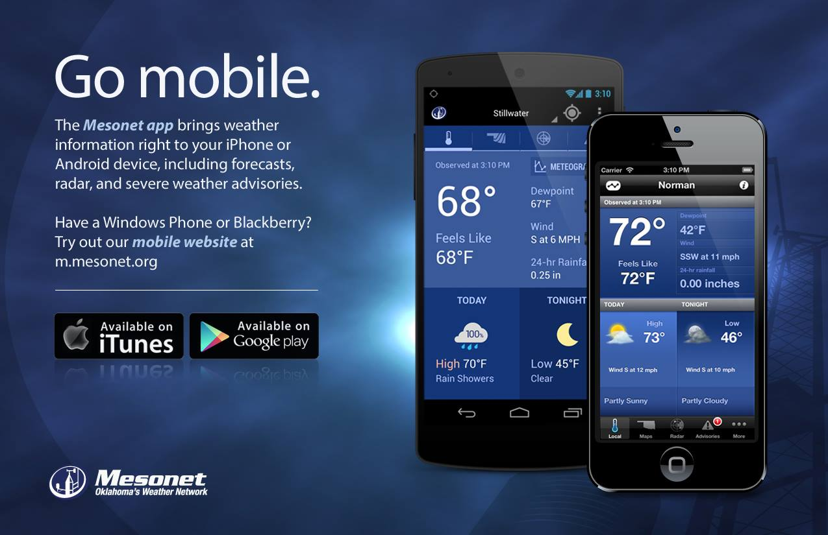
The Oklahoma Mesonet app is FREE!
Content goes here
List item 1
List item 2
List item 3
Notes:
Once storms start to develop, conditions can deteriorate rapidly. So staying on top of current information is critical.
If you live in Oklahoma this is really the weather app you need most. And it’s free.

Slide 27
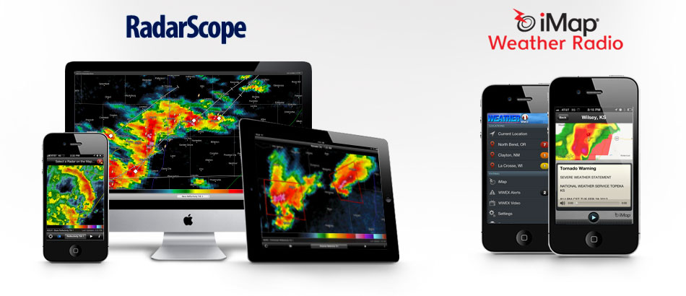
Other useful mobile apps:
RadarScope ($10)
iMap Weather Radio ($10)
Specialized high resolution radar data and derived products for the entire country.
Pushes NWS weather alerts to your phone like a NOAA weather radio.
Both sold by Weather Decision Technologies in Norman, OK
Notes:
As a side note, I wanted to briefly mention apps that we highly recommend for staying safe during severe weather.
Here are two other mobile apps I’ll recommend, they’re not free but still really useful.
iMAP Weather Radio is an app that allows you to get push NWS weather alert notifications, which kind of makes your device like a mobile weather radio. ($10)
RadarScope is great if you really love looking at weather radar because it allows you to access all the technical radar products meteorologists use. ($10)
(And no, WDT didn’t pay us for this advertisement. ☺)

Slide 28
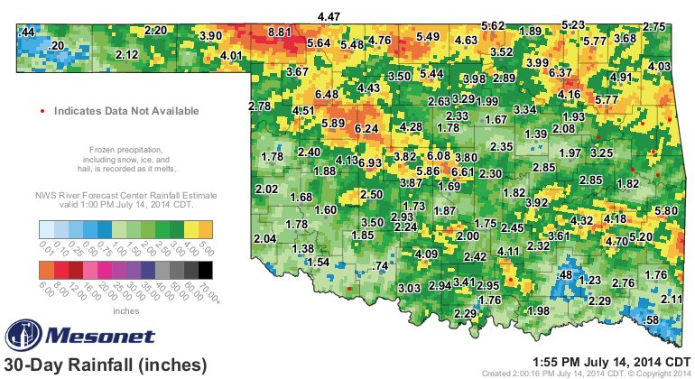
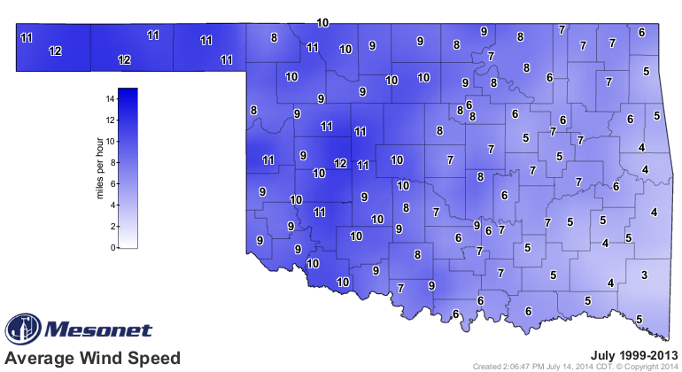
Oklahoma Mesonet
Basic weather information such as temperature, precipitation, winds, and dewpoint, etc.
Maps and graphs.
Some climatological information.
Notes:
Back to the Mesonet…
One benefit of Mesonet data compared to other data sources is that you can obtain very localized data, since there is at least one station per county. However, data are only available back to 1994, so if you’re looking for climate data that goes back farther in time, or you want data for a different state, you’ll have to go somewhere else. You can view long-term averages for Mesonet data, though.

Slide 29
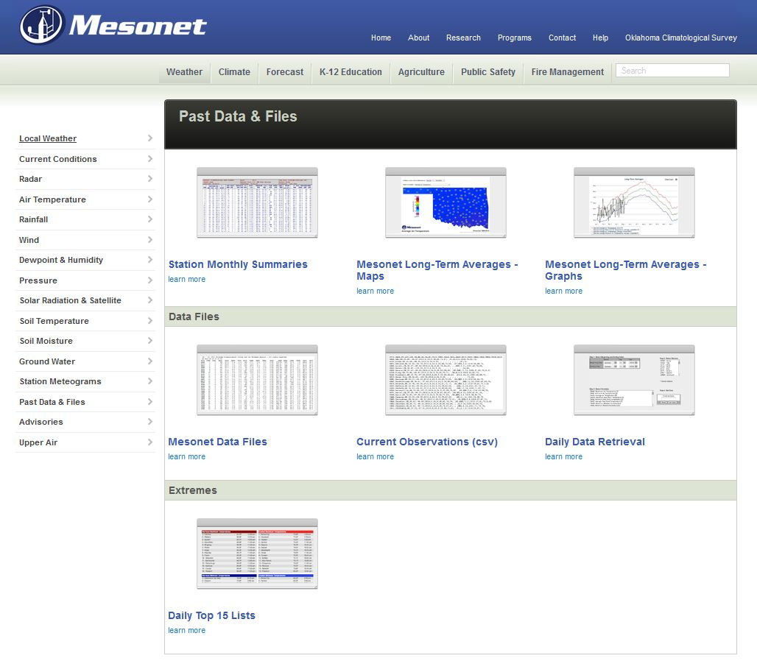
Notes:
To access this data, click on the Weather tab on the Mesonet homepage (www.mesonet.org), and then click on Past Data & Files. Two use-friendly options are the long-term averages maps and graphs. For the purposes of the Mesonet, 14 years is considered long term, but that’s not actually that long on a climate scale. So just keep that in mind when you’re looking at this data. Over time, of course, the period of record will get longer.

Slide 30
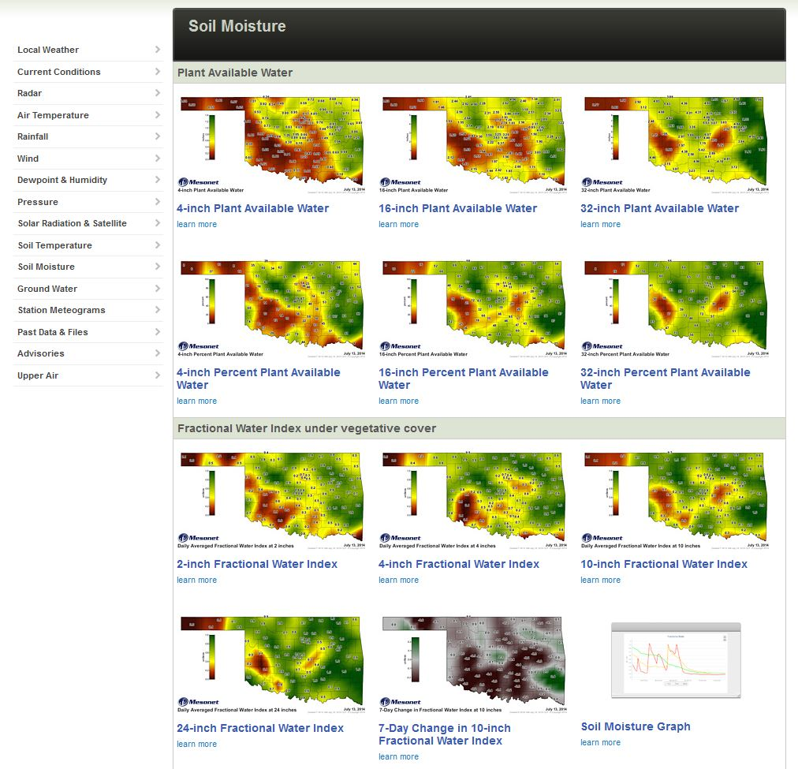
Notes:
Some other data that might be of interest is soil moisture data. To access it, click on “Soil Moisture” on left-hand menu, then click on “Soil Moisture Graph”.
There are other products that might be of interest so feel free to click around.

Slide 31
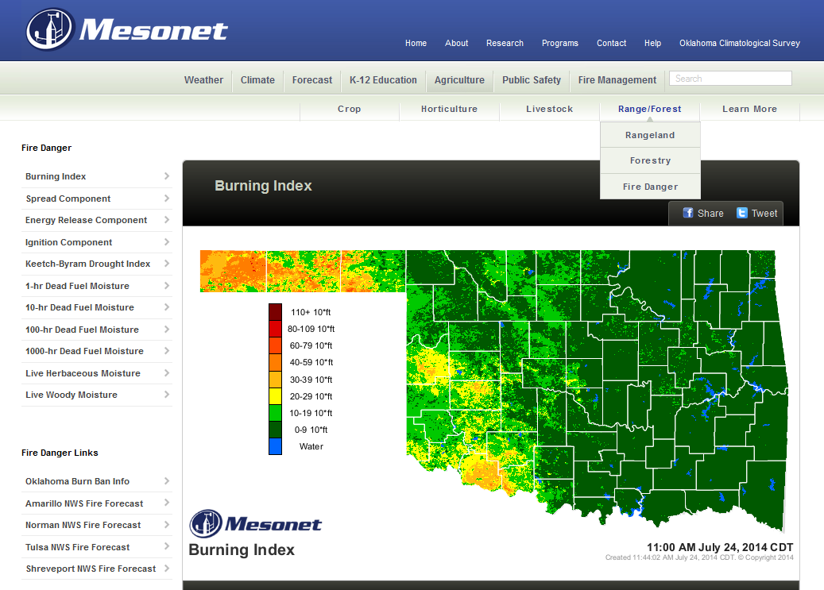
Burning Index (Fire Conditions)
The Burning Index (BI) represents potential fire conditions in response
to short term meteorological factors such as temperature, relative humidity, wind speed, and solar radiation.
A satellite measure of
vegetative health (greenness)
and a fuel model for native
vegetation are also incorporated.
The BI infers fire line
intensity and flame length. The
higher the number, the more
difficult it is to fight a wildfire.
Notes:
The Burning Index (https://www.mesonet.org/index.php/agriculture/map/range_forest/fire_danger/burning_index1) is a short-term response to meteorological factors. The burning index includes real-time observations of temperature, relative humidity, wind speed and solar radiation. It applies those factors to a vegetation model, which includes the “relative greenness” – a satellite-derived measure of the health of the vegetation – and fuel models for native vegetation, assigned on a 1-kilometer grid across the State. The model uses these inputs to produce four indices: Spread Component, Energy Release Component, Ignition Component, and Burning Index. Burning Index is a synthesis of the Spread and Energy Release components, and infers fire line intensity and flame length. The higher the number, the more difficult it is to fight a wildfire.

Slide 32
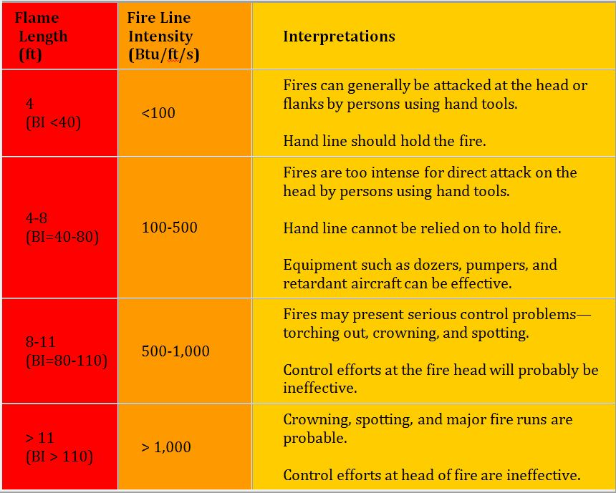
Burning Index Legend
Notes:
Fine fuels, such as small twigs and vegetation litter, respond quickly to changing weather conditions and can dry quickly following a rain. Locations with a higher average burning index most likely have experienced repeated episodes of high fire danger, although individual events can peak at locations that are not as prone to high fire danger. Nearly one in three of the 120 Oklahoma Mesonet stations, which have continuous records from July 1996 – present, have peaked in the upper category of the Burning Index (BI >110). Many of these locations are in western Oklahoma, where wind speeds are higher and humidity is lower, contributing to more favorable burning conditions.

Slide 33
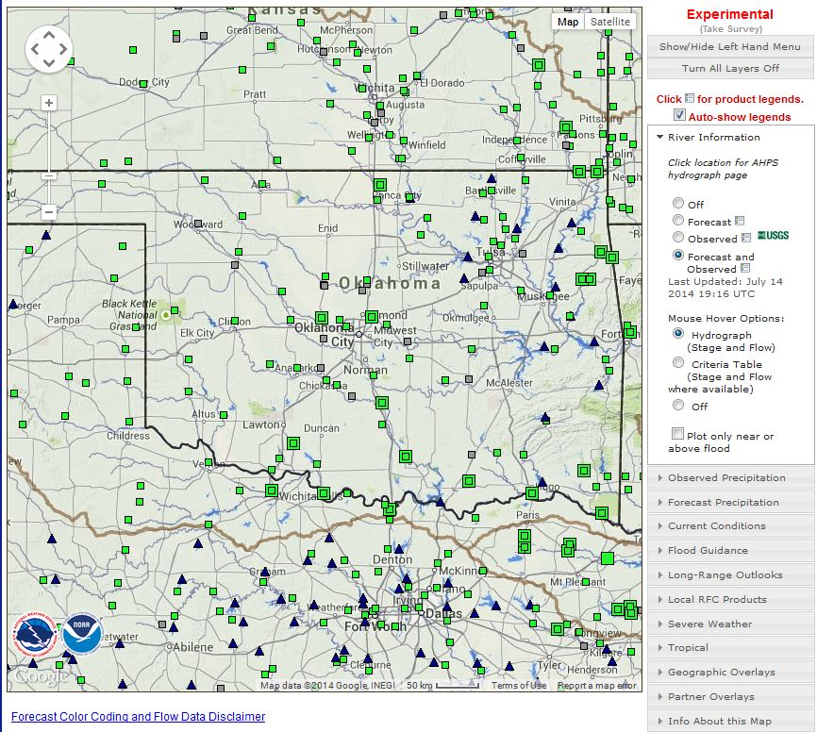
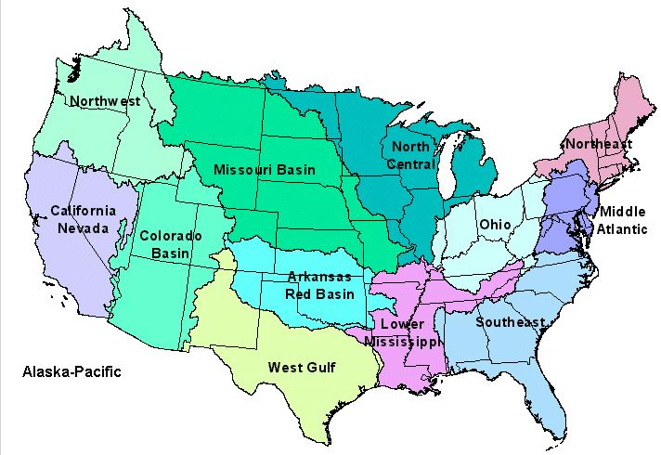
River Forecast Center Products (NWS)
Description:
Provides flood observation and forecast data.
Notes:
Another monitoring tool comes from the National Weather Service River Forecast Centers (http://water.weather.gov/ahps/rfc/rfc.php). A lot of data are found on their website, but the main purpose is providing flood observation and forecast data. There are 13 RFCs across the country and the Arkansas-Red Basin RFC covers Oklahoma. Texas is covered by the Arkansas Red Basin, West Gulf, and Lower Mississippi River Forecast Centers.
This is the default image on the local RFC webpage. It shows flood conditions (or lack thereof) throughout the state and region. Like many of these tools you can view a variety of data within the tool by making selections on the menu on the right-hand side of the page. Two selections that I think will be of interest to you are the following:

Slide 34
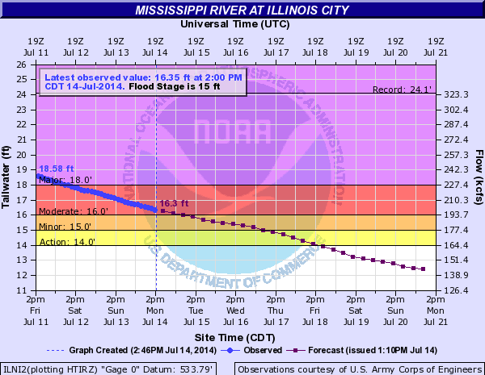
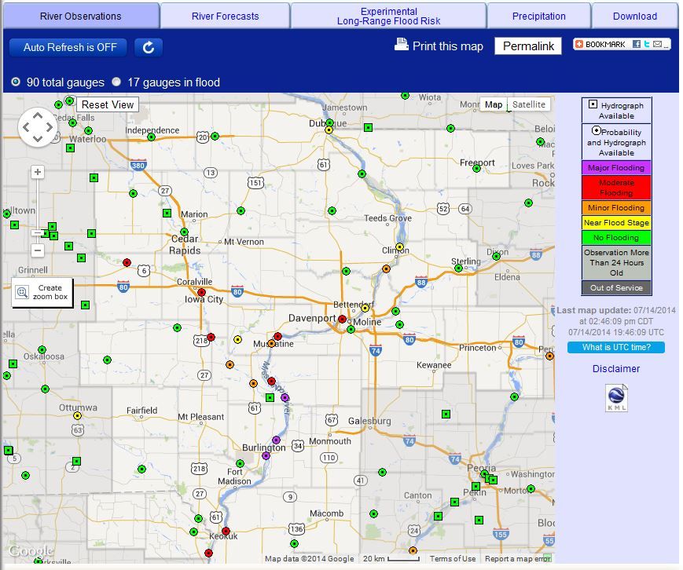
How to use it
Notes:
The first is how to look at flooding already occurring or forecasted for your area (http://www.srh.noaa.gov/abrfc/). To do so, click on the stream gauge (square or circle) or reservoir (triangle) in the area in which you’re interested. If you click on a stream gauge, a hydrograph will appear like the one you see here (please note that I had to go out of state to obtain an interesting hydrograph!). You will then see the observed river level (blue solid line) followed by the forecasted river level (purple dots). The hydrograph also shows the flood stages (minor, moderate, and major) associated with water levels. X-axis is time, left Y-axis is water height, right y-axis is flow rate.

Slide 35
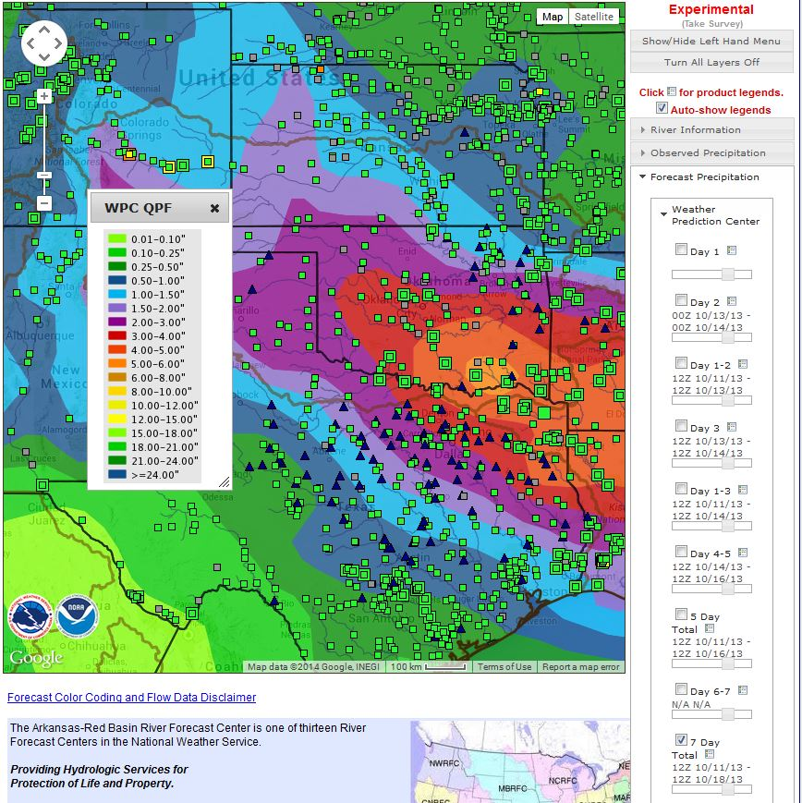
How to use it
Legend
Notes:
Another product of interest may be forecasted precipitation. The image here is showing forecasted precipitation for a 7 day period in July. The output is what is called QPF – quantitative precipitation forecast. The values are based on model data so sometimes you have to take the value at a specific location with a grain of salt. The legend shows you the rainfall values to which each of the colors correspond.
There are many products available on the RFC’s site so you may want to browse it and see if anything else is of interest to you.

Slide 36
Forecasting Tools
Future Conditions
Notes:
Next I will talk about some climate forecasting tools. These tools provide a look at what might happen in the future.

Slide 37
Already Mentioned
SPIA Index
Notes:
Sperry-Piltz Ice Accumulation Index: http://www.spia-index.com/

Slide 38
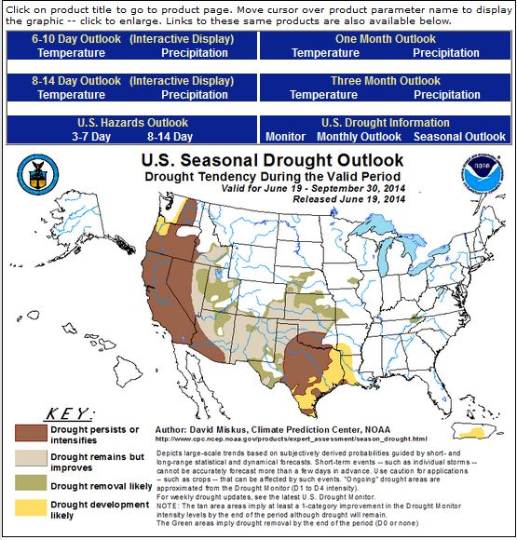
Climate Prediction Center Outlooks (NWS)
Description:
Users can obtain temperature and precipitation outlooks for seasonal timescales, as well as drought outlooks.
Notes:
The Climate Prediction Center (http://www.cpc.ncep.noaa.gov/), which is run by the NWS, provides a lot of seasonal forecast information. You will see the following image when you visit their homepage. They provide products at a variety of timescales, including 6-10 days, 8-14 days, one month, and three months for temperature and precipition,3-7 and 8-14 days for hazards, and monthly and seasonal drought outlooks. Today I’ll focus on the one month and three month outlooks, and the seasonal drought outlook.

Slide 39
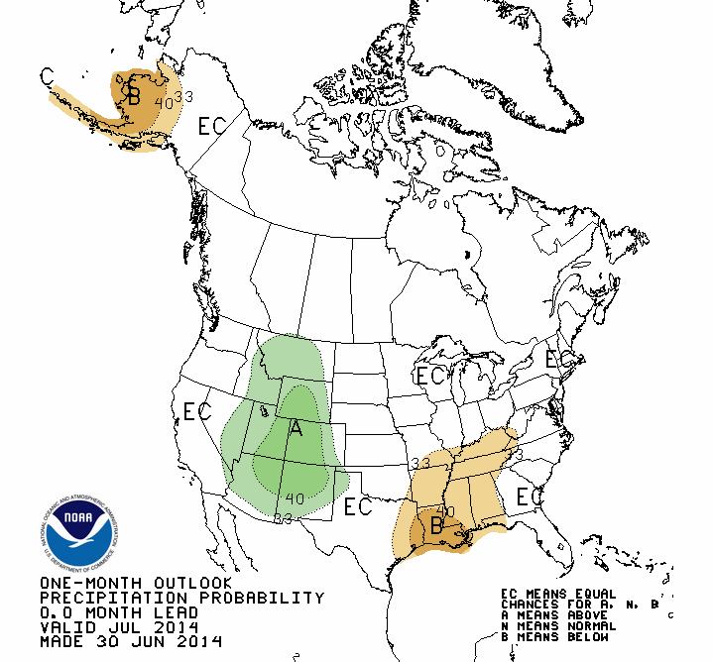
Example: One Month Outlook - Precipitation
Probability of above or below average precipitation during the period (e.g., July 2014).
Keep lead time and forecast period in mind when interpreting.
“EC” does not mean normal/average!
Notes:
I want to spend a little bit of time talking about how to interpret the 1 and 3 month outlooks. First, here is an example one month outlook for precipitation.
This outlook shows the probability that above or below average precipitation will occur for the month July 2014. Green colors correspond to above, brown corresponds to below, and the numbers correspond to the numerical probability. The darker colors (higher %’s) do *not* indicate how *much* above or below, but rather are just the probability that it will be above or below. EC stands for equal chances of being above, normal, or below normal. It does *not* mean that normal precipitation is expected, it just means that there is no climate signal one way or the other.
Also, make sure to pay attention to the text in the lower left-hand corner of the image, which tells you when the map was issued (6/30/14 in this case) and when it is valid (July 2014 in this case). Some of the maps are issued .5 months in advance. In those cases, the map is issued with a .5 month lead time.

Slide 40
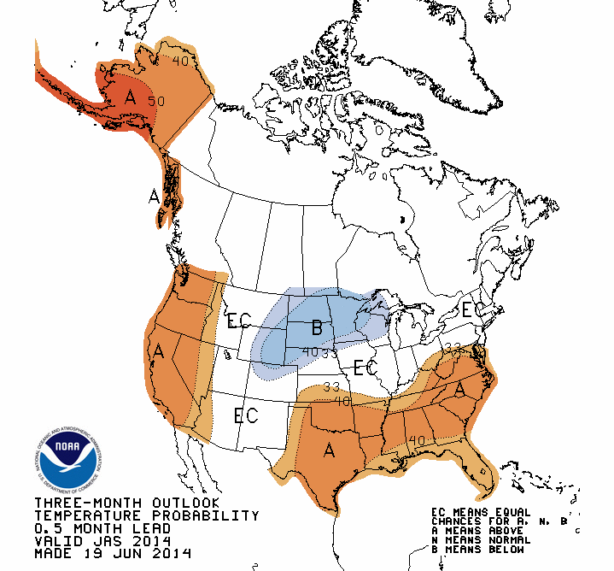
Example: Three Month Outlook - Temperature
Probability of above or below average temperatures during the period (e.g., July-August-Sept).
Keep lead time and forecast period in mind when interpreting.
“EC” does not mean normal/average!
Notes:
Here is an example 3 month outlook for temperature. It is interpreted the same way as the precipitation map, but refers to the probability that the temperature will be above, normal, or below normal for the period described (3 months in this case). The 3 month outlook is valid for a 3 month period. In this case that was July, August, and September 2014. Again, the darker colors don’t mean that the temperature will be much above or below normal, they just mean that there is a high probability that those areas will see above or below normal temperatures.

Slide 41
Uses of CPC Seasonal Outlooks
Temperature and precipitation outlooks can be monitored for determining whether drought conditions may persist.
Example: A chance of above normal temperatures coupled with below normal rainfall could lead to drought intensification.
Example: A chance of below normal temperatures coupled with normal rainfall could lead to less evaporation.
Notes:
Here is an example of how the CPC seasonal outlooks (1 and 3 month outlooks) can be useful for planning purposes.

Slide 42
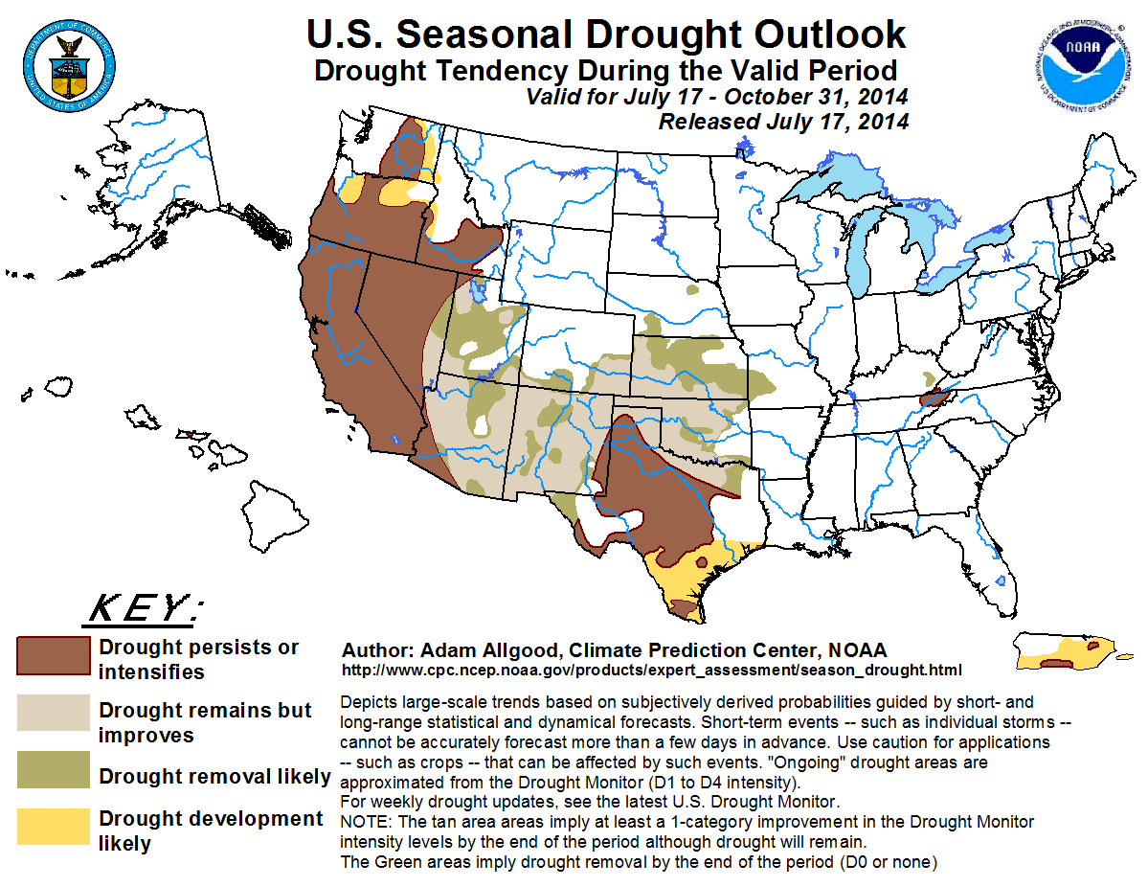
Example: Seasonal Drought Outlook
A forecast for whether drought will improve or get worse.
Keep forecast period in mind when interpreting.
Notes:
Here is another forecasting tool from the Climate Prediction Center. Make sure to pay attention to the period for which the outlook is valid (July 17 – October 31, 2014 in this case).

Slide 43
Questions?

