Slide 1
National Climate Assessment: Indigenous Peoples, Lands, and Resources Chapter
Notes:
The full 2014 National Climate Assessment report can be found here: http://nca2014.globalchange.gov/report or http://nca2014.globalchange.gov/downloads.
Indigenous Peoples chapter: http://nca2014.globalchange.gov/report/sectors/indigenous-peoples or http://nca2014.globalchange.gov/downloads.
Great Plains chapter: http://nca2014.globalchange.gov/report/regions/great-plains or http://nca2014.globalchange.gov/downloads.

Slide 2
Note: This slide set is one of several that were presented at climate training workshops in 2014. Please visit the SCIPP Documents page in the Resources tab on the SCIPP’s website, www.southernclimate.org, for slide sets on additional topics.
Workshop funding was provided by the NOAA Regional Integrated Sciences and Assessments program.

Slide 3
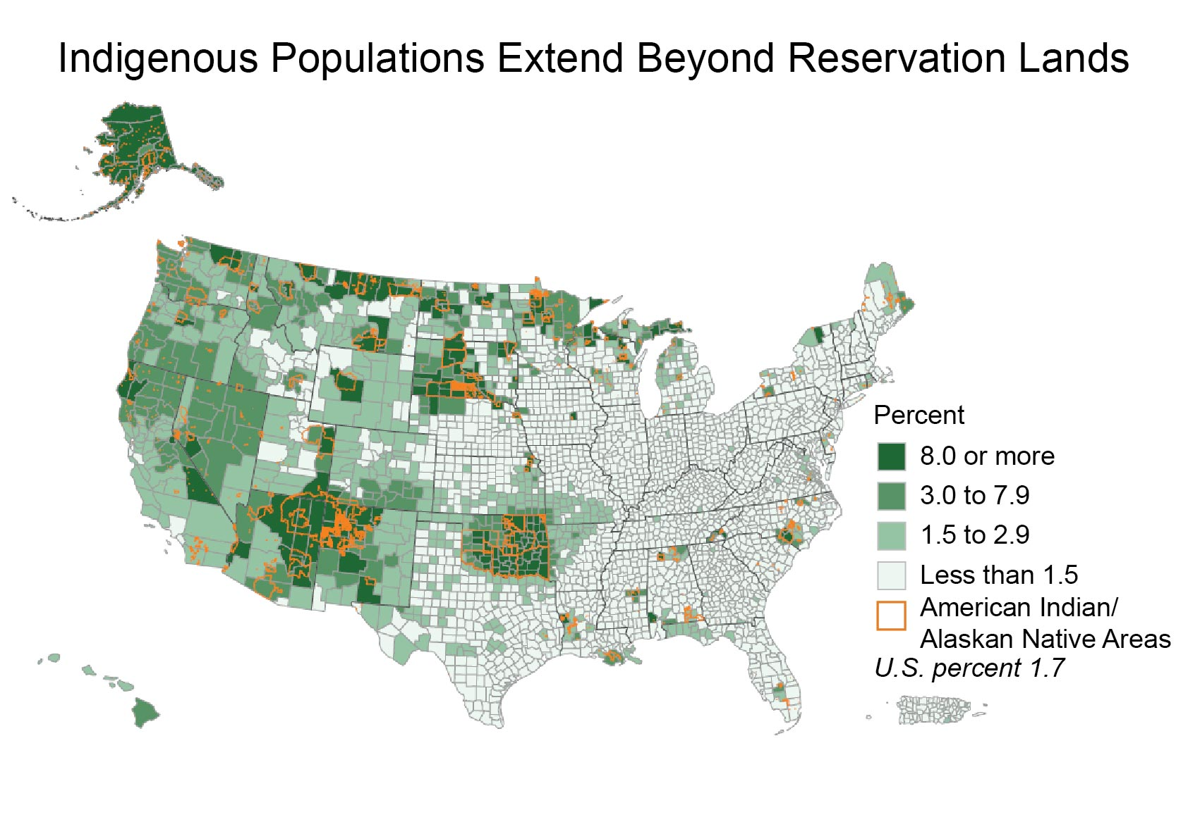
Notes:
Just where are Indigenous populations?

Slide 4
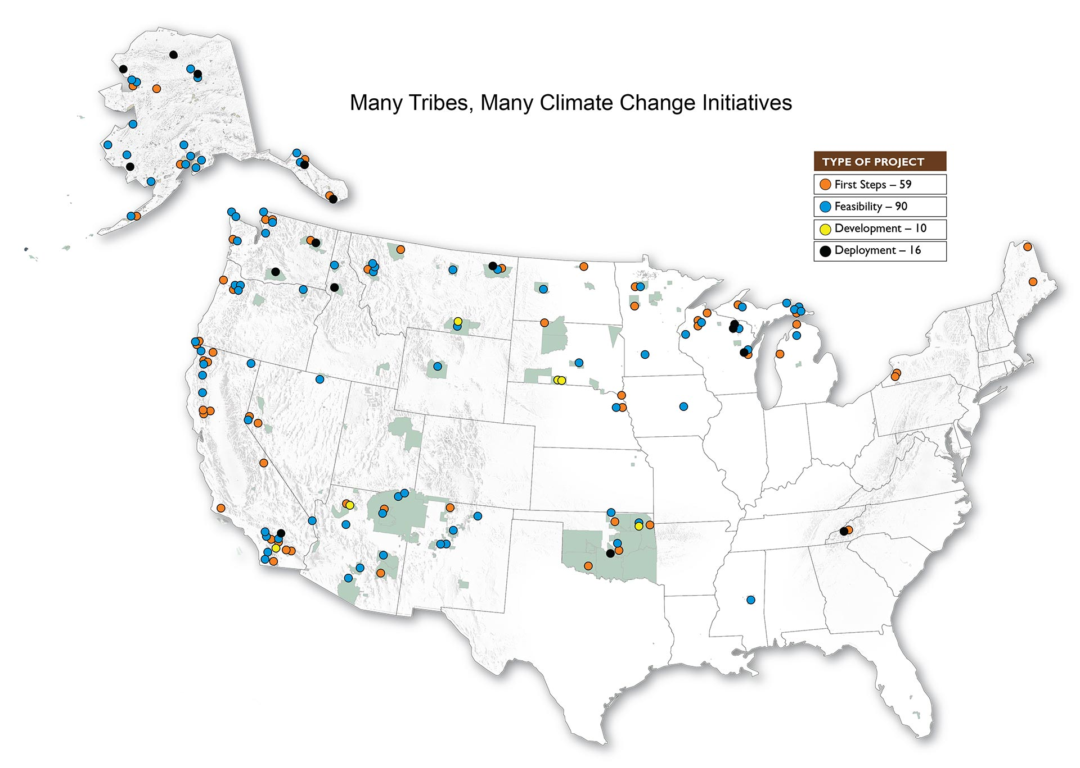
Source: NOAA
Notes:
There are tribes already doing work to address climate change and adaptation.

Slide 5
Theme 1: Climate Change and Traditional Knowledge
Source of information for climate assessments, policies, and adaptation strategies.
Essential to the economic and cultural survival of indigenous peoples.
Increasingly vulnerable with changing climatic conditions, including cultural identities, ceremonies, and traditional ways of life.
Traditional knowledge and western-based approaches are used together to address climate change and related impacts.
Notes:
There are three relevant themes in the NCA chapter.

Slide 6
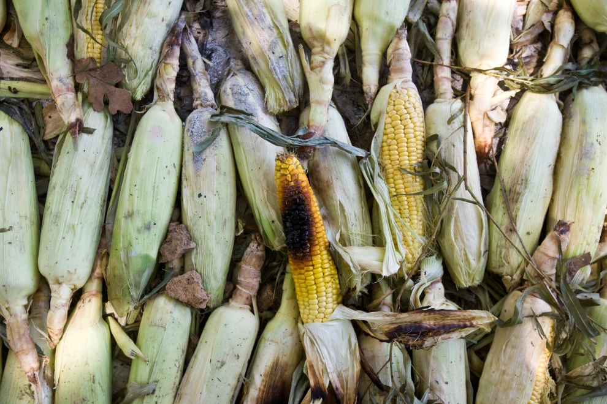
Theme 2: Forests, Fires, and Flood
Tribal access is threatened.
Impacts culturally important plant and animal species.
Impacts subsistence food sources.
Impacts diet and health of members.

Slide 7
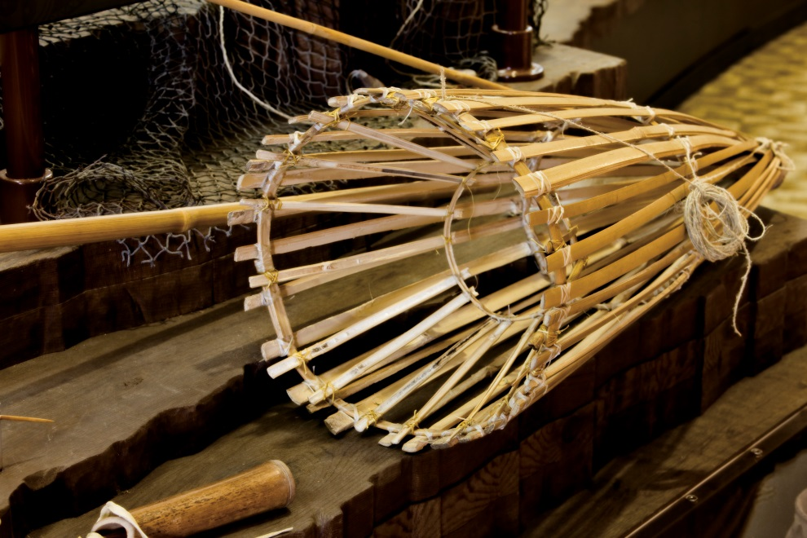
Theme 3: Water Quality and Quantity
Drought and floods.
Capacity to monitor changes.
Need for water infrastructures.

Slide 8
Discussion Session
Each group will have a large notepad and markers.
Discuss the questions provided on the handout.
You will have 20 min.
A representative will summarize their discussion to the larger group.

Slide 9
Discussion Questions
Do you find the Indigenous Peoples chapter relevant to your tribal community?
What are some of the key points that stand out and which should be given priority?
What are some of the things missing from the chapter that should be considered?
Does your tribal community have the capacity to plan for climate change and variability?

