Slide 1
Climate Vulnerability Assessment Introduction
Info from VCAPS:
http://www.vcapsforplanning.org
Notes:
The source for much of the introductory material in this presentation is from VCAPS: www.vcapsforplanning.org.

Slide 2
Note: This slide set is one of several that were presented at climate training workshops in 2014. Please visit the SCIPP Documents page in the Resources tab on the SCIPP’s website, www.southernclimate.org, for slide sets on additional topics.
Workshop funding was provided by the NOAA Regional Integrated Sciences and Assessments program.

Slide 3
Hazard Management
Hazards (threats to people and what they value) emerge from causally linked series of events, choices, and consequences – a causal chain.
Whatever the hazard, its impacts and consequences are dependent on societal and individual choices and actions.
Example: Development along the wildland urban interface
- Might increase risk, wildfire danger
- Direct effect: losses and damages from wildfire
- Indirect effect: runoff/erosion or poor water quality
after a fire
What other considerations are involved in this example?
Notes:
This gets at the idea of the causal structure of hazards.
Wildland urban interface: defined as areas where homes are built near or among lands prone to wildland fire.
Activity/plan: development along the wildland urban interface.

Slide 4
Hazard Management
The stream of choices and activities that culminate in undesirable consequences can be interrupted and blocked at various stages by management activities.
Once a plan, activity or event has begun, the next steps in the chain are outcomes and exposures to them.
Example: Development along the wildland urban interface
- Natural buffers or growth boundaries
- Brush clearing
- Controlled burns
Source: NOAA
Notes:
So the point of investigating climate vulnerability is to reduce exposure or mitigate consequences through hazard management.

Slide 5
Vulnerability
The point of a vulnerability assessment is to better understand how hazards arise, the exposures and sensitivity to them, and how to adapt or cope with the threat.
Vulnerability: the differential susceptibility to loss from a given result
For planning purposes it is appropriate to prioritize vulnerable areas of concern.

Slide 6
Vulnerability
Exposure to climate variation is primarily a function of geography.
For example, with precipitation variability and semi-arid areas, Oklahoma is exposed to drought.
Sensitivity: the degree to which a given community or ecosystem is affected by climate stresses.
In Oklahoma increased heat during already hot summers might have significant impacts.

Slide 7
Adaptive Capacity
Adaptive capacity or resilience coping is the ability to withstand negative impacts from a hazard and adapt to a given climate impact.
Coping actions are things people do to protect themselves from harm, like getting help from friends or neighbors.
Examples: - mutual aid agreements
- conservation
- reliable water resources
- insurance
- knowledge of developing risks (like drought or severe - weather monitoring)

Slide 8
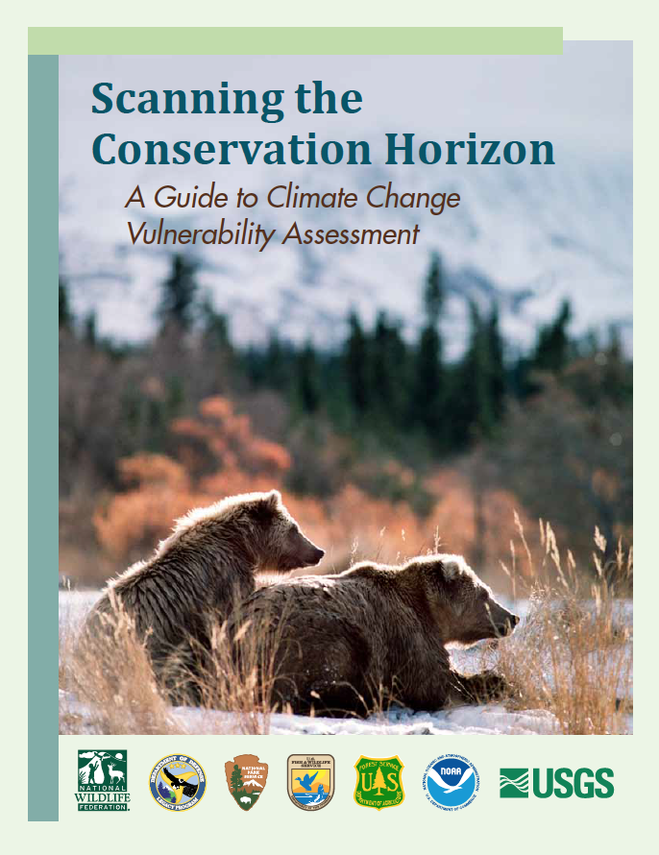
Vulnerability Assessment Examples
Scanning the Conservation Horizon is
a vulnerability assessment guide
focusing on ecological impacts and
resource management.
The document covers vulnerability
basics and features case study
examples from around the US.
Online pdf:
www.nwf.org/vulnerabilityguide
Notes:
Vulnerability assessments can range from large reports that involve multiple agencies and hundreds of man-hours to smaller projects conducted within the context of a single community or organization. This is an example of a large assessment (report is 176 pages).

Slide 9
Vulnerability Assessment Examples
One of the case study examples is
An Integrated Climate Change
Assessment Framework in the Four
Corners Region.
For this ecosystem it involved:
- defining a plausible climate change
scenario (like warmer and drier with
increased climate extremes)
- assessing known and potential climate
change impacts
- identifying intervention points that
environmental management can affect
- evaluating adaptation strategies
(like wetland restoration)

Slide 10
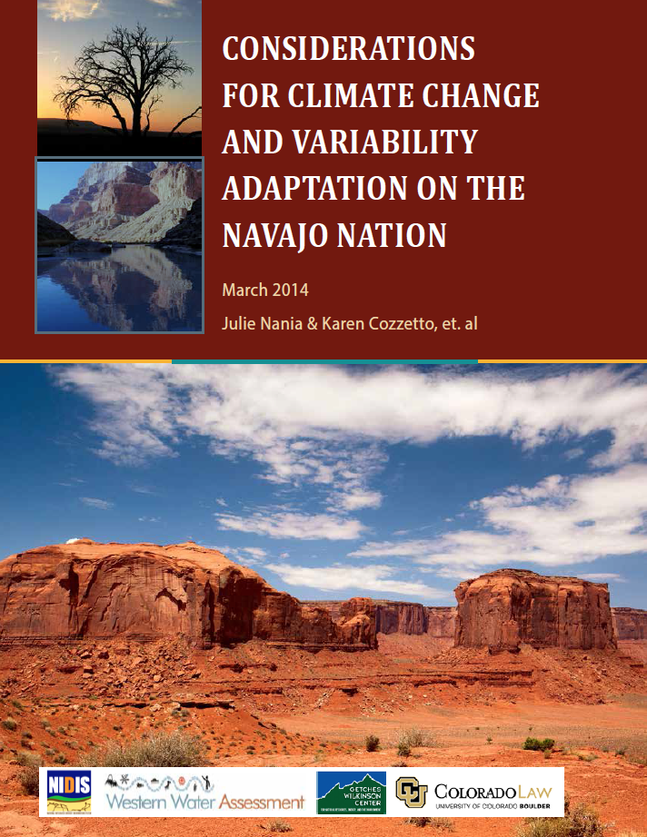
Vulnerability Assessment Examples
Considerations for Climate Change
and Variability Adaptation on the
Navajo Nation is a vulnerability
assessment guide focusing on
ecological impacts and resource
Management.
The document highlights
environmental changes in the
Southwest, and includes information
on the adaptation planning process.
Online pdf:
http://drought.gov/media/pgfiles/
navajo_adaptation_report_final_
lowresolution_2014.pdf
Notes:
Here is another example of a very detailed vulnerability assessment.

Slide 11
Vulnerability Assessment Examples
Water Resources Key Points
Water demand management:
Improve water conservation in buildings
and use water efficient technologies.
Water supply management:
Continue working to settle water rights
claims and save high quality water for
drinking supply.
Enhancing storage:
Add wind breaks around stock ponds
and enhance groundwater recharge
with rock dams, dikes, and catch basins.
Notes:
Let’s take a closer look at the water resources component of this report. The report is 205 pages.

Slide 12
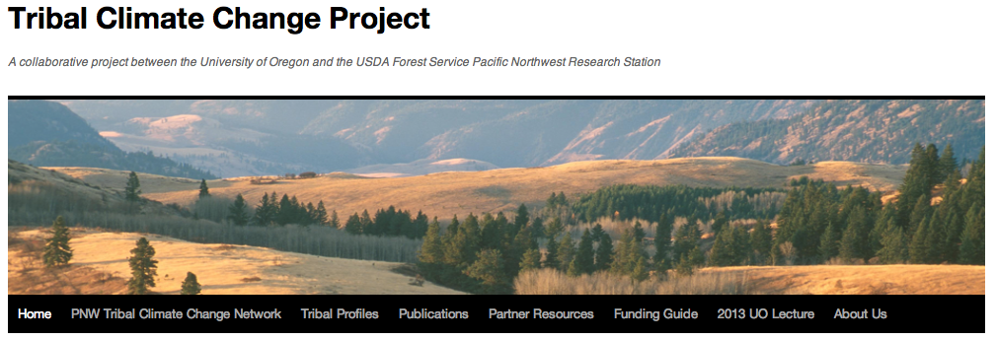
Vulnerability Assessment Examples
Extensive information on how tribes in the Pacific Northwest are addressing climate change can be found through the Tribal Climate Change Project.
Notable examples include work by the Jamestown S’Klallam and Swinomish Tribes.
Online:
http://tribalclimate.uoregon.edu

Slide 13
Vulnerability Assessment Examples
The Jamestown S’Klallam plan resulted
from a two day workshop the tribe
completed where they identified the most
important climate impacts to the
community, such as:
- Increasing temperatures and changing
precipitation
- Sea level rise and coastal flooding
Also identified were key areas of concern
important to the tribe, such as:
- Salmon
- Clams and Oysters
- Wildfires
Online:
http://tribalclimate.uoregon.edu/files/2010/
11/Jamestown_Sklallam_Adaptation_Plan_Profile_FINAL-1qqgd7e.pdf
Notes:
The formal report is 6 pages. This is an example of an organized, tribal-wide effort, but with a more reasonable scope

Slide 14
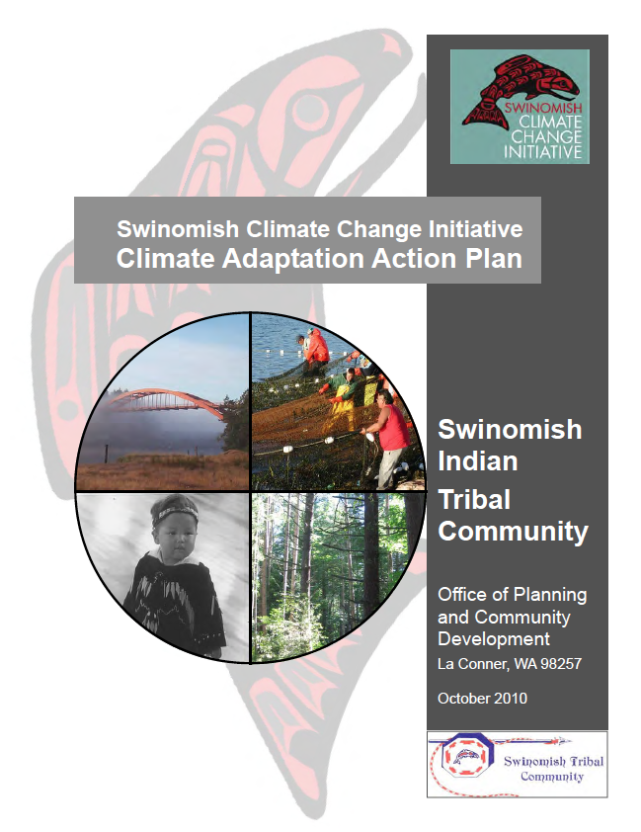
Vulnerability Assessment Examples
The Swinomish Climate Change Initiative
was initially a two year study on the
impacts of climate change on tribe
resources, assets and community.
The plan also identified recommended
actions relating to coastal resources,
upland resources, physical health, and community infrastructure and services.
The initiative continues to guide tribal
interests through the Swinomish Office of Planning and Community Development.
Online:
http://www.swinomish-nsn.gov/climate_
change/climate_main.html
Notes:
This plan is 144 pages.

Slide 15
Vulnerability Assessment Examples
The Chicago Action Plan is a large urban planning and policy initiative guided by climate vulnerability and adaptation.
The main resiliency themes include:
- Energy efficient buildings
- Clean and renewable energy resources
- Improved transportation options
- Reduced waste and industrial pollution
- Adaptation (like stormwater system upgrades and heat wave emergency response plans)
Online:
http://www.chicagoclimateaction.org
Notes:
The plan itself is 60 pages, but the website includes many supporting documents for the the planning process and other information.
Some of the reports mentioned are climate change plans that contain a vulnerability assessment within them.

Slide 16
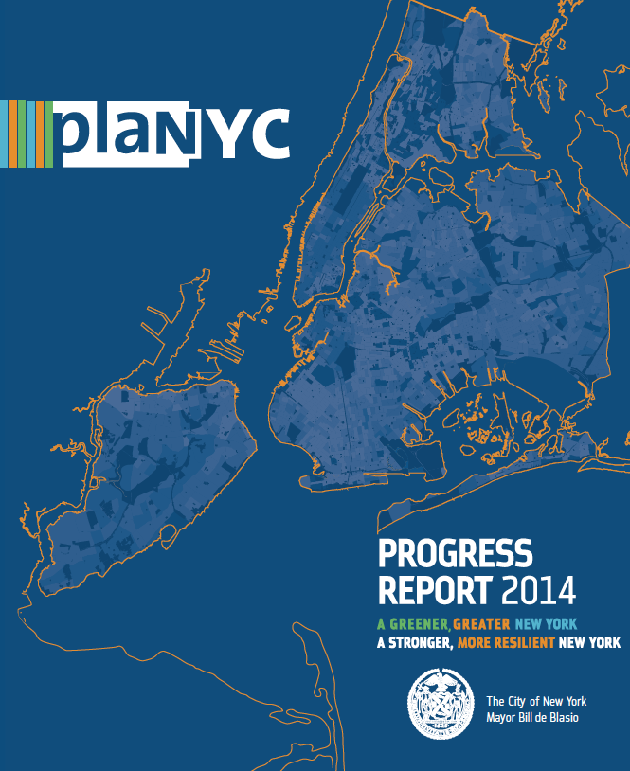
Vulnerability Assessment Examples
PlaNYC represents a sustainability and
resiliency blueprint for New York City.
The main progress themes include:
Housing and Neighborhoods, Parks and Public Space, Brownfields, Waterways, Water Supply, Transportation, Energy, Air Quality, Solid
Waste, and Climate Change
Specific goals involve implementing updates
to building codes, a 30% reduction in carbon emissions, and having the cleanest air of
large cities.
Online:
http://www.nyc.gov/planyc
Notes:
100 page report with many supporting documents and other information online that includes initiatives to improve air quality, reduce carbon, and protect from future risks.
So this and the Chicago plan represent monumental efforts by two of the country’s largest cities, but within these plans are specific initiatives or policy methods that could be applicable to a wide range of vulnerability assessment efforts.

Slide 17
Questions to Consider
What infrastructure could be effected by the weather or climate hazard?
What programs or initiatives could be impacted?
Which services or businesses could be interrupted?
Do you think the sensitivity to disruption from the hazard is high or low?
What are the costs of adaptive measures verses the costs should failure or damage occur?
Which locations or citizens are most at risk?
What ecological impacts could be negative to the community?
Compared to other hazards, which are most important right now in terms of planning importance?
Notes:
You may want to consider the following questions when conducting a vulnerability assessment.

Slide 18
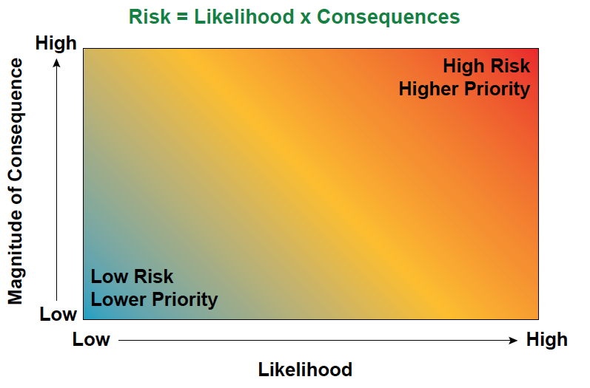
Other Considerations
The risk to a climate impact can be represented as a function of its likelihood and the magnitude of its consequence.
Source: Chicago Area Climate Change Quick Guide

