Slide 1
2007 Flooding and Tropical Storm Erin
Jeffrey Basara
Associate Professor, School of Meteorology,
Director of Research, Oklahoma Climatological Survey
Director, Kessler Atmospheric and Ecological Field Station
University of Oklahoma

Slide 2
Just Another Tropical Storm …?

Slide 3
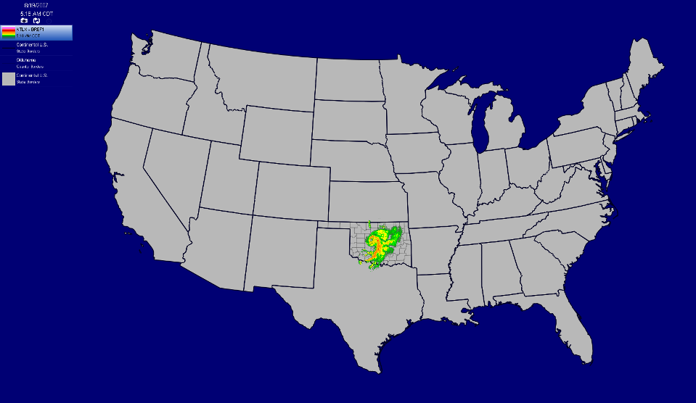
Tropical Storm Erin

Slide 4
Summer 2007: Make It Stop
June-July-August 2007

Slide 5
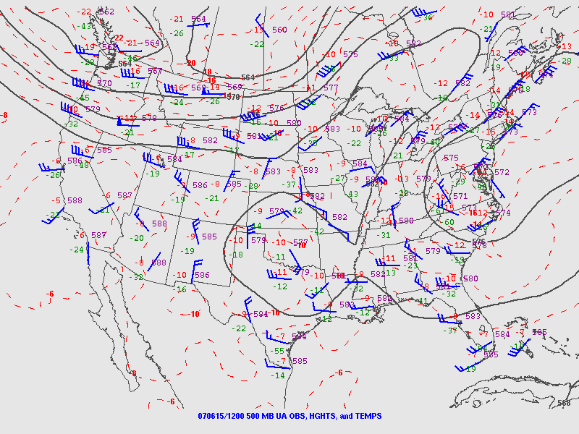
June 15, 2007

Slide 6
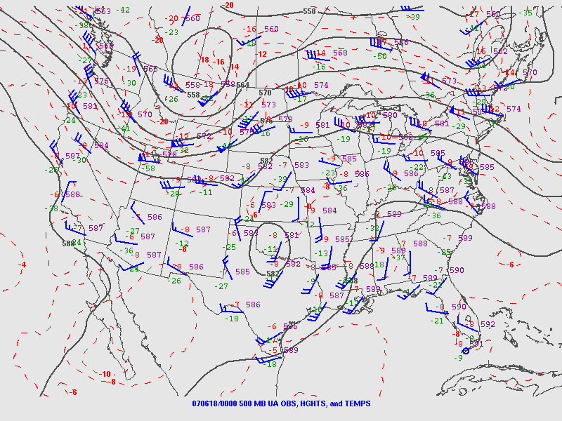
June 18, 2007

Slide 7
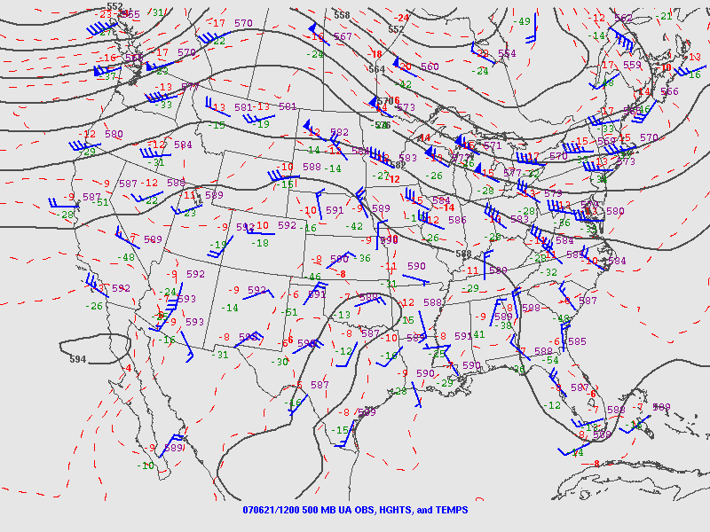
June 21, 2007

Slide 8
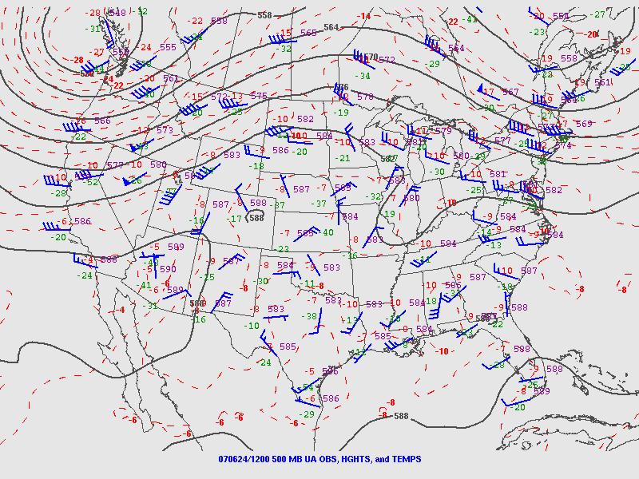
June 24, 2007

Slide 9
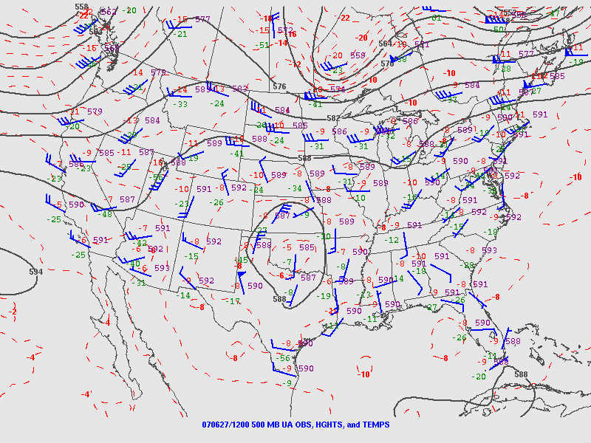
June 27, 2007

Slide 10
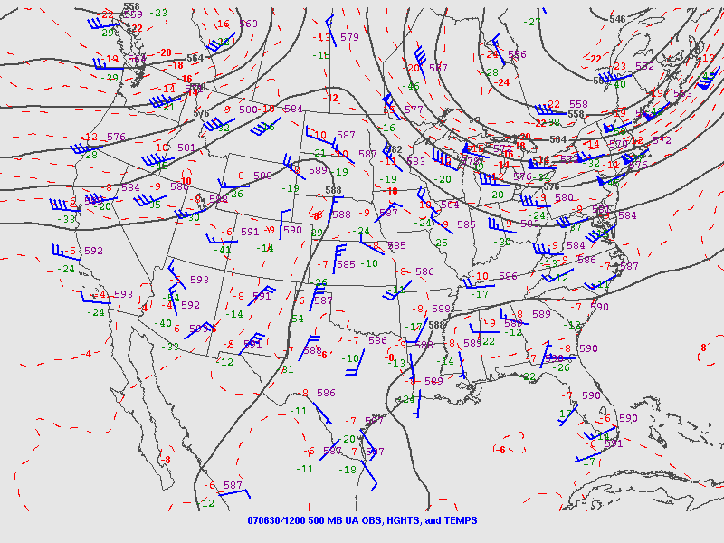
June 30, 2007

Slide 11
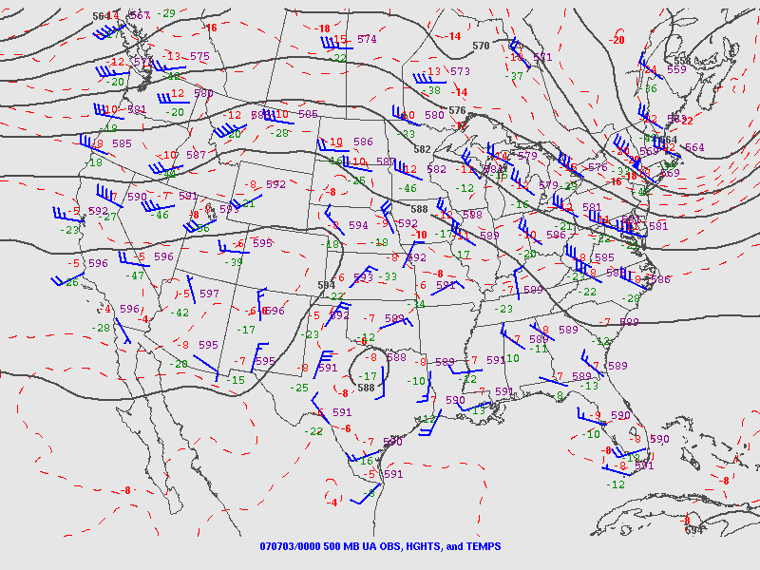
July 3, 2007

Slide 12
Reported Flooding: June 2007

Slide 13
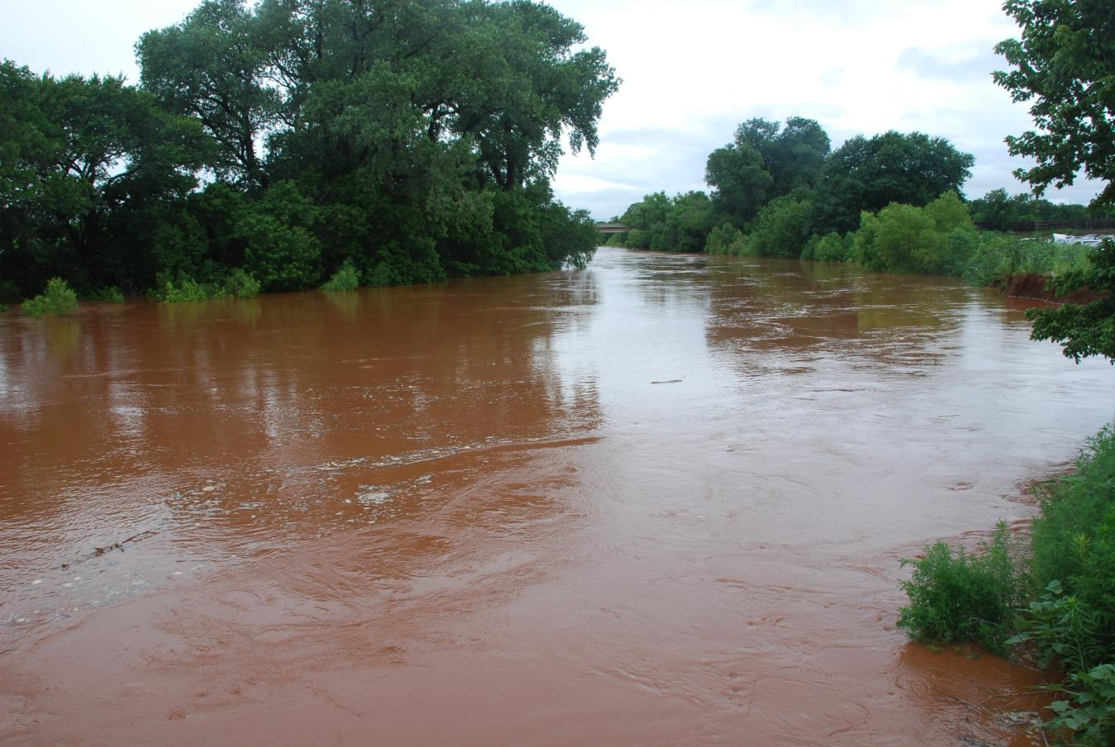
Washita R. Near Chickasha
Photo by Laura Martin, Oklahoma Mesonet

Slide 14
Reported Flooding: July 2007

Slide 15
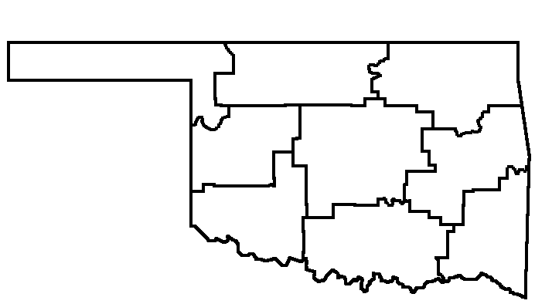
Summer 2007
June 2007: Wettest on record (since 1895) for four climate divisions, and for the state overall.
Damaging [flash-]flooding reported on 15 days
Consecutive days with precipitation at OKC:
Previous record:
14 days (Spring 1937)
New record:
20 days (Jun. 13 – Jul. 2, 2007)
June 2007 precipitation rank
(out of 113 yrs)
72nd
1st
2nd
8th
1st
15th
1st
1st
10th

Slide 16
June 2007

Slide 17
July 2007

Slide 18
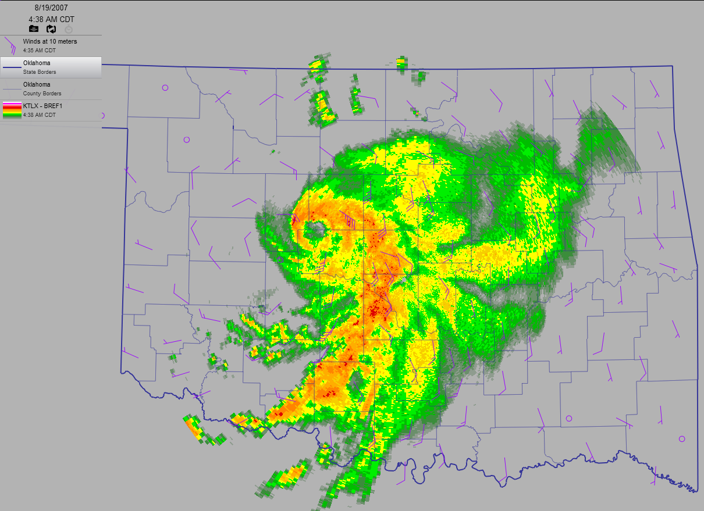
Oh yeah, back to that Tropical Storm
Tropical Storm Erin: Aug 18-19, 2007

Slide 19
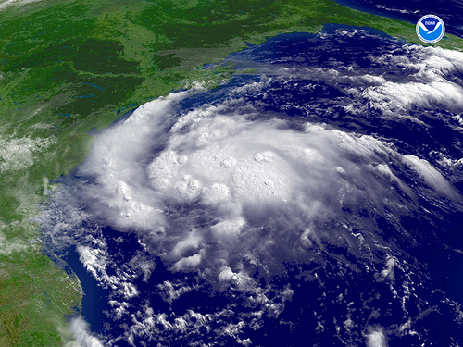
Erin Over the Gulf of Mexico

Slide 20
Erin’s Storm Track
Courtesy of Brad Illston, OCS

Slide 21
Erin’s Offshore Life
Date | Time (UTC) | Lat (deg) | Lon (deg) | Movement | Sustained wind | Central Pressure | Category
15 Aug | 0300 | 23.9 N | 91.1 W | NW @ 10mph | 30 mph | 1006 hPa | Trop. Depression
15 Aug | 0600 | 24.3 N | 91.3 W | NW @ 10mph | 30 mph | 1006 hPa | Trop. Depression
15 Aug | 0900 | 24.6 N | 91.8 W | NW @ 10mph | 30 mph | 1006 hPa | Trop. Depression
15 Aug | 1200 | 24.7 N | 93.0 W | WNW @ 13mph | 30 mph | 1006 hPa | Trop. Depression
15 Aug | 1500 | 25.4 N | 93.5 W | WNW @ 14 mph | 30 mph | 1006 hPa | Trop. Depression
15 Aug | 1530 | 25.6 N | 93.5 W | WNW @ 12mph | 40 mph | 1005 hPa | Trop. Storm
15 Aug | 1800 | 26.0 N | 93.8 W | WNW @ 12mph | 40 mph | 1005 hPa | Trop. Storm
15 Aug | 2100 | 26.3 N | 94.4 W | NW @ 13mph | 40 mph | 1005 hPa | Trop. Storm
16 Aug | 0000 | 26.5 N | 95.1 W | NW @ 13mph | 40 mph | 1003 hPa | Trop. Storm
16 Aug | 0300 | 26.5 N | 95.7 W | WNW @ 14 mph | 40 mph | 1004 hPa | Trop. Storm
16 Aug | 0600 | 26.4 N | 96.1 W | WNW @ 12 mph | 40 mph | 1004 hPa | Trop. Storm
16 Aug | 0900 | 27.3 N | 96.7 W | WNW @ 12 mph | 40 mph | 1004 hPa | Trop. Storm
16 Aug | 1200 | 28.0 N | 97.2 W | WNW @ 12 mph | 35 mph | 1006 hPa | Landfalling Trop. Depression
16 Aug | 1500 | 28.5 N | 97.8 W | NW @ 15mph | 35 mph | 1006 hPa | Overland Trop. Depression

Slide 22
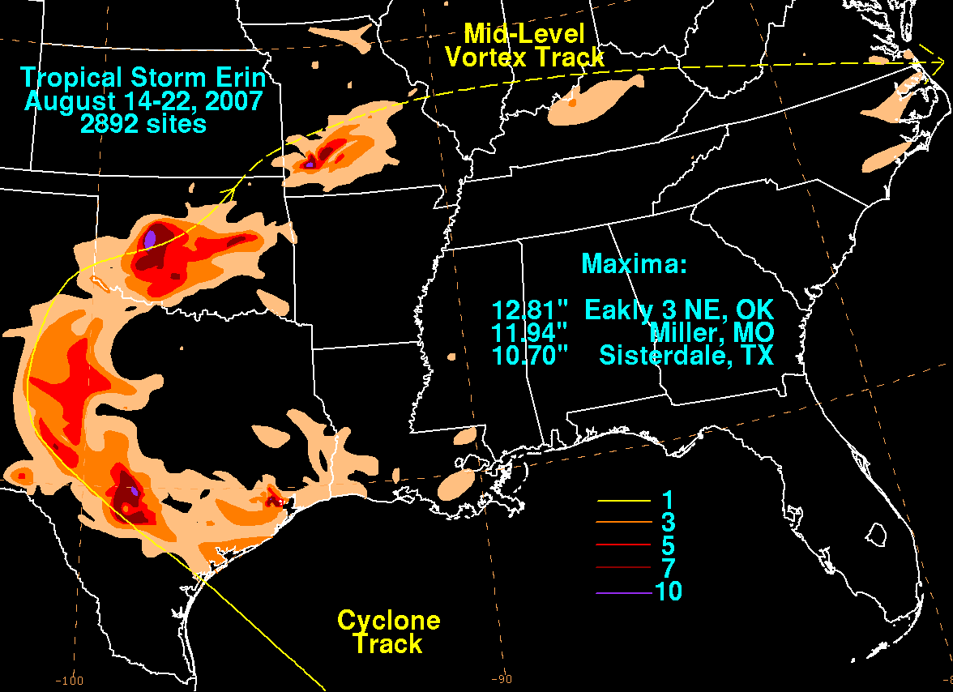
Rainfall Path of Erin

Slide 23
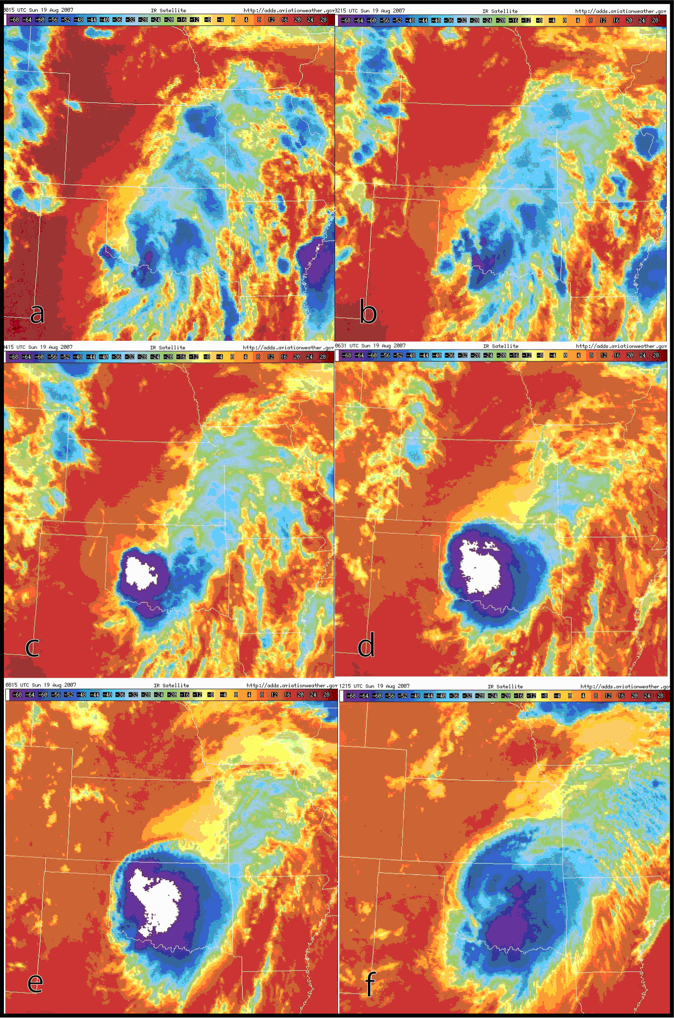
Infrared Satellite over Oklahoma
Eruption of Convection!

Slide 24
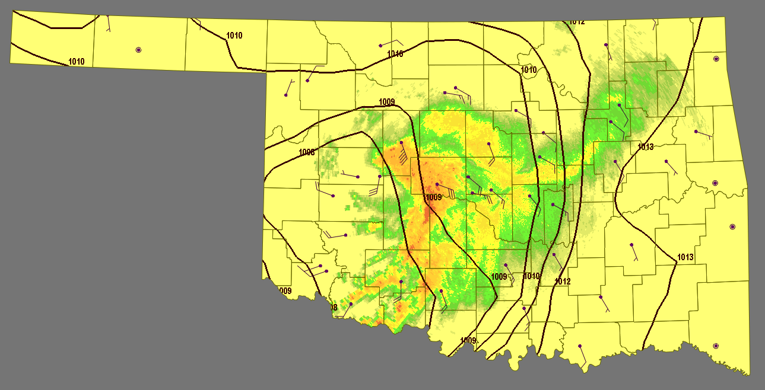
ASOS Observations, 2:00 am CDT

Slide 25
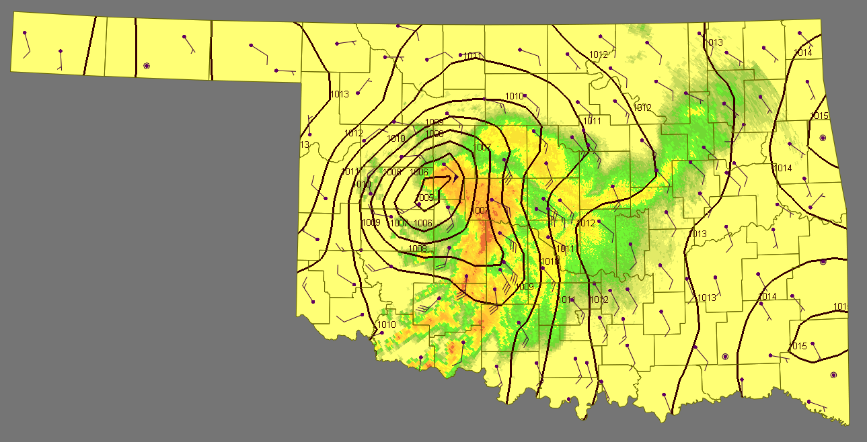
OK Mesonet Obs, 2:00 am CDT
Observed winds greater than any time during offshore life.
Observed sea-level pressure deeper than any time during offshore life.

Slide 26
Erin: 2:23 am CDT
Central Pressure: 1001.3 mb
Peak sustained wind: 57.6 mph

Slide 27
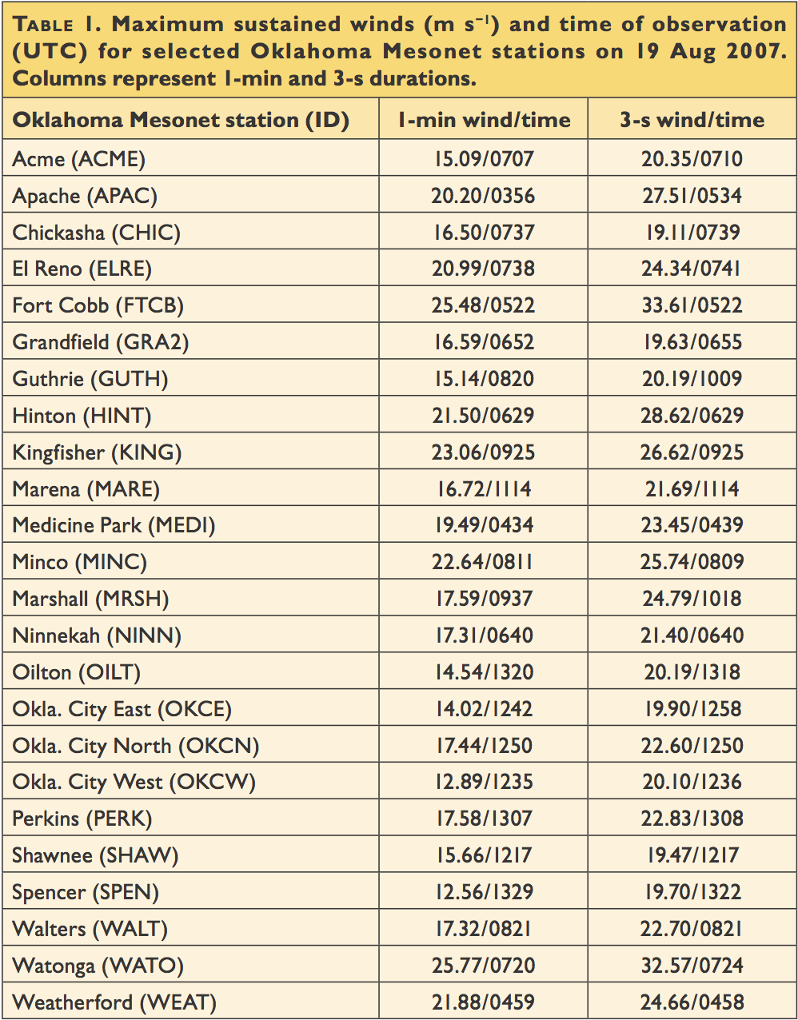
Impressive Wind Gusts
75 mph (Thunderstorm)
74 mph (Rain Band)

Slide 28
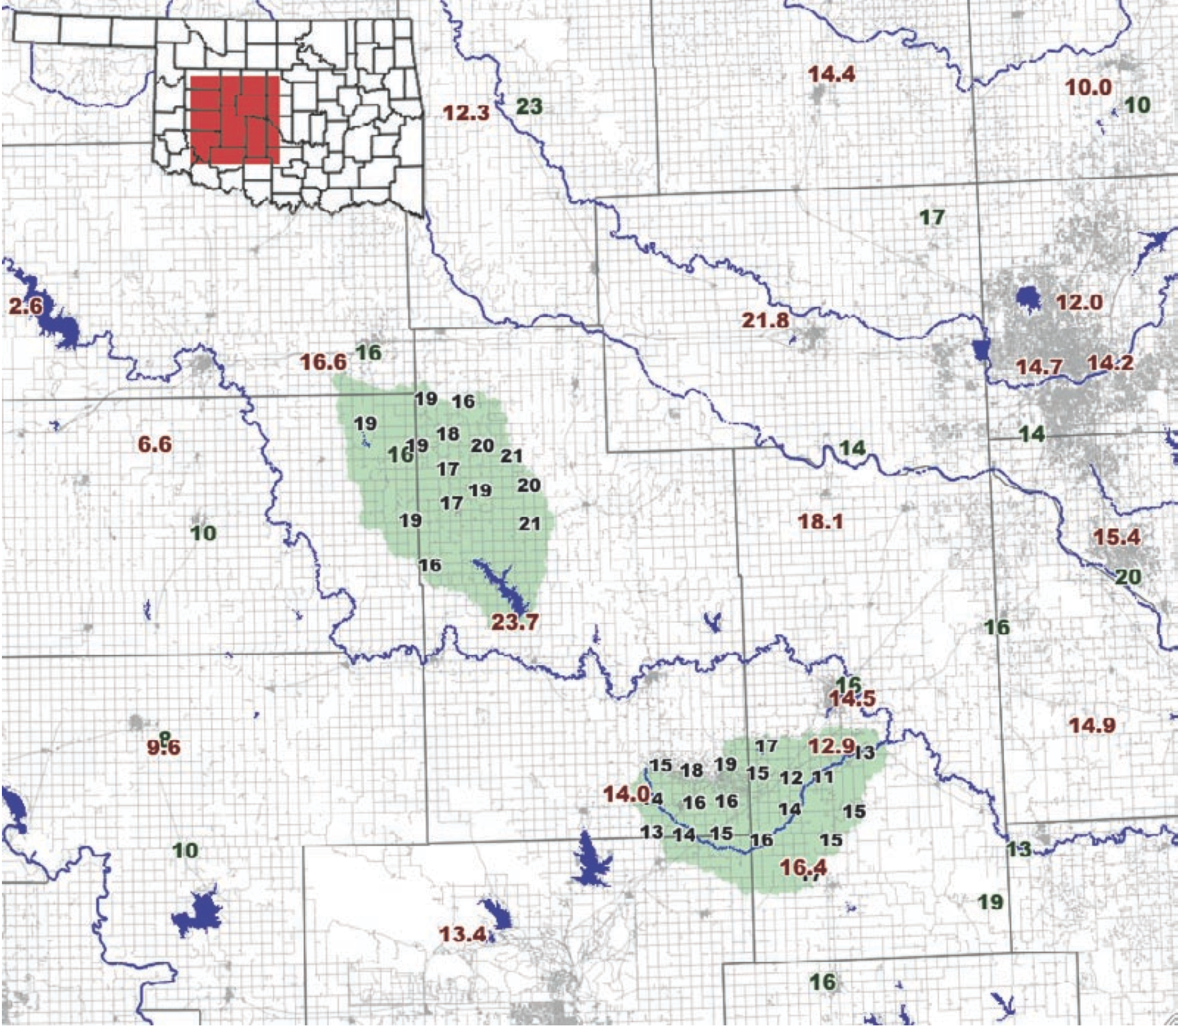
Erin Rainfall Totals

Slide 29
Erin’s Rainfall Superlatives
Amount (cm) | Station (identifier) | Historical Rank (1 = wettest) | Month | Period of Record
23.0 | Watonga (349364) | 1 | All Months | 1902-2007
22.9* | Fort Cobb (FTCB) | 1 | All Months | 1994-2007
21.7 | Okmulgee (OKMU) | 1 | All Months | 1994-2007
19.7 | Okemah (OKEM) | 1 | All Months | 1994-2007
18.0 | El Reno (ELRE) | 1 | All Months | 1994-2007
16.6* | Weatherford (WEAT) | 1 | All Months | 1994-2007
16.4 | Weatherford (349422) | 4 / 1 | All Months / August | 1905-2007
15.6 | Marlow 1WSW (345581) | 4 / 1 | All Months / August | 1900-2007
15.4 | Chickasha Experiment Stn (341750) | 5 / 1 | All Months / August | 1953-2007
14.3 | Union City (349086) | 3 / 1 | All Months / August | 1914-2007
14.2 | Norman 3SSE (346386) | 10 / 1 | All Months / August | 1894-2007
13.6 | Kingfisher (KING) | 1 | All Months | 1994-2007
13.2 | Blanchard 2SSW (340830) | 4 / 1 | All Months / August | 1902-2007
13.0 | Lindsay 2W (345216) | 9 / 1 | All Months / August | 1938-2007
12.6 | Norman (NRMN) | 1 | All Months | 2002-2007
12.5 | Minco (MINC) | 1 | All Months | 1994-2007
10.6 | Acme (ACME) | 1 | All Months | 1994-2007
9.9 | Rossevelt (347727) | 1 | August | 1943-2007
9.7 | Okla. City Will Rogers (346661) | 1 | August | 1948-2007

Slide 30
More Erin Rainfall Superlatives
Station | Period | Observed Amount | Comparable Benchmark (Tortorelli & Rea) | Benchmark Value
Fort Cobb Mesonet | 24-Hr Rain | 23.5 cm (9.25”) | 100-yr Event | ~21.1 cm
Watonga COOP | Daily Rain | 23.0 cm (9.05”) | 100-yr Event | ~20.3 cm
Fort Cobb Mesonet | 12-Hr Rain | 23.2 cm (9.13”) | 500-yr Event | ~23.6 cm
Fort Cobb Mesonet | 3-Hr Rain | 18.7 cm (7.36”) | 500-yr Event | ~19.1 cm

Slide 31
Near Chickasha
Photo by Laura Martin, Oklahoma Mesonet

Slide 32
Near Chickasha
Photo by Laura Martin, Oklahoma Mesonet

Slide 33
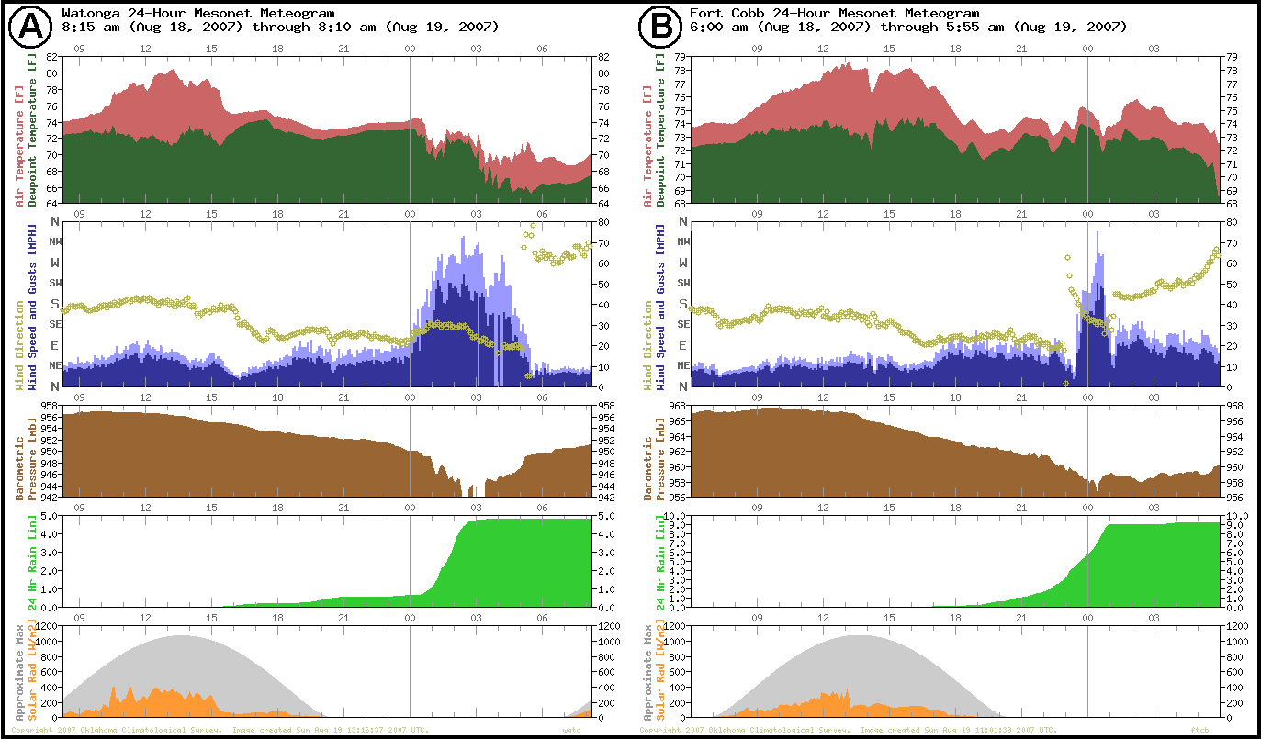
Mesonet Meteograms

Slide 34
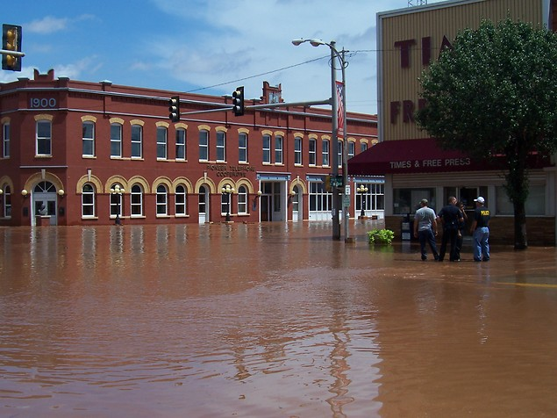
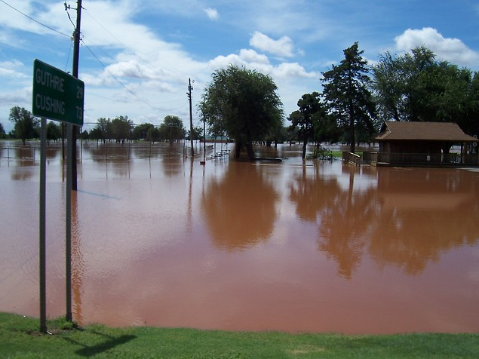
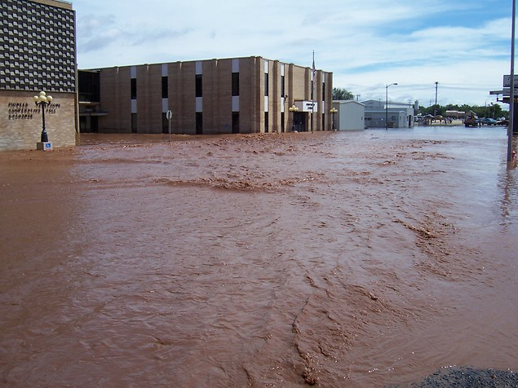
The Aftermath of So Much Rain

Slide 35
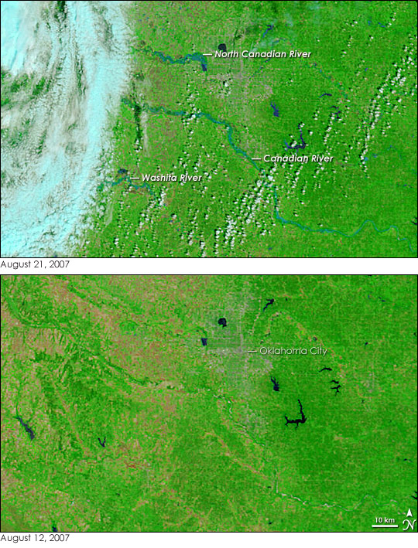
The Aftermath of So Much Rain
Swollen Rivers

Slide 36
Final Notes on Erin
“Erin’s intensification was unique because the system reacquired some tropical characteristics even though the process occurred ~800 km inland from its landfall point, after nearly 72 h over land. Such inland reintensification over North America is rare, documented in detail only twice previously (Bosart and Lackmann 1995; Bassill and Morgan 2006). Oklahoma Mesonet observations
revealed that the system reached a lower central pressure and exhibited stronger sustained winds than at any time during its marine existence. The extent of this inland development—to exceed offshore strength before classical extratropical transition—is unique to any documented North American case.”
- Arndt, D. S., J. B. Basara, R. A. McPherson, B. G. Illston, G. D. McManus, and D. B. Demko, 2009: Observations of the Overland Reintensification of Tropical Storm Erin (2007). Bulletin of the American Meteorological Society, 90, 1079-1093.
Erin was a rare, yet extreme event!

Slide 37
Food For Thought Concerning Heavy Rainfall and Tropical Systems
Expect the unexpected. While forecasts for the period during the rapid intensification of Erin included thunderstorms and localized heavy rainfall, the re-intensification of Erin was beyond anyone’s expectations … yet rapidly significant to all involved.
Historically, the remnants of tropical systems (from both the Gulf of Mexico and the Pacific Ocean) have yielded environments favorable for very heavy rainfall and flooding across Oklahoma during the late summer and early Fall period.
Copious rainfall creates a flood risk … downstream.
Must plan accordingly.

